Slide 1

Instructions:
Please use the CMQCC template for any slide you use from the slide deck
Please do not use the CMQCC logo if you modify a slide – feel free to use your own logo in these situations
Slides with copyright material that we do not yet have copyright permission to use should not be shared with others (these slides are marked)
If you add slides to the slide set please do not use the CMQCC logo
Please provide us feedback and recommendations for improving the slide set
1

Slide 2
Generic Slide
2

Slide 3
Improving Health Care Response to Preeclampsia: A California Quality Improvement Toolkit
Funding for the development of this toolkit was provided by:
Federal Title V block grant funding from the California Department of Public Health; Maternal, Child and Adolescent Health Division and Stanford University.
3

Slide 4
Preeclampsia Task Force Members
Maurice Druzin, MD – Stanford
Elliott Main, MD – CMQCC
Barbara Murphy, RN – CMQCC
Tom Archer, MD – UCSD
Ocean Berg, RN, CNS – SF General Hospital
Brenda Chagolla, RNC, CNS – UC Davis
Holly Champagne, RNC, CNS – Kaiser
Meredith Drews – Preeclampsia Foundation
Racine Edwards-Silva, MD – UCLA Olive View
Kristi Gabel, RNC CNS – RPPC Sacramento
Thomas Kelly, MD – UCSD
Larry Shields, MD – Dignity Health
Nancy Peterson, RNC, PNNP – CMQCC
Christine Morton, PhD – CMQCC
Sarah Kilpatrick, MD – Cedars Sinai
Richard Lee, MD – Univ. of Southern California
Audrey Lyndon PhD, RNC – UC San Francisco
Mark Meyer, MD – Kaiser SD
Valerie Cape – CMQCC
Eleni Tsigas – Preeclampsia Foundation
Linda Walsh, PhD, CNM – UC San Francisco
Mark Zakowski, MD – Cedars Sinai
Connie Mitchell, MD, MPH – CDPH - MCAH
Development of the California Toolkit ‘Improving Health Care Response to Preeclampsia’ was funded by the California Department of Public Health (CDPH), Center for Family Health, Maternal Child and Adolescent Health (MCAH) Division, using federal Title V MCH funds.
4
Notes:
4

Slide 5

Maternal Mortality Rate, California Residents; 1970-2010
ICD-8 codes
ICD-9 codes
ICD-10 codes
Maternal Deaths per 100,000 Live Births
HP Objectives – Maternal Deaths (<42days postpartum) per 100,000 Live Births
SOURCE: State of California, Department of Public Health, California Birth and Death Statistical Master Files, 1970-2010. Maternal mortality for California (deaths ≤ 42 days postpartum) was calculated using the ICD-8 cause of death classification for 1970-1978, ICD-9 classification for 1979-1998 and ICD-10 classification for 1999-2010. Healthy People Objectives: HP2000: 5.0 deaths per 100,000 live births; HP2010: 3.3 deaths, later revised to 4.3 deaths per 100,000 live births, and; HP2020: 11.4 deaths per 100,000 live births. Produced by California Department of Public Health, Center for Family Health, Maternal, Child and Adolescent Health Division, December, 2012.
5
Notes:
Maternal mortality in California is increasing and is as high as it was in the 1970’s. Why is maternal mortality increasing? Possible reasons include:
Changes in the coding of maternal deaths on death certificates may account for some (i.e., 30%) of the increase (Hoyert, 2007)
In addition, more pregnant women have chronic health conditions that contribute to worse outcomes
Numerous social factors (poverty, reduced education, exposure to chronic stress)
Hospital quality of care and health care provider issues also contribute to some degree

Slide 6
California Pregnancy-Associated Mortality
Review (CA-PAMR) Quality Improvement Review Cycle
1. Identification of cases
2. Information collection, review by multidisciplinary committee
3. Cause of Death, Contributing Factors and Quality Improvement (QI) Opportunities identified
4. Strategies to improve care and reduce morbidity and mortality
5. Evaluation and Implementation of QI strategies and tools
Toolkits Developed:
Hemorrhage
Preeclampsia
6
Notes:
This is the process we go through to collect and analyze the data that guides us towards toolkit development.

Slide 7
CA-PAMR: Chance to Alter Outcome
Grouped Cause of Death; 2002-2004 (N=145)
Grouped Cause of Death | Chance to Alter Outcome
 | Strong / Good (%) | Some (%) | None (%) | Total N (%)
Obstetric hemorrhage | 69 | 25 | 6 | 16 (11)
Deep vein thrombosis/ pulmonary embolism | 53 | 40 | 7 | 15 (10)
Sepsis/infection | 50 | 40 | 10 | 10 (7)
Preeclampsia/eclampsia | 50 | 50 | 0 | 25 (17)
Cardiomyopathy and other cardiovascular causes | 25 | 61 | 14 | 28 (19)
Cerebral vascular accident | 22 | 0 | 78 | 9 (6)
Amniotic fluid embolism | 0 | 87 | 13 | 15 (10)
All other causes of death | 46 | 46 | 8 | 26 (18)
Total (%) | 40 | 48 | 12 | 145
7
Notes:
TALKING POINTS:
CA PAMR Committee judged that there was a strong-to-good chance to have altered the fatal outcome in 40% of all the pregnancy-related deaths in California in 2002 to 2004.
12 of the 25 cases of preeclampsia (50%) had a good–to-strong chance to alter outcome.
In comparison, none of the 15 deaths from amniotic fluid embolism had a good-to-strong chance to alter outcome.
Data Source: CA PAMR, Pregnancy-Related Deaths; 2002-2004 (N=145)

Slide 8

Executive Summary:
Hypertension in Pregnancy
American College of Obstetricians and Gynecologists
Obstet Gynecol 2013;122:1122-31
8
Notes:
Now lets all be on the same page with official definitions of preeclampsia from ACOG.

Slide 9
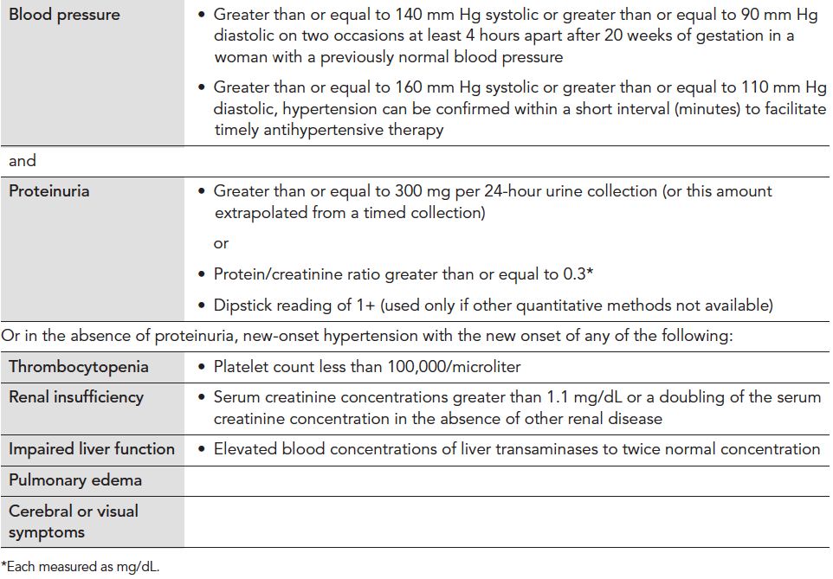
Diagnosis Criteria for Preeclampsia
Executive Summary: Hypertension in Pregnancy, American College of Obstetricians and Gynecologist, Obstet Gynecol 2013;122:1122-31. Copyright permission received.
9
Notes:
The new ACOG guidelines which will be published in Fall 2013, may eliminate proteinuria as a criterion for diagnosis of preeclampsia.

Slide 10
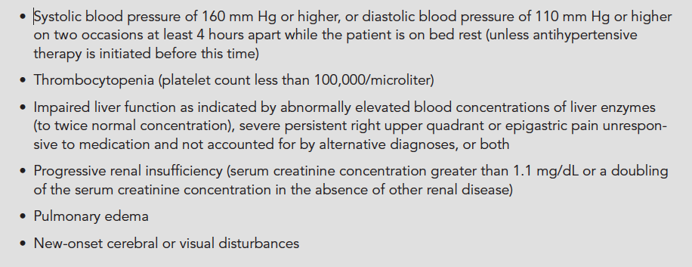
Diagnosis of Severe Preeclampsia
Executive Summary: Hypertension in Pregnancy, American College of Obstetricians and Gynecologist, Obstet Gynecol 2013;122:1122-31. Copyright permission received.
10
Notes:
To make the diagnosis of severe PE, you need to have documented SBP of 160 or greater on two occasions 4 hrs apart. However in the acute onset of HTN above threshold 160/105-110 it is unadvisable to wait 4 hrs for treatment. A BP should be repeated in 15 min and if still elevated above threshold, treat with antihypertensive medication within 30-60 min.

Slide 11
However…
Acute onset, persistent (lasting 15 min or more), severe systolic (≥160 mm Hg) or severe diastolic hypertension (≥ 110 mm Hg) or both in pregnant or postpartum women with preeclampsia/eclampsia constitutes a hypertensive emergency* and it is inadvisable to wait 4 hrs for treatment.
If BP is still elevated above threshold after 15 min, treat with antihypertensive medication within 30-60 min.
*Emergent Therapy for Acute-Onset, Severe Hypertension With Preeclampsia or Eclampsia, ACOG Committee Opinion, # 514, December 2011
11

Slide 12
Hemolysis, Elevated Liver Enzymes, and Low Platelets Syndrome (HELLP) and Eclampsia
Women with severe preeclampsia and hepatic involvement may develop HELLP syndrome. In one study, HELLP syndrome occurred in approximately 20% of women with severe preeclampsia.
As with severe preeclampsia, HELLP syndrome is associated with an increased risk of adverse outcomes including: placental abruption, renal failure, subcapsular hepatic hematoma, recurrent preeclampsia, preterm delivery, and fetal or maternal death.
Eclampsia – Seizures with preeclampsia.
ACOG Practice Bulletin #33, Reaffirmed 2012; ACOG Committee Opinion #514, 2012; Tuffnell D, Jankowitcz D, Lindow S, et al. BJOG 2005;112:875-880.
12

Slide 13
The Deadly Triad
Severe Preeclampsia -
HELLP Syndrome - Eclampsia
Associated with an increased risk of adverse outcomes such as:
Placental Abruption
Renal Failure
Subcapsular Hepatic Hematoma
Preterm Delivery
Fetal or Maternal Death
Recurrent Preeclampsia
ACOG Practice Bulletin #33, Reaffirmed 2012; ACOG Committee Opinion #514, 2012; Tuffnell D, Jankowitcz D, Lindow S, et al. BJOG 2005;112:875-880.
13
Notes:
The spectrum of PE is variable. Patients often present with one of the deadly triad diagnoses, however many patients present with the more classic PE picture with mild PE and then either slowly or rapidly progress to more severe PE.

Slide 14
Spectrum of Preeclampsia
CHTN
Gestational Hypertension
Superimposed
Preeclampsia
Proteinuria
Preeclampsia
Severe Preeclampsia
Eclampsia
Atypical
Preeclampsia
RCVS
PRES
HELLP
Syndrome
14
Notes:
This is the spectrum of PE and HTN in pregnancy.
CHTN –chronic hypertension
PRES – posterior reversible encephalopathy syndrome
RCVS – reversible cerebral vasoconstriction syndrome

Slide 15
Key Clinical Pearl
Forty percent of patients with
New-onset hypertension or
New-onset proteinuria will develop
classic preeclampsia.
Barton JR, Sibai BM. Prediction and prevention of recurrent preeclampsia. Obstet Gynecol. 2008;112(2 PART 1): 359-372.
15
Notes:
Any new onset HTN, new onset proteinuria and any vague symptoms discussed should prompt evaluation

Slide 16
Key Clinical Pearl
Patients presenting with vague symptoms of:
  headache
  abdominal pain
  shortness of breath
  generalized swelling
  complaints of “I just don’t feel right”
should be evaluated for atypical presentations of preeclampsia or “severe features”
Sibai BM, Stella CL. Diagnosis and management of atypical preeclampsia-eclampsia. Am J Obstet Gynecol. May 2009;200(5):481 e481-487.
16

Slide 17
Laboratory Evaluation of Preeclampsia
Initial lab studies should include:
  CBC with platelet count
  AST, ALT, LDH
  Creatinine, Bilirubin, Uric acid, Glucose
For women with acute abdominal pain, add:
  Serum amylase, lipase and ammonia
17
Notes:
Bilirubin comes on most liver function lab panels and is helpful in cases of severe HELLP syndrome and Acute fatty liver disease.

Slide 18
ACOG Executive Summary on Hypertension In Pregnancy, Nov 2013
1. The term “mild” preeclampsia is discouraged for clinical classification. The recommended terminology is:
  a. “preeclampsia without severe features” (mild)
  b. “preeclampsia with severe features” (severe)
2. Proteinuria is not a requirement to diagnose preeclampsia with new onset hypertension.
3. The total amount of proteinuria > 5g in 24 hours has been eliminated from the diagnosis of severe preeclampsia.
4. Early treatment of severe hypertension is mandatory at the threshold levels of 160 mm Hg systolic or 110 mm Hg diastolic.
5. Magnesium sulfate for seizure prophylaxis is indicated for severe preeclampsia and should not be administered universally for preeclampsia without severe features (mild).
18

Slide 19
ACOG Executive Summary on Hypertension
In Pregnancy, Nov 2013
6. Preeclampsia with onset prior to 34 weeks is most often severe and should be managed at a facility with appropriate resources for management of serious maternal and neonatal complications.
7. Induction of labor at 37 weeks is indicated for preeclampsia and gestational hypertension.
8. The postpartum period is potentially dangerous. Patient education for early detection during and after pregnancy is important.
9. Long-term health effects should be discussed.
19
Notes:
It should be noted however that the CMQCC Preeclampsia task force recommends that magnesium sulfate be considered for preeclampsia without severe features.

Slide 20

Maternal Morbidity and Mortality: Preeclampsia
About 8 Preeclampsia Related Mortalities/2007 in CA
Near Misses: 380/year (ICU admissions)
400-500x
40-50x
Serious
Morbidity: 3400/year (prolonged postpartum length of stay)
Source: 2007 All-California Rapid Cycle Maternal/Infant Database for CA Births: CMQCC
20
Notes:
Based on analysis of data in the All-California Rapid Cycle Maternal/Infant Database for California births in 2007 – the extent of morbidity associated with preeclampsia is shown in this slide.
There are approximately 8 deaths per year related to preeclampsia/eclampsia among CA women, but the rate of “near–miss” defined here as the number of ICU admissions is 380/yr and serious morbidities defined as prolonged postpartum length of stay is 3400/yr.

Slide 21
CA-PAMR Causes of Death (Top 5), 2002-2004
Grouped Cause of Death, per CA-PAMR Committee | Pregnancy-Related Deaths N (%)
Cardiovascular disease | 29 (20)
Cardiomyopathy | 19 (13)
Other cardiovascular | 10 (7)
Preeclampsia/eclampsia | 25 (17)
Obstetric hemorrhage | 16 (11)
Amniotic fluid embolism | 15 (10)
DVT/ PE | 15 (10)
Other | 45 (31)
TOTAL | 145
Pregnancy-Related Mortality Rate: 1.6 deaths /100,000 live births
21
Notes:
Updated 4.20.12
REMINDER _ Preeclampsia is 2nd leading cause of pregnancy-related death.
CAUSE OF DEATH: TOP 5 CAUSES
TALKING POINTS: Slide shows top 5 causes of death
CA-PAMR most frequent causes of pregnancy-related death
20% were Cardiovascular disease (13% of those were cardiomyopathy) (<CLICK TO SHOW RED CIRCLE>
17% of the deaths were attributed to pre-eclampsia or eclampsia
11% were due to obstetric hemorrhage
10% were result of amniotic fluid embolism
And 10% were due to deep vein thrombosis or pulmonary embolism

Slide 22
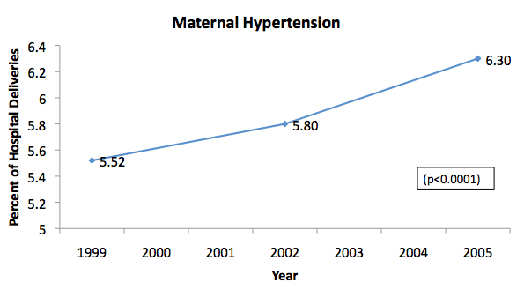
Maternal Hypertension in California, 1999-2005
All maternal hypertension identified at time of hospitalization for labor and delivery (includes pre-gestational and gestational hypertension)
Source: http://www.cdph.ca.gov/programs/mcah/Documents/MO-CAPAMR-TrendsinMaternalMorbidityinCalifornia-1999-2005-TechnicalReport.pdf
22
Notes:
Pregnancy with HTN in U.S. OB population=5-10% - Williams Obstetrics, 23rd Edition, 2009
1. There have been significant increases in the prevalence of hypertension among childbearing women in CA from 1999-2005;
2. Which may be continuing to rise;
3. Vigilance for recognizing preeclampsia and responding rapidly to manage it will continue to be important if these trends persist.

Slide 23
Impact of Hypertension in CA-PAMR
Cohort, 2002-2004
Cohort of pregnancy-related deaths, N=145
  25 (17%) of deaths were grouped as “Preeclampsia/Eclampsia” cause of death
Over half of all pregnancy-related deaths had HTN diagnoses
  50 (34%) had inpatient diagnosis of HTN
  57 (39%) had any diagnosis of HTN (inpatient, prenatal, preexisting)
23

Slide 24
CA-PAMR Final Cause of Death Among Preeclampsia Cases, 2002-2004 (n=25)
How Do Women Die Of Preeclampsia in CA?
Final Cause of Death | Number | % | Rate/100,000
Stroke Hemorrhagic Thrombotic | 16 14 2 | 64.0% (87.5%) (12.5%) | 1.0
Hepatic (liver) Failure | 4 | 16.0% | .25
Cardiac Failure | 2 | 8.0%
Hemorrhage/DIC | 1 | 4.0%
Multi-organ failure | 1 | 4.0%
ARDS | 1 | 4.0%
24
Notes:
16 of the 25 women or 64% of the deaths were due to strokes, with 87.5% being hemorrhagic stroke.
As we will see in the analysis of quality improvement opportunities, the greatest opportunity to prevent maternal deaths from preeclampsia is to prevent stroke. In order to to this it is imperative to recognize and appropriately treat systolic and diastolic hypertension in a timely manner.

Slide 25
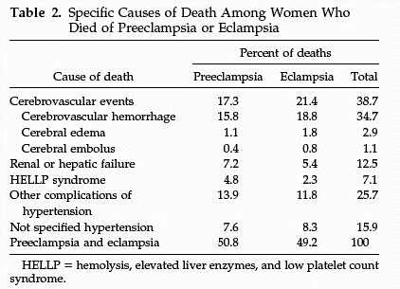
Cause of U.S. Maternal Mortality
CDC Review of 14 years of coded data: 1979-1992
4024 maternal deaths
790 (19.6%) from preeclampsia
90%
of CVA were from hemorrhage
25
MacKay AP, Berg CJ, Atrash HK. Obstetrics and Gynecology 2001;97:533-538
Notes:
We have made no progress with regard to preventing maternal death from hemorrhagic cerebral vascular accidents.

Slide 26
Key Clinical Pearl
Controlling blood pressure
is the optimal intervention
to prevent deaths due to stroke
in women with preeclampsia.
Over the last decade, the UK has focused QI efforts on aggressive treatment of both systolic and diastolic blood pressure and has demonstrated a reduction in deaths.
26

Slide 27
Preeclampsia Mortality Rates in California and UK
Cause of Death among Preeclampsia Cases | CA-PAMR (2002-04) Rate/100,000 Live Births | UK CMACE (2003-05) Rate/100,000 Live Births
Stroke | 1.0 | .47
Pulmonary/Respiratory | .06 | .00
Hepatic | .25 | .19
OVERALL | 1.6 | .66
The overall mortality rate for preeclampsia in California
is greater than 2 times that of the UK,
largely due to differences in deaths caused by stroke.
27
Notes:
The major source of the difference in the Preeclampsia-specific Mortality rate in the UK versus California is the much lower rate due to stroke or cerebral causes of death for the UK (.47 in the UK compared to 1.0 in California). Over the last decade, the UK has focused QI efforts on aggressive treatment of both systolic and diastolic hypertension which likely contributed to their lower rates of deaths from stroke. Of note, the California rates of hepatic death (which are harder to treat and prevent) are nearly identical to that in the UK. Caveat: These CA rates are based on small numbers, e.g., hepatic N= 4.
*Rates applied to events numbering less than 20 are unstable, and subject to change with additional events. Caution should be applied in interpreting rates applied to small samples.
Data Sources:
The California Pregnancy-Associated Mortality Review. Technical Report from 2002 - 2004 Maternal Death Reviews: California Department of Public Health, Maternal Child and Adolescent Health Division; 2011
CMACE. Saving Mothers Lives: reviewing maternal deaths to make motherhood safer: 2006-08. The Eighth Report on Confidential Enquiries into Maternal Deaths in the United Kingdom. Br J Obstet Gynaecol. 2011;118(Supplement 1):1-203.

Slide 28
Gestational Age Groups of CA-PAMR Deaths, 2002 to 2004
GESTATIONAL AGE GROUPS | 2002-2004 CA-CA CA-PAMR PREECLAMPSIA DEATHS (N=25) | CA-PAMR NON-PREECLAMPSIA DEATHS
 | N (%) | N (%)
<24 weeks | 0 (0) | 2 (2%)
24-31w6d | 2 (8%) | 13 (11%)
32-36w6d | 12 (48%) -- 56% | 29 (24%) --37%
>37 weeks | 11 (44%) | 76 (63%)
TOTAL | 25 | 120
Early Preterm Birth Preeclampsia Deaths:
36% (n=9) were <34 weeks gestation
28
Notes:
More than half of these patients were preterm and 36% were prior to 34 weeks.
Thus this is not a disease of term patients.
We must assess and evaluate early preeclampsia related triggers.

Slide 29
Expectant Management of Pregnancies with Preeclampsia < 34 Weeks Gestation
Maternal Stabilization refers to:
  Seizure prophylaxis
  BP control
  Adequate maternal cardio-pulmonary function
AND
  Consultation with:
    NICU
    MFM
    Anesthesia and/or
    Critical care services
29

Slide 30
Expectant Management in Pregnancies with Severe Preeclampsia < 34 Weeks Gestation
Expectant management recommendations:
With stable maternal/fetal conditions, continued pregnancy should be undertaken only at facilities with adequate maternal and neonatal intensive care resources
Administer corticosteroids for fetal lung maturity benefit
ACOG Executive Summary: Hypertension in Pregnancy. Obstet Gynecol 2013;122:1122-31
30

Slide 31
Key Clinical Pearl
In patients with
severe preterm preeclampsia,
the disease can rapidly progress to significant maternal morbidity and/or mortality.
31
Notes:
We must emphasize the fact that in patients with preterm preeclampsia the progression of disease is highly unpredictable and therefore the level of surveillance in these patients must be increased. We strongly recommend that all patients with new onset hypertension, new onset proteinuria or new onset symptoms under 34 weeks gestation, be admitted for a minimum 24 hour observation period. Serial blood pressure measurements and serial laboratory studies should be initiated to detect progression of disease and allow for ongoing fetal assessment.

Slide 32
Management of Suspected Severe Preeclampsia < 34 Weeks Gestation
No contraindications to expectant management – Short Term
Initial 24-48 hours observation
Initiate antenatal corticosteroids if not previously administered
Initiate 24 hour urine monitoring as appropriate
Ongoing assessment of maternal symptoms, BP, urine output
Daily lab evaluation (minimum) for HELLP and renal function
May observe on an antepartum ward after initial evaluation
Proceed to delivery for:
Recurrent severe hypertension despite therapy
Other contraindications to expectant management
Antenatal corticosteroid treatment completed:
Expectant management not contraindicated
Consider ongoing in-patient expectant management
Adapted from Sibai BM. Evaluation and management of severe preeclampsia before 34 weeks’ gestation. American Journal of Obstetrics & Gynecology, September 2011, pg. 191-198.
32

Slide 33
Expectant Management of Pregnancies
< 34 Weeks Gestation(From CMQCC Preeclampsia Toolkit, 2013)
33
Notes:
These tables describe the approach to severe preeclampsia < 34 wks.
*Patients with eclampsia and visual disturbances should be evaluated in consultation with critical care medicine/neurology for the presence of Posterior Reversible Encephalopathy Syndrome (PRES).
**Mental status changes in the presence of severe thrombocytopenia should be evaluated in consultation with hematology for Thrombotic Thrombocytopenic Purpura (TTP) and consideration for treatment or transfer to a center with treatment capacity should be given.

Slide 34
Management of Suspected Severe Preeclampsia < 34 Weeks Gestation
Long Term Management
Consider ongoing, inpatient expectant management:
Monitor vital signs frequently (at least each shift)
At least daily maternal assessment for subjective symptoms of severe preeclampsia
At least daily assessment of fetal well-being
Serial evaluation for HELLP syndrome and of renal function
Serial estimation of fetal growth and amniotic fluid volume
Adapted from Sibai BM. Evaluation and management of severe preeclampsia before 34 weeks’ gestation. American Journal of Obstetrics & Gynecology, September 2011, pg. 191-198.
34

Slide 35
Management of Suspected Severe
Preeclampsia < 34 Weeks Gestation
Long Term Management
Proceed to delivery at 34 weeks gestation or earlier if any of the following are present:
New-onset contraindications to expectant management (see slide 32)
Recurrent symptoms of severe preeclampsia
Recurrent severe hypertension despite therapy
HELLP syndrome
Significant renal dysfunction
Abruptio placentae
Fetal growth restriction, oligohydramnios, or abnormal fetal testing
Adapted from Sibai BM. Evaluation and management of severe preeclampsia before 34 weeks’ gestation. American Journal of Obstetrics & Gynecology, September 2011, pg. 191-198.
35

Slide 36
Key Clinical Pearl
All patients with severe preeclampsia, irrespective of gestational age, should have an evaluation by an obstetrician as soon possible.
36
Notes:
We need to emphasize the importance of emergency department providers who often see the patients for their initial assessment to involve the obstetrical services immediately on suspicion of preeclampsia.

Slide 37
Factors Associated with Maternal Morbidities in both Developing and Developed Countries
Lack of and/or poor prenatal care
  Delay in early diagnosis and treatment
  Progression to severe eclampsia
Lack of access to hospital care
  Lack of access to transportation to clinic
  Lack of transport from clinic to hospital
  Lack of transport from hospital to tertiary facility
Lack of well-trained staff and personnel
Lack of proper resources
  Medications, Equipment, Laboratory and ICU
Magnitude may differ, but the QI issues are similar
  Ghulmiyyah L, Sabai BM. Maternal Mortality from Preeclampsia/Eclampsia. Semin Perinatol 2012;36:56-59.
37
Notes:
These factors are often present in the USA and in the State of California.

Slide 38
Factors Contributing to Pregnancy-Related Deaths, CA-PAMR 2002-2004
Contributing Factor (at least one factor probably or definitely contributed) | Preeclampsia N (%) | TOTAL N (%)
OVERALL | 25 (100%) | 129 (89%)
PATIENT FACTORS | 16 (64%) | 104 (72%)
Underlying significant medical conditions | 8 (50%) | 40 (39%)
Delay or failure to seek care | 10 (63%) | 27 (26%)
Lack of understanding the importance of a health event | 9 (56%) | 16 (15%)
HEALTHCARE PROFESSIONALS | 24 (96%) | 115 (79%)
Delay in diagnosis | 22 (92%) | 62 (54%)
Use of ineffective treatment | 19 (79%) | 48 (42%)
Misdiagnosis | 13 (54%) | 36 (31%)
Failure to refer or seek consultation | 6 (25%) | 26 (23%)
HEALTHCARE FACILITY | 12 (48%) | 72 (50%)
38
Notes:
Contributing factors R/T the healthcare providers involved in the care of the patient were identified in 96% of the cases and of these, the factors which definitely or probably contributed to the fatal outcome were Delay in Dx, ineffective tx and misdiagnosis.
At least 1 healthcare facility factor was identified in 12 (48%) of the deaths and the most frequent factors that contributed to the deaths include: inadequate staff and lack of continuity of care.

Slide 39
Key Clinical Pearl
An organized tool to identify “clinical signs,” of high concern or triggers can aid clinicians to recognize and respond in a more timely manner to avoid delays in diagnosis and treatment.
39
Notes:
Early recognition and treatment of worsening signs and symptoms of preeclampsia was identified as a critical factor in reducing maternal morbidity and mortality in the 2002-2004 data from the California Pregnancy-Associated Maternal Mortality Review. Missed vital sign triggers occurred in 60% of preeclampsia deaths.

Slide 40
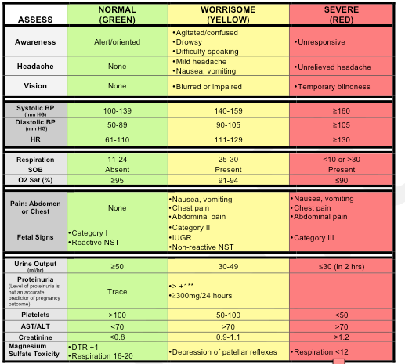
Preeclampsia Early Recognition Tool
40
Notes:
This is a tool that is designed to aid in the early recognition and response to a patient’s deteriorating condition as the disease process progresses in severity. The next slide is a continuation of this form with interventions based on the number of triggers.

Slide 41
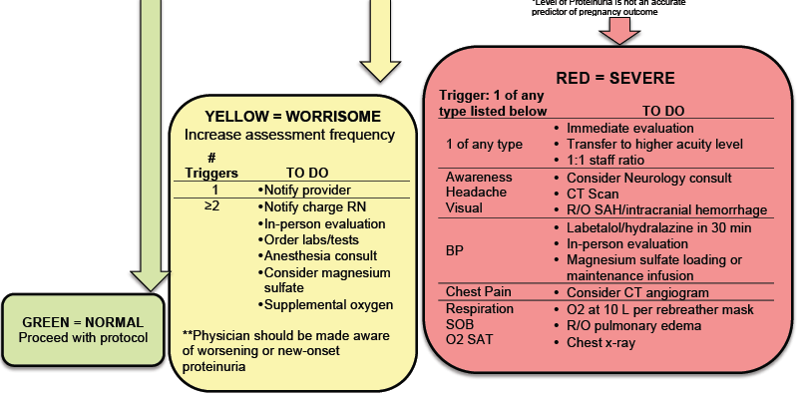
Clinical Signs to Watch for:
10.30.13v1
41
Notes:
The hope is that this Early Recognition Tool can be incorporated into the maternal notes and can be initiated in prenatal clinics and utilized as vital sign documentation until discharge. The chart stays with the patient until discharge creating a visual trend of individual physiology and allows assessment and treatment based on what is abnormal for the patient.

Slide 42
Eclampsia
Eclampsia is defined as NEW ONSET grand mal seizures in a woman with preeclampsia
Incidence is 1 in 1,000 deliveries in U.S.
Mortality from eclampsia ranges from approximately 1% in the developed world, to as high as 15% in the developing world
  Ghulmiyyah L, Sabai BM. Maternal Mortality from Preeclampsia/Eclampsia. Semin Perinatol 2012;36:56-59.
42

Slide 43
Characterization of Symptoms Immediately Preceding Eclampsia
3,267 deliveries and 46 cases of eclampsia (1.4%)
Most common prodromal neurological symptoms (regardless of the degree of hypertension OR whether the seizure occurred antepartum or postpartum):
  Headaches (80%)
  Visual disturbance (45%),
20% of women with eclampsia reported no neurologic symptoms before the seizure
Cooray SD, Edmonds SM, Tong S, et al. Characterization of Symptoms Immediately Preceding Eclampsia. Obstetrics & Gynecology, Vol 118(5):1000-1004, November 2011.
43

Slide 44
Preeclampsia Toolkit Treatment Recommendations
44

Slide 45
Preeclampsia Toolkit BP Treatment Recommendations
Systolic ≥ 160 | Diastolic ≥ 110 | Repeat BP and treat within 60 minutes (ideally ASAP)
≥155 | ≥105-110 | Alternative triggers*
These recommendations apply to all forms of hypertension in pregnancy:
Gestational HTN - Preeclampsia - Severe Preeclampsia
* Based on Martin 2005: Martin J, Thigpen B, Moore R, et al. Stroke and severe preeclampsia and eclampsia: a paradigm shift focusing on systolic blood pressure. Obstet Gynecol 2005; 105(2):246-254.
45
Notes:
Treatment should be initiated for blood pressures that are ≥160 mm Hg systolic or 105-110 mm Hg diastolic.
Alternative triggers that have been discussed in Martin’s study (2005), suggest that treatment should be initiated at a lower threshold of 155/105 if the primary goal is to reduce maternal intracranial hemorrhage, which remains the leading cause of death from preeclampsia.⁴

Slide 46
Reaffirmed 2012
46

Slide 47
Preventing Stroke from Preeclampsia
Blood Pressure Comparisons: Baseline and Pre-stroke
Measure | Pregnancy Baseline (mm Hg) | Pre-stroke (mm Hg)
Mean systolic BP | 110.9 + 10.7 (n=25) | 175.4 + 9.7 (n=24)
Systolic BP range | 90-136 | 159-198
Systolic BP % > 160 | 0 | 95.8 (n=27/28)
Mean diastolic BP | 67.4 + 6.5 (n=25) | 98.0 + 9.0 (n=24)
Diastolic BP range | 58-80 | 81-113
Diastolic BP % > 110 | 0 | 12.5 (n=3)
Diastolic BP 5 > 105 | 0 | 20.8 (n=5)
Adapted from Martin JN, Thigpen BD, Moore RC, Rose CH, Cushman J, May. Stroke and Severe Preeclampsia and Eclampsia: A Paradigm Shift Focusing on Systolic Blood Pressure, OG 2005;105-246.
47

Slide 48
Key Clinical Pearl
antihypertensive
The critical initial step in decreasing maternal morbidity and mortality is to administer anti-hypertensive medications within 60 minutes of documentation of persistent (retested within 15 minutes) BP ≥160 systolic, and/or >105-110 diastolic.
Ideally, antihypertensive medications should be administered as soon as possible, and availability of a “preeclampsia box” will facilitate rapid treatment.
In Martin et al., stroke occurred in:
  23/24 (95.8%) women with systolic BP > 160mm Hg
  24/24 (100%) had a BP ≥ 155 mm Hg
  3/24 (12.5%) women with diastolic BP > 110mm Hg
  5/28 (20.8%) women with diastolic BP > 105mm Hg
Martin JN, Thigpen BD, Moore RC, Rose CH, Cushman J, May. Stroke and Severe Preeclampsia and Eclampsia: A Paradigm Shift Focusing on Systolic Blood Pressure, Obstet Gynecol 2005;105-246.
48

Slide 49
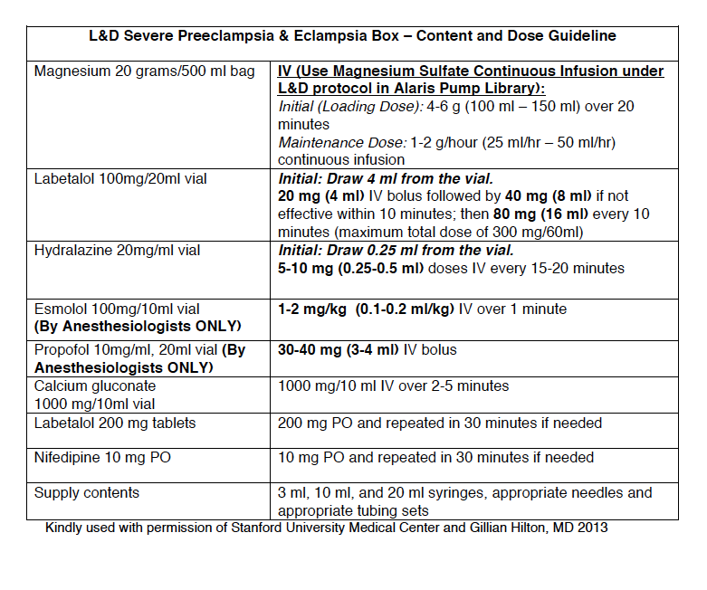
Labor and Delivery Medication Box and Dose Guidelines for Severe Preeclampsia and Eclampsia
49
Notes:
This is a sample Box from Stanford University. Each facility can customize their own box based on their hospital formulary.

Slide 50
Protocol for Labetalol Treatment
50

Slide 51
Hypertensive Medication Administration Oral v. IV
IV Labetalol
  Onset: 2-5 min
  Peak: 5 min
PO Labetalol:
  Onset: 20 min-2 hrs
  Peak: 1-4 hrs
IV Hydralazine
  Onset: 5-20 min
  Peak: 15-30 min
PO Nifedipine
  Onset: 5-20 min*
  Peak: 30-60 min
*PO, (oral) not sublingual nifedipine, onset of action is 15-30 minutes depending on the reference source.
* Cohan J, Checcio L. Nifedipine in the Management of Hypertensive Emergencies: Report of Two Cases and Review of the Literature. 1985 Nov;3(6):524-30
Raheem I, Saiid R, Omar S, et al. Oral nifedipine versus intravenous labetalol for acute blood pressure control in hypertensive emergencies of pregnancy: a randomized trial. BJOG 2012;119:78-85.
http://www.uspharmacist.com/content/d/feature/i/1444/c/27112/
Current Cardiovascular Drugs, edited by William H. Frishman, Angela Cheng-Lai, James Nawarskas, 4th edition 2005 pg. 2-186
51

Slide 52
Hypertensive Medication Administration
Oral versus IV
First line therapy recommendations for acute treatment of critically elevated BP in pregnant women (160/105-110) are with either IV labetalol or hydralazine.
In the event that acute treatment is needed in a patient without IV access oral nifedipine may be used (10 mg) and may be repeated in 30 minutes.
PO (oral) nifedipine appears equally as efficacious as IV labetalol in correcting severe BP elevations.
Oral labetalol would be expected to be less effective in acutely lowering the BP due to its’ slower onset to peak and thus should be used only if nifedipine is not available in a patient without IV access.
ACOG Practice Bulletin #33, Reaffirmed 2012; ACOG Committee Opinion #514, 2012; Tuffnell D, Jankowitcz D, Lindow S, et al. BJOG 2005;112:875-880.
52

Slide 53
ACOG Protocol for Hydralazine Treatment
53

Slide 54
Magnesium Sulfate
Primary effect is via CNS depression
Improves blood flow to CNS via small vessel vasodilation
Blood pressure after magnesium infusion:
  6 gm loading then 2 gm/hr.
 | sBP mm Hg | sBP 30 min | sBP 120 min | dBP mm Hg | dBP 30 min | dBP 120 min
Mild Group | 145 ±10 | 143 ±13 | 141 ±14 | 87 ±10 | 79 ±9 | 82 ±9
Magnesium sulfate should not be considered a antihypertensive medication
Belfort M, Allred J, Dildy G. Magnesium sulfate decreases cerebral perfusion pressure in preeclampsia.Hypertens Pregnancy. 2008;27(4):315-27.
54

Slide 55
Magnesium Sulfate in the Management of Preeclampsia
Magpie Trial Collaboration Group. Do women with pre-eclampsia, and their babies, benefit from magnesium sulfate?
58% reduction in seizures
45% reduction in maternal death*
33% reduction in placental abruption
*The 45% reduction in maternal death is not statistically significant but clinically important.
Altman D, Carroli G, Duley L, et al. The Magpie Trial: a randomized placebo-controlled trial; Lancet 2002;359:1877–90.
55
Notes:
The 45% reduction in maternal death is not statistically significant but clinically important.

Slide 56
Recommendations for Women
Who Should Be Treated With Magnesium
 | Preeclampsia without severe features | Severe Preeclampsia | Eclampsia
ACOG | ** | X | X
NICE |  | X | X
SOGC | X* | X | X
CMQCC | X* | X | X
WHO | X | X | X
**ACOG Executive Summary, 2013: for preeclampsia without severe features, it is suggested that magnesium sulfate not be administered universally for the prevention of eclampsia.
* Should be considered: Numbers needed to treat (NNT) = 109 for “mild”, 63 for “severe”
56
Notes:
ACOG did not recommend the use of magnesium sulfate in the case of mild preeclampsia because 109 patients had to be treated to prevent one case of eclampsia.
In the case of severe preeclampsia, 63 patients needed to be treated to prevent eclampsia, and the use of magnesium sulfate was recommended.

Slide 57
Key Clinical Pearl
Magnesium sulfate therapy for seizure prophylaxis should be administered to any patients with:
  Severe Preeclampsia
  Preeclampsia with “severe features” i.e., subjective neurological symptoms (headache or blurry vision), abdominal pain, epigastric pain AND
  should be considered in patients with mild preeclampsia (preeclampsia without severe features)
57

Slide 58
Key Clinical Pearl
Algorithms for acute treatment of severe hypertension and eclampsia should be readily available or preferably posted in all clinical areas that may encounter pregnant women.
58

Slide 59
Timing of Pregnancy-Related Deaths,
CA-PAMR, 2002 to 2004
89%
Non-Preeclampsia Deaths
(n=129)
87%
96%
Preeclampsia Deaths
(n=25)
88%
59
Notes:
Preeclampsia and non-preeclampsia cases have about the same proportion of deaths in the 2 week postpartum period, so targeting early follow-up for preeclampsia should help to address this group of patients.
Of the 25 cases of deaths from preeclampsia, 17/25 (68%) occurred within 4 days of delivery. 96% of the deaths occurred within 42 days. Only 1 death occurred more than 42 days after delivery.
Preeclampsia deaths occurred significantly closer to the delivery than all other causes (mean 7.5 days for preeclampsia vs. 28.2 days for other causes).
Timing of the Critical Event
All but 3 of the women who died within 4 days postpartum were diagnosed with severe preeclampsia/HELLP on admission. Of the other three, two were diagnosed with hypertension and one had an eclamptic seizure on admission to the ED.
In summary, 21 of the women experienced the critical event during the first two days postpartum; of the remaining four, the critical event occurred on days 6, 8, 16 and 26 postpartum.

Slide 60
Postpartum Case Study
24 year-old G2, P0-0-1-0 @ 39 wks
Prenatal course unremarkable, GBS (+)
Blood pressure normal throughout prenatal period
Presented to the office with complaint of regular uterine contractions
Cervical exam: 3 cm dilated
BP: 142/95
Urinalysis negative for protein
60

Slide 61
Postpartum Case Study (continued)
Status on Admission
The patient was admitted for spontaneous labor and gestational hypertension
On admission to Labor and Delivery
  BP 133/74
  Urinalysis negative
  Platelet count: 187,000/unit
  AST 14
  ALT 18
  Uric Acid 5.5
61

Slide 62
Postpartum Case Study (continued)
Course in Labor
BP remained modestly elevated throughout labor and the postpartum stay
Fetal heart rate consistently Category 1 (normal) tracing
Patient had primary late term c/section for failure to progress on day 2
Postpartum course was unremarkable. No documented complaints of headache, blurred vision or epigastric pain
62

Slide 63
Postpartum Case Study (continued)
Post-op Day # 3
Patient complained of “acute, crushing headache”, pain rated 8/10. D/C orders already written
Received hydrocodone 15 mg/acetaminophen 650 mg
Discharged 30 minutes later; no follow-up of headache documented
63

Slide 64
Postpartum Case Study (continued)
Post Discharge
Post-op day #4: Patient reported worsening headache to family
Post-op day #5: Progressively worsening headache and new-onset visual changes
911 call placed by family
Initial seizure occurred shortly thereafter
Multiple seizures witnessed by family
Intubated in the field and transported to hospital
  Started on MgSO4, ativan, keppra, labetalol
Helicopter transport to tertiary center, neurology ICU
64

Slide 65
Postpartum Case Study (continued)
Post-op Day 6 to 9
Extubated shortly after admission
BP’s remained elevated; BP max 148/98; SBP mostly 130’s; DBP mostly 80’s
Platelet count 370,000, AST 30, ALT 33, Creatinine 0.9 mg/dl
Urinalysis: Negative for protein
Persistent, mild headache with some postural component
  Anesthesia consult obtained; Conservative treatment
MRI: “no evidence of ischemic injury”; no parieto-occipital edema suggestive of PRES*
*PRES: Posterior Reversible Encephalopathy Syndrome
65
Notes:
PRES: Posterior Reversible Encephalopathy Syndrome

Slide 66
Late Postpartum Eclampsia
>48 hours following delivery, up to 4 weeks PP
Accounts for approximately 15% of cases of eclampsia
63% had no antepartum hypertensive diagnosis
The magnitude of blood pressure elevation does not appear to be predictive of eclampsia
The most common presenting symptom was headache, which occurred in about 70% of patients; other prodromal symptoms included shortness of breath, blurry vision, nausea or vomiting, edema, neurological deficit, and epigastric pain
Al-Safi Z, Imudia A, Filetti L, et al. Delayed Postpartum Preeclampsia and Eclampsia. Obstet Gynecol. 2011;118(5):1102-1107.
66

Slide 67
Eclampsia: Observations from 67 recent cases
67 cases of eclampsia managed over 4 years
1:310 deliveries
21% had no proteinuria
21% had no DBP in excess of 90 mmHg
37% of first eclamptic seizures occurred postpartum
16% of first eclamptic seizures occurred late postpartum (3-11 days postpartum)
    Sibai BM, McCubbin JH, Anderson GD, et al. Eclampsia. Observations from 67 Recent Cases. Obstet Gynecol; 58:609, 1981.
67

Slide 68
Eclampsia: Maternal-Perinatal Outcome In 254 Consecutive Cases
254 consecutive cases of eclampsia over 12 years
83,720 deliveries, for an incidence of one in 330
49 patients (19%) did not have proteinuria
58 patients (23%) did not have hypertension
73 occurred postpartum, half of which occurred >48 hours after delivery
Over half of postpartum cases, (40 cases/16%) occurred in the late postpartum period
18 of these 40 cases were normotensive; all 18 had symptoms of headache or visual disturbance
Sibai BM. Eclampsia VI. Maternal-perinatal outcome in 254 consecutive cases. Am J Obstet Gynecol Sep 163(3):1049-1054; discussion 1054-1065 1990.
68
Notes:
Late postpartum period is > 48 hrs, up to 4 weeks .

Slide 69
Key Clinical Pearls
Early post-discharge follow-up recommended for all patients diagnosed with preeclampsia/eclampsia
Preeclampsia Toolkit recommends post-discharge follow-up:
  within 3-7 days if medication was used during labor and delivery OR postpartum
  within 7-14 days if no medication was used
Postpartum patients presenting to the ED with hypertension, preeclampsia or eclampsia should either be assessed by or admitted to an obstetrical service
69
Notes:
These clinical pearls emphasize the importance of early postpartum follow-up in women diagnosed with hypertension, preeclampsia or eclampsia.

Slide 70
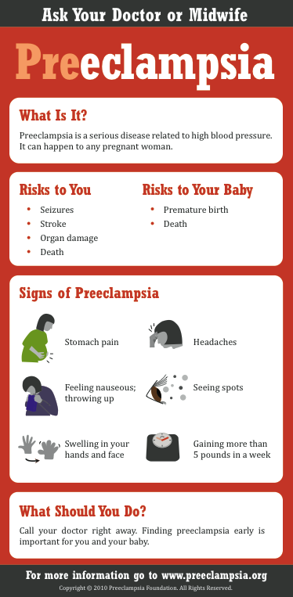
Patient Education Materials
This and many other patient education materials can be ordered from www.preeclampsia.org/market-place
70
Notes:
Here is an example of patient education materials from the Preeclampsia Foundation.

Slide 71
Key Clinical Pearls
Use of preeclampsia-specific checklists, team training and communication strategies, and continuous process improvement strategies will likely reduce hypertensive related morbidity.
Use of patient education strategies, targeted to the educational level of the patients, is essential for increasing patient awareness of signs and symptoms of preeclampsia.
71
Notes:
Education strategies include a clear and simply written list of patient symptoms to share with patients and their families during prenatal visits and upon discharge from the hospital. Written instructions should help patients to recognize preeclampsia symptoms and seek care.

Slide 72
Getting The Job Done in Your Institution
Establish tools / new recommendations
Establish champions and collaborators
Provide convincing rationale for change
Get providers to adopt the changes
Provide convincing evidence that the proposed changes in clinical care will improve outcome
Distribute the convincing rationale and evidence
72
Notes:
Champions will be both local at each hospital, regional (through hospital local OB groups) and nationally by being in alignment with organizations like ACOG, SOGC, NICE.
Distribute the rationale and evidence including:
Data from maternal mortality reviews and other large databases. This may still be received with resistance as most physicians and other healthcare professionals will view their own personal experience as different.
Distribute the evidence and rationale through publications, and local and regional presentations.

Slide 73
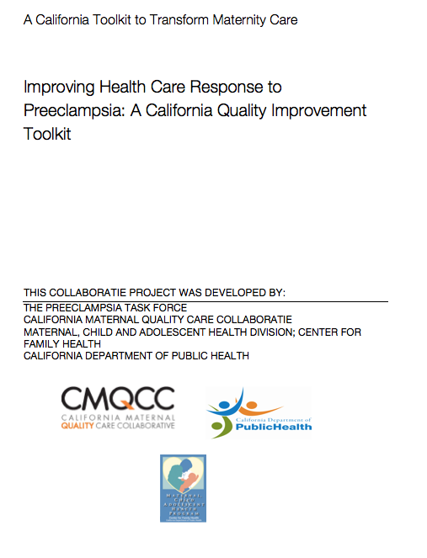
For More Information and to
Download the
Toolkit
Visit our website: www.cmqcc.org
Or contact us:
info@cmqcc.org
Available online at www.cmqcc.org
73

