Slide 1
Improving Diagnosis and Treatment of Maternal Sepsis
A CMQCC Quality Improvement Toolkit
Toolkit Co-authors/Lead Editors:
Ronald Gibbs, MD
Lori Olvera, DNP
Melissa Bauer, DO
Elliott Main, MD
Christa Sakowski, MSN, RN Valerie Cape
Notes:
Title Slide layout

Slide 2
Instructions
Please use the CMQCC template for any slide you use from the slide deck
Please do not use the CMQCC logo if you modify a slide – feel free to use your own logo in these situations
If you add slides to the slide set, please do not use the CMQCC logo
Please provide us feedback and recommendations for improving the slide set
Notes:
One column layout

Slide 3
Acknowledgements
Sepsis Task Force Advisory Group
Gillian Abir, MBChB, Anesthesia, Stanford University | Herman Hedriana, MD, MFM, University of CA Davis
Muhammad Afzal, MD, Critical Care, Sutter Health | Beth Stephens-Hennessy, MSN, Sutter Health
Natali Aziz, MD, Maternal Fetal Medicine, Stanford University | Shanthi Kappagoda, MD, Infectious Disease, Stanford University
Melissa Bauer, DO, Anesthesiology, University of Michigan | Tom Kelly, MD, MFM, UC San Diego
Valerie Cape, CMQCC, Stanford University | Michelle Khan, MD, MFM Kaiser Permanente
Holly Champagne, DNP, RNC-OB, Kaiser Permanente | Brett Laurence, MD, Infectious Disease, Sutter Health
Meyng S. Cho, MD, PharmD, Sutter Health | Elliott Main, MD, MFM, CMQCC, Stanford University
Katarina Lanner-Cusin, MD, FACOG, Sutter Health | Lori Olvera, DNP, RNC-OB, Sutter Health
Mary D’Alton, MD, MFM, Columbia University | Christa Sakowski, MSN, CMQCC, Stanford University
Matthew Garabedian, MD, MFM, Kaiser Permanente | Marla Seacrist, PhD, Cal State Stanislaus
Shabnam Gaskari, MD, PharmD, Lucile Packard Children’s Hospital | Laurence Shields, MD, MFM, Dignity Health
Ronald Gibbs MD, MFM, Stanford University | Angelique Silva, MS, RN, University of CA Davis
William Gilbert, MD, MFM, Sutter Health

Slide 4
Learning Objectives:
Know the importance of maternal sepsis on morbidity and mortality
Understand the Two-Step Method for screening and diagnosis of sepsis in pregnancy
Describe the pregnancy related differences in vital signs and lab values
Describe treatment recommendations for maternal sepsis
Identify steps to begin implementation on your unit

Slide 5
Introduction
Part I: Screening and Diagnosis of Sepsis
Part II: Assessment and Treatment: Care Bundles
Part III: Assessment and Treatment: Antibiotics and Source Control
Part IV: Obstetric considerations
Part V: Discharge education
Summary
Case Presentation

Slide 6
Introduction
Christa Sakowski, MSN, RN

Slide 7
Introduction
Sepsis occurs in about 0.04% of deliveries and is a leading cause of maternal death (12.7-23.0%)
Most cases (63%) of maternal death from sepsis are likely to have been preventable
For each maternal death from sepsis, there are 50 women who experience life-threatening morbidity from sepsis
Hensley, Bauer, Admon, et al. JAMA 2019
California Pregnancy-Associated Mortality Review Report from 2002-2007
Acosta, Kurinczuk, Lucas, et al. PLoS Med 2014

Slide 8
Cause-Specific Pregnancy-Related Mortality, US: 2011-2013
Primarily Medical Causes

Slide 9
Leading Causes of Maternal Sepsis
Antepartum | Intrapartum/ Immed. Postpartum | Post-discharge
Septic abortion | Chorioamnionitis/ intraamniotic infection | Pneumonia/influenza
Chorioamnionitis/ intraamniotic infection | Endometritis | Pyelonephritis
Pneumonia/ influenza | Pneumonia/influenza | Wound Infection/ Necrotizing Fasciitis
Pyelonephritis | Pyelonephritis | Mastitis
Appendicitis | Wound Infection/ Necrotizing Fasciitis | Cholecystitis

Slide 10
Key Clinical Pearl
Prompt recognition and rapid treatment of
maternal sepsis improve outcomes

Slide 11
Introduction
Diagnosis of sepsis in pregnancy may be difficult because physiologic changes of pregnancy may mimic the signs of sepsis
  Increased heart rate
  Decreased blood pressure
  Increased white blood cell count
  Increased lactic acid levels in labor
Criteria for diagnosing sepsis in non-pregnant adults do not perform well in pregnant women
Pregnant women are at increased risk for severe outcomes in some infections such as influenza
Singer, Deutschman, Seymour, et al. JAMA 2016

Slide 12
Definitions: 2016 Surviving Sepsis Guidelines
Sepsis:
  Life threatening organ dysfunction caused by a dysregulated host response to infection
Septic shock:
  Subset of sepsis with underlying circulatory and cellular metabolism abnormalities that are profound enough to substantially increase mortality

Slide 13
Historically, ‘severe sepsis’ was defined as sepsis plus end organ dysfunction*
New definition of sepsis focuses on end organ dysfunction**
The term ‘severe sepsis’ is no longer recommended**
*Bone, et al 1991; **Singer, et al 2016

Slide 14
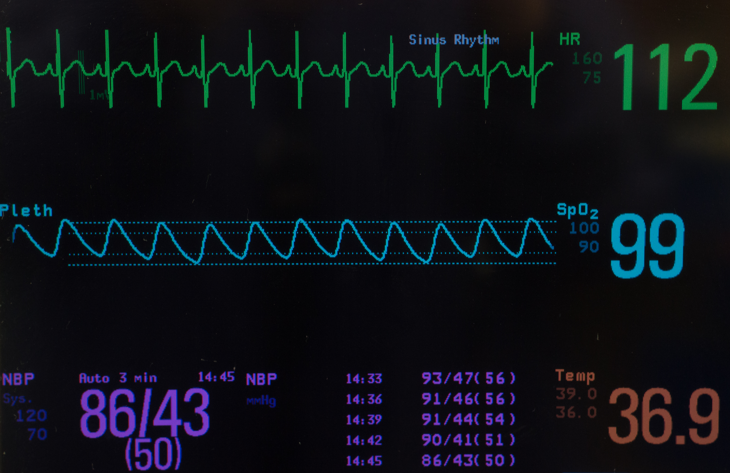
PART I:
Screening and Diagnosis of Sepsis
Elliott Main, MD

Slide 15
PART I: Screening and Diagnosis: Key Principles
1. Current screening systems perform poorly in pregnancy.
2. We recommend a two-step approach for the diagnosis of sepsis during pregnancy and postpartum.
  The first screening step is limited to vital signs adjusted for pregnancy and the most recent white blood cell WBC count (within 24 hours).
  The second diagnostic step uses evaluation for end organ injury with laboratory values adjusted for pregnancy where needed.
3. The utility of lactic acid during labor is debated, but women with elevated values require careful individual consideration.

Slide 16
CMQCC Diagnosis of Maternal Sepsis: A Two-Step Approach
Aims to reduce false positives (avoid ‘alarm fatigue’) and reduce false negatives (avoid missing cases)
Is based on clinical practice data sets from three hospital systems in CA with adjustment for physiologic changes of pregnancy
Features a two-step approach: a screening step followed by a confirmatory step

Slide 17
Pregnancy adjusted vital signs
Two standard deviations from the mean:
38.1○C (100.6○F)
Heart rate = 107 beats per minute
Respiratory rate = > 24 breaths per minute
Assuming a normal distribution, patients meeting these thresholds for each criterion would occur 2.5% of the time. It would be expected that approximately 2.5% or less (since two or more criteria are required) of patients may meet the proposed screening criteria due to physiological changes of pregnancy rather than infection
Bauer, Bauer, Rajala, et al. Obstet Gynecol 2014

Slide 18
Sepsis Evaluation
Flow Chart

Slide 19
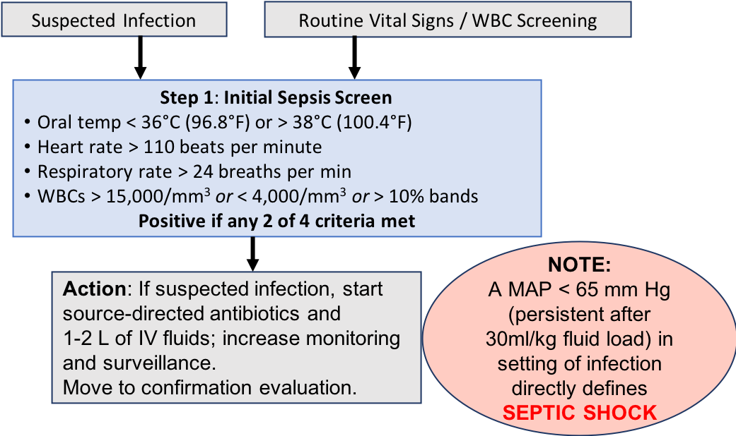
Initial Sepsis Screen (Step 1)

Slide 20
Confirmation of Sepsis: Step 2
Tests to Evaluate End Organ Injury
Laboratory values
CBC (including % immature neutrophils [bands], Platelets)
Coagulation status (PT, INR, PTT)
Comprehensive Metabolic Panel (specifically include bilirubin, creatinine)
Venous Lactic Acid
Bedside assessment
Urine output (place Foley catheter with urometer)
Pulse oximetry
Mental status assessment

Slide 21
Step 2: Criteria for end organ injury
Measure of End Organ Injury | Criteria Positive if one (1) or more criteria are met
Respiratory function* | Acute respiratory failure as evidenced by acute need for invasive or non-invasive mechanical ventilation, OR PaO₂/FiO₂ < 300
Coagulation status | Platelets < 100 x 10⁹/L, OR International Normalized Ratio (INR) > 1.5, OR Partial Thromboplastin Time (PTT) > 60 seconds
Liver function | Bilirubin > 2 mg/dL
Cardiovascular function | Persistent hypotension after fluid administration: SBP < 85 mm Hg, OR MAP < 65 mm Hg, OR > 40 mm Hg decrease in SBP
Renal function | Creatinine > 1.2mg/dL, OR Doubling of serum creatinine, OR Urine output less 0.5 mL/kg/hour (for 2 hours)
Mental status assessment | Agitation, confusion, or unresponsiveness
Lactic acid | > 2 mmol/L in absence of labor (Lactic acid not used for diagnosis in labor, but remains important for treatment.)

Slide 22
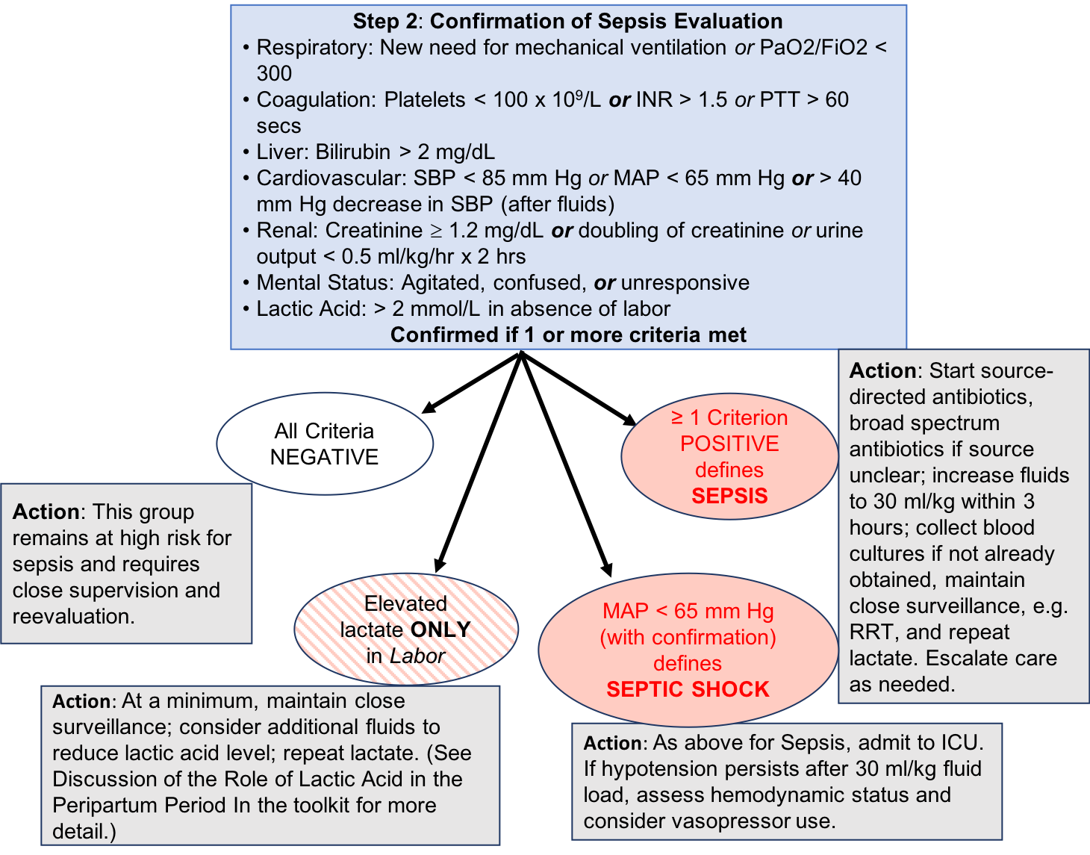
Confirmation of
Sepsis Evaluation:
Step 2

Slide 23
Performance of Two-Step System for Diagnosis of Maternal Sepsis (data extracted from clinical practice data sets, not formal research studies)
 | OB Vital Signs Screen |  | Sepsis (End Organ Injury)
Source | Population Screened | Screen Positive | Total with End Organ injury | Among Screen Positive (Sens) | Not Among Screen Positive (Spec)
Combined Systems* | 14,752 | 199 (1.3%) | 33 (16.6% of screen positives) (0.22% of all screened) | 32 (97%) | 1 (3%)
Notes: (1) Initial screen positive rate is 1.3%
(2) Overall performance of the Two-Step System as shown above gives an approximate sensitivity of 97% TP/(TP+FN) : 32/33; and an approximate specificity of 99% (14,552/14,552 + 166. TN/(TN+FP).
* Data from Dignity Health and Sutter Health

Slide 24
Advantages of Two-Step Approach
Promotes fewer missed cases (higher sensitivity)
Promotes fewer false alarms (higher specificity)
Estimates that only 2% of patients will screen positive

Slide 25

Key Clinical Pearls
All members of the clinical team should maintain a high index of suspicion and embrace non-hierarchical communication to detect impending sepsis
All team members should feel empowered to speak up and know that their input is valued by the care team

Slide 26

Part II:
Assessment and Treatment:
Care Bundles
Lori Olvera, DNP

Slide 27
Part II: Assessment and Treatment of Maternal Sepsis: Care Bundles: Key Principles
1. Act quickly upon recognition of sepsis and septic shock.
2. Minimize time to treatment: Sepsis is a medical emergency.
3. Monitor closely for response to or lack of response interventions.
4. Communicate sepsis status during bedside care and handoff.

Slide 28
Sepsis = Screen positive with end organ injury
First steps
Source-directed antibiotics if not already started
If source unclear, give broad spectrum antibiotics
Increase fluids to 30 mL/kg within 3 hours if not already done
Repeat lactate
Blood cultures, if not already drawn
Call for RRT to escalate care, as needed

Slide 29
Monitoring Recommendations Following a Positive Step 1 Initial Sepsis Screen
Monitoring | Time Frame | Additional Considerations
Fetal Monitoring | Continuous | Antepartum/intrapartum
Pulse Oximetry | Continuous | Until vital signs are normalized
Blood Pressure (MAP) | Q 30 minutes from ‘Time Zero’ | Until lactate less than 2.0 mmol/L, then Q2 h for non-laboring patients (Jones AE)
Temperature | Q 30 minutes from ‘Time Zero’ | Until lactate less than 2.0 mmol/L, then Q2 h for non-laboring patients*
Urine Output | Q 1 hour from ‘Time Zero’ | Foley catheter with urometer
Mental Status | Continuous | Note: agitation, confusion or unresponsiveness
The ongoing assessment recommendations are based on ‘Time Zero’. Once the patient triggers a positive Initial Sepsis Screen, ‘Time Zero’ will start. A review of nursing technique for collecting a urine sample from a Foley catheter is provided in Appendix E of the Toolkit.
*Jones, AE. Acad Emerg Med 2013

Slide 30
Assessment and Treatment: Cultures
For chorioamnionitis/intraamniotic infection and endometritis, lower genital tract cultures are rarely performed because they may reflect primarily contaminating organisms
Patients initially diagnosed with chorioamnionitis/ endometritis generally have negative blood cultures or a positive culture is reported after a recovered patient has been discharged
If patient show signs of end-organ injury or septic shock, blood cultures should be obtained if not already done

Slide 31
Assessment and Treatment: Cultures (cont)
Blood cultures should be collected prior to antibiotic administration in patients with suspected sepsis and septic shock
Two sets of cultures for anaerobes and aerobes should be collected
If the same organism is identified in both sets of blood cultures, the likelihood that the organism is causing sepsis is increased
Note: Blood cultures should be drawn within 3 hours following a diagnosis of sepsis with organ dysfunction per CMS guidelines (CMS guidelines 5.5)
Dellinger, Mitchell, Rhodes, et al. Int Care Med 2013

Slide 32
Assessment and Treatment: Fluid Management
Optimize circulating volume and improve cardiac output (blood pressure) and tissue perfusion
Initial resuscitation includes at least 30 mL/kg of intravenous crystalloid fluid within 3 hours
Following initial fluid resuscitation, additional fluids should be guided by frequent reassessment of hemodynamic status
  using non-invasive cardiac output monitor (NICOM)
  Input and assessment from RRT
Levy, Evans, Rhodes. Int Care Med 2018

Slide 33
Assessment and Treatment: Escalation of Care
Criteria for consideration of transfer to a higher level of care
Hypotension (MAP below 65mm Hg) despite fluid resuscitation or need for administration of vasopressors
Persistent Hypoxia (SpO₂ < 92% on room air)
Altered mental status (combativeness, confusion, disorientation)

Slide 34
Rapid Response Team (RRT)
Usually comprised of a critical care nurse and a respiratory therapist
Supports the care team outside of the emergency and intensive care departments and is particularly useful for Obstetric units where critically ill patients are uncommon
Can:
  assist with assessment of deteriorating patient
  provide early intervention
  make recommendations for lab tests, fluid management and treatment

Slide 35
Escalation of Care: Transfer to ICU
The transfer of an obstetric patient to a higher level of care is usually sought for clinically-unstable patients
A multidisciplinary team can be included in the decision to transfer
Safe transport of a critically-ill obstetric patient to a different hospital requires continuous cardiac monitoring, pulse oximetry, venous access and assessment of vital signs
Do not delay transport of a critically-ill pregnant woman because of inability to monitor the fetus
Stabilizing the mother will often stabilize the fetus

Slide 36
Additional Considerations for Pregnant Women with Sepsis
Vasopressors | Norepinephrine is the pressor of choice in pregnancy and used if MAP <65 mm Hg and if unresponsive to intravenous fluids
Inotrope | Dobutamine is recommended for myocardial dysfunction or hypoperfusion despite intravenous fluids and vasopressors as it increases cardiac output.
Glucose Control | Avoid hyperglycemia >180 mg/
Maternal Temperature Control | Reduce fetal oxygen consumption and fetal tachycardia using acetaminophen and cooling blankets
Fetal lung maturity | Consider steroids for fetal lung maturity if 23-36* weeks of pregnancy
DVT prevention | Pharmacologic VTE prophylaxis and mechanical prophylaxis whenever possible
*Gymafi-Bannerman C, Thom EA, Blackwell SC et al. Antenatal Betamethasone for Women at Risk for Late Preterm Delivery. 2016 N Eng J Med

Slide 37

Part III:
Assessment and Treatment:
Antibiotics and Source Control
Elliott Main, MD

Slide 38
Part III: Assessment and Treatment: Antibiotics and Source Control: Key Principles
Early administration of antibiotics, ideally within one hour of presentation, is critically important in sepsis.
The initial choice of antibiotics in critically-ill patients is generally empiric and broad spectrum to cover most or all likely pathogens.
Assessment for source control (such as surgical/percutaneous drainage or debridement) should be initiated in a timely fashion using the least invasive approach possible.

Slide 39
Assessment and Treatment: Antibiotics
As culture information becomes available and the patient stabilizes, it is often recommended that the antibiotic regimen be narrowed if possible
However, many pelvic infections are polymicrobial, involving aerobes and anaerobes. Cultures from the genital site may not be collected for or tested for anaerobes

Slide 40
Assessment and Treatment: Antibiotics (cont)
Empiric antibiotic choices should be guided by the local antibiogram
Recently hospitalized patients are at risk of multi-drug resistant organisms such as MRSA and extended spectrum beta-lactamase producing (ESBL) organisms
Initiate antibiotics for women with sepsis as quickly as possible through a sepsis order set available to clinicians

Slide 41
Key Clinical Pearl
Necrotizing fasciitis: Diagnosed clinically in the presence of fever, pain out of proportion to exam, crepitus, bullae, erythema, and rapid progression of findings. Prompt surgical management (with tissue pathology) confirms the diagnosis. Early debridement is critical.

Slide 42
Antibiotic Regimen by Condition
(See full recommendations in Toolkit)
Condition | Antibiotic Choices | Duration | Notes
Chorioamnionitis / intraamniotic infection (Plante, et al 2019, ACOG) | Ampicillin 2 g IV q6h PLUS Gentamicin 2 mg/kg IV load, then 5mg/kg every 24h ____________________ Alternate regimens: (Based on local antibiotic resistance patterns) Ampicillin-sulbactam 3g IV q6h OR Piperacillin-tazobactam 3.375g IV q6h OR Cefoxitin 2g IV q6H OR | Generally limited to the peripartum period Duration of therapy is unclear, but there are some recommendations to continue until afebrile for 24h | For post-cesarean delivery: one additional dose of the chosen regimen is indicated. Add clindamycin 90 mg IV or Metronidazole 500 mg IV for at least one additional dose. For post-vaginal delivery: No additional antibiotic doses required, but if additional doses of antibiotics are given, clindamycin is not indicated.
Sample

Slide 43
Antibiotic regimens by source of infection
Source infection | Recommended antibiotics
Abdominal infections | Ceftriaxone, cefotaxime, ceftazidime, or cefepime plus metronidazole;
 | Complicated cases may require monotherapy with a carbapenem or piperacillin-tazobactam
Chorioamnionitis | Ampicillin plus gentamicin. Add anaerobic coverage with clindamycin or metronidazole if cesarean delivery required
Community- acquired pneumonia | Cefotaxime, ceftriaxone, ertapenem, or ampicillin plus azithromycin, clarithromycin, or erythromycin
Endomyometritis | Ampicillin, gentamicin, and metronidazole (or clindamycin); Alternatively, may use cefotaxime or ceftriaxone plus metronidazole
Hospital-acquired pneumonia | Low risk patients: Piperacillin-tazobactam, meropenem, imipenem, or cefepime
 | High mortality risk patients: double coverage for pseudomonas (beta lactam plus an aminoglycoside or a quinolone) and MRSA coverage with vancomycin or linezolid
Skin and soft tissues (necrotizing) | Vancomycin plus piperacillin-tazobactam If Streptococcus Group A or Clostridium perfringens are present, use penicillin G plus clindamycin
Urinary tract infections | Gentamicin with ampicillin; Alternatively, may use monotherapy with a carbapenem or piperacillin-tazobactam
Plante, Pacheco, Louis, 2019 A J Obstet Gynecol

Slide 44
Antibiotics and Source Control
If patient has no improvement with initial resuscitation with antibiotics/fluids:
Patients with identified sources of infection that are amenable to percutaneous drainage should undergo consultation with Interventional Radiology and assessment for possible drainage
  Infectious disease consultation may be appropriate

Slide 45
Source control (cont)
Patients with identified sources of infection requiring surgery should undergo consultation with:
  Gynecologic surgeon for procedures such as D&C for retained products, hysterectomy for necrotizing Group A streptococcal uterine infection, or drainage of pelvic or perineal abscess not amenable to percutaneous draining by Interventional Radiology
  General surgeon for procedures such as drainage of abdominal abscess, appendectomy, cholecystectomy, or debridement for necrotizing fasciitis
  Early surgical consultation is strongly recommended for any concerns regarding necrotizing skin and soft tissue infections

Slide 46
PART IV:
Obstetric Considerations
Elliott Main, MD

Slide 47
PART IV: Obstetric Considerations: Key Principles
1. The timing of delivery in a pregnant woman who is septic should be individualized, taking into consideration gestational age and maternal-fetal status.
2. A careful assessment individualized to patient should be made for use of neuraxial procedures.

Slide 48
Obstetric Considerations: Indications for delivery
Sepsis is not an immediate indication for delivery
The timing of delivery in a septic pregnant woman should be individualized
  Consider gestational age and maternal-fetal status
  Improving maternal hemodynamics often improves fetal status
  Cesarean delivery is usually reserved for supervening obstetric indications after the patient is stabilized
Corticosteroids for fetal lung maturity are not contraindicated
Plante, Pacheco, Louis. 2019 Am J Obstet Gynecol

Slide 49
Obstetric Considerations: Septic Shock patients
In patients with sepsis or septic shock, strongly consider avoiding neuraxial procedures
The physiologic status of the patient with sepsis or septic shock is compromised
Cardiovascular effects of a neuraxial block technique may cause further detriment with high potential for maternal (and fetal) morbidity and mortality

Slide 50
Part V:
Discharge education
Christa Sakowski, MSN, RN

Slide 51
Part V: Discharge Education: Key Principles
1. Every woman and at least one support person should receive discharge instructions on the danger signs of sepsis.
2. Instructions at every point of care should include ways to decrease infection risk, such as frequent hand washing.
3. For women who have had sepsis, planned follow-up contact should be made within 3-4 days after discharge.

Slide 52
Key Clinical Pearls Summary
Prompt recognition and rapid treatment of maternal sepsis improves outcomes
None of the systems performs satisfactorily in pregnant women as they have low detection rate (low sensitivity) or high false positive (false alarms)
With suspected infection, a MAP < 65 mm Hg is sufficient to initiate the sepsis protocol even if other sepsis screening criteria are not met
CMQCC recommends a new two-step approach to diagnosis of maternal sepsis
A screen is considered positive if two or more values meet the criteria listed (heart rate and respiratory rate are sustained for 15 minutes)
If there is concern with a patient’s clinical status and suspected infection, it may be sufficient to proceed to Step 2 for further evaluation

Slide 53
Key Clinical Pearls Summary
Two-Step Approach promotes fewer missed cases (higher sensitivity) and fewer false alarms (higher specificity)
Two-Step Approach estimates that only 2% of patients will screen positive
Early administration of antibiotics is critically important in sepsis, ideally within one hour of presentation
The initial choice of antibiotics in critically ill patients is generally empiric and broad spectrum to cover most or all likely pathogens
Assessment for source control (such as surgical/percutaneous drainage or debridement) should be initiated in a timely fashion and using the least invasive approach possible

Slide 54
Case Presentation
Lori Olvera, DNP

Slide 55
Case Presentation #1:
26 yo, G2P1, hospitalized with preterm rupture of membranes at 32 weeks
Day 8: felt warm with heart racing
Vital signs: T = 97.8F, HR 130/min; RR 22/min; BP 115/62; FHR=160/min
Contractions every 3 minutes
Cervical exam 3/80/-1

Slide 56
Case #1 (cont)
WBC = 22,000/mm³
Patient screen positive but no sepsis confirmation performed due to no fever or clear source of infection
Elevated WBC attributed to betamethasone 4 days prior
2 hrs later, repeat cesarean performed for non-reassuring fetal heart rate tracing

Slide 57
Case #1 (cont)
Infant Apgar 1/8
In recovery room, temperature 101.8F, HR 120/min; BP 88/40 (MAP 56 mm Hg); RR 36
RRT called
IV fluids at 30 mL/kg + zosyn administered for unknown source of infection
Lactate = 9 mmol/L, urine output 10 mL/hr

Slide 58
Case #1 (cont)
Patient bleeding at incision site
Patient transferred to ICU and stabilized on broad spectrum antibiotics and supportive care
Final diagnosis: septic shock due to chorioamnionitis with bacteremia with Group B streptococci and E. coli

Slide 59
Case #1: Lessons Learned
No fever initially but patient met initial screening criteria for sepsis
With lack of sepsis confirmation testing, missed opportunities for earlier treatment with fluids and broader spectrum antibiotics to avoid progression to septic shock
Elevated white count explained away as due to betamethasone

Slide 60
Appendices to Toolkit
A: Comparison of Sepsis Terminology
B: CMS Sepsis-1 Accommodations for Special Populations
C: Justification for Adjustments to CMS Sepsis-1 for End Organ Injury
D: Maternal Sepsis Evaluation Flow Chart
E: Collecting a Urine Specimen from a Foley Catheter
F: The Importance of Taking a Respiratory Rate
G: How to Take an Oral Temperature Measurement
H: Team Reassessment Communication
I: Sample OB Sepsis Debriefing Form
J: Sample UC Davis Health OB Sepsis Drill Scenario
K: Obstetric Education for RNs
L: Lactation Safety of Antimicrobials Used for Treatment of Sepsis
M: Sample Order Set

Slide 61

Thank you!
Questions??
Contact information:
  info@cmqcc.org
How to access slides and toolkit
  https://www.cmqcc.org/resources-tool-kits/toolkits
  Toolkit release date: January 23, 2020

