Slide 1


Introduction to the Toolkit to Support Vaginal Birth and
Reduce Primary Cesareans
Toolkit Co-authors/Lead Editors:
Holly Smith MPH, MSN, CNM
David Lagrew Jr. MD
Elliott Main, MD
Nancy Peterson, MSN, PNNP
Funding for the development of this toolkit was provided by the California Health Care Foundation
Notes:
1

Slide 2
Instructions:
Please use the CMQCC template for any slide you use from the slide deck
Please do not use the CMQCC logo if you modify a slide – feel free to use your own logo in these situations
There may be slides with copyright material that we do not yet have copyright permission to use & should not be shared with others (these slides would be marked)
If you add slides to the slide set please do not use the CMQCC logo
Please provide us feedback and recommendations for improving the slide set
1

Slide 3
California Maternal Quality Care Collaborative (CMQCC)
Multi-stakeholder organization established in 2006: providers, state agencies, public groups with focus on Maternal Care
Hosts California Maternal Mortality Review Committee
Sister organization with CPQCC (neonatal care)
Developer of QI toolkits: Early Elective Delivery, OB Hemorrhage, Preeclampsia, CVD in Pregnancy, and First Cesarean Prevention
Leads multiple QI Collaboratives (Hemorrhage, HTN)
Established Maternal Data Center in 2011
3
Notes:
CMQCC and CPQCC are operated as research and quality improvement programs under the umbrella of Stanford University. Our mission is improving care for moms and newborns.
CMQCC started off as a partner to the California Department of Public Health (looking at maternal quality of care issues), and has used that expertise to develop QI toolkits, including partnering with the March of Dimes and CDPH to develop the Early Elective Delivery Toolkit used nationally by the MoD.
Our sister organization, CPQCC may be more familiar to hospitals, as they have operated a perinatal data center for over 15 years. Virtually all hospitals with NICUs participate in the Perinatal Data Center, which is focused on babies < 1500 grams. The CMQCC Maternal Data Center is modeled on the CPQCC data center, but its scope will include ALL births in California.

Slide 4
Today’s Discussion
Discuss the wide variation in risk adjusted CS rates
Identify multiple reasons as to why should we care about CS rates
Summarize key parts of The Toolkit: Readiness, Recognition, Response, Reporting—barriers, strategies and tools
Recall pilot hospital success stories
Identify areas to prioritize: What do we do first? (Implementation guide)
4

Slide 5
Let’s Begin with a Test:
You are about to give birth. Pregnancy has gone smoothly. The birth seems as if it will, too. It’s one baby, in the right position, full term, and you’ve never had a cesarean section — in other words, you’re at low risk for complications.
What’s likely to be the biggest influence on whether you will have a C-section?
(A) Your personal wishes.
(B) Your choice of hospital.
(C) Your baby’s weight.
(D) Your baby’s heart rate in labor.
(E) The progress of your labor.
Rosenberg T, NYT, Jan 19 2016
5
Notes:
Answer: Your choice of hospital. This slides gets to the heart of why CMQCC and hospitals around the state (and nation) are prioritizing an in-depth look at the cesarean practices at their institution in order to address the issue of unwarranted variation.

Slide 6
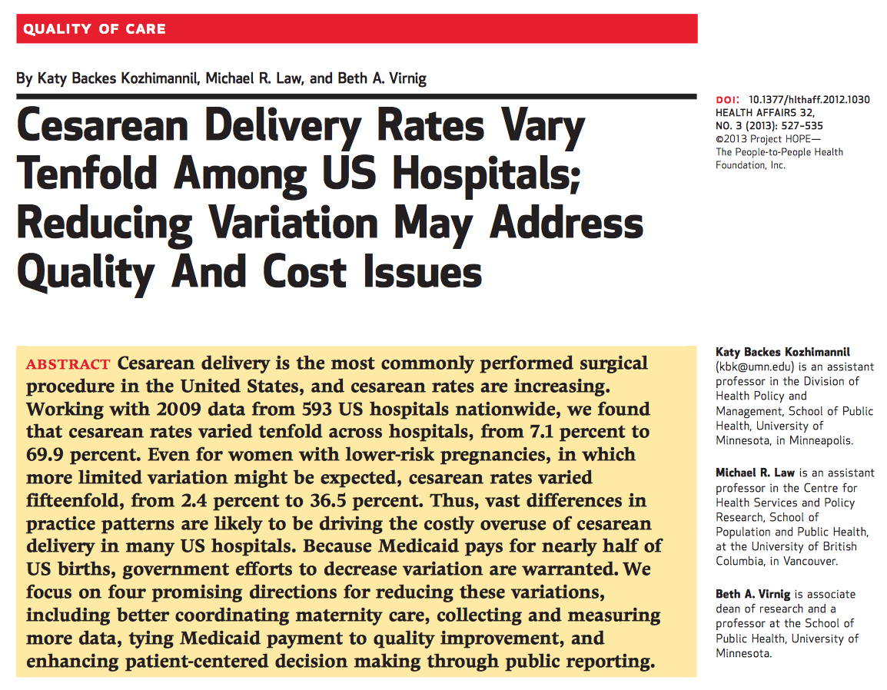
6
Notes:
As this screen shot of a 2013 study shows, when almost 600 hospitals across the nation were evaluated, cesarean rates varied tenfold between hospitals. Furthermore, rates varied FIFTEENFOLD when comparing low risk pregnancies, where one would expect more limited variation.

Slide 7
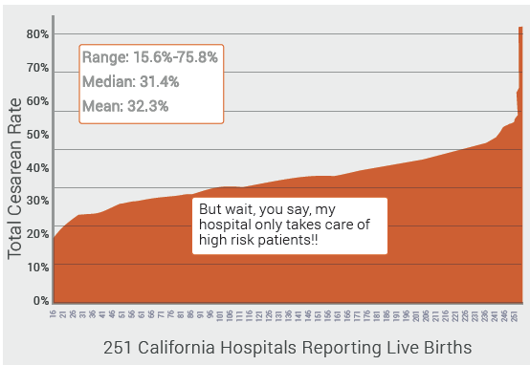
There is a Large Variation in Cesarean Rates Among California Hospitals
Notes:
California hospitals mirror what is happening nationally. In fact, there is roughly a fivefold difference between the best and worst performing hospitals when comparing Total Cesarean Rate between facilities.
The most commonly heard concern when looking at this data is that different hospitals obviously see patients of different risk status e.g. “I see mostly ‘high risk’ patients who no one else will see.” Even providers in the same institution may have widely different case mixes. For this reason, when comparing cesarean rates, the appropriate risk adjustment must be made. Therefore, the NTSV Cesarean Rate is the metric that should always be used for cesarean quality improvement (not the Primary Cesarean Rate or the Total Cesarean Rate), and is the focus of the CMQCC Toolkit and Collaborative to Support Vaginal Birth and Reduce Primary Cesareans. This is also the metric used for reporting by Joint Commission, Medicaid, NQF, LeapFrog Group, etc.

Slide 8
Why focus on Nulliparous Term Singleton Vertex Cesarean Birth?

Slide 9

Why does the Toolkit Focus on NTSV Cesarean Rate?
Nulliparity is a critical risk adjuster because it creates a standardized population that can be compared between providers, hospitals, states, etc
NTSV CS measure is already risk stratified
NTSV is special in that it technically represents the most favorable conditions for vaginal birth, but also the most difficult labor management
The NTSV population is the largest contributor to the recent rise in cesarean rates
The NTSV population exhibits the greatest variation for all sub-populations of cesarean births for both hospitals and providers
Notes:
Nulliparity is the critical risk adjuster because it creates a standardized population that can be compared (between providers, hospitals, states, etc). Hospitals have widely varying rates of nulliparous versus multiparous birth rates. You can understand, then, how a hospital with a high multiparous population would appear to have a much lower primary cesarean rate than a hospital with a higher rate of nulliparous births. Multiparous patients must be removed from the equation.
NTSV CS measure is already risk stratified in that term, singleton, vertex removes many common high risk conditions that vary among hospitals.
- Additionally, while TSV represents the most favorable conditions for vaginal birth, nulliparous labors are the longer and more difficult labors to manage, creating a need for increased focus on labor management and labor support.
- Recent studies have shown the NTSV population to be the largest contributor to the recent rise in cesarean rates AND a population that exhibits the greatest variation (greater variation than women with medical risk factors!), even after controlling for medical, social, and demographic factors. Additionally, while NTSV technically denotes a “low risk” population, it has been referenced as a “low risk but vulnerable population” or, in other words, “a low risk group at highest risk for unnecessary cesarean.”
Refs: Jolles DR. Unwarranted Variation in Utilization of Cesarean Birth Among Low-Risk Childbearing Women. Journal of Midwifery & Women's Health. 2017;62(1):49-57;
MacDorman MF, Menacker F, Declercq E. Cesarean birth in the United States: epidemiology, trends, and outcomes. Clin Perinatol. 2008;35(2):293-307; Pacific Business Group on Health. Report: variation in NTSV c-section rates among California hospitals. 2015. http://www.pbgh.org/storage/documents/PBGH_C-Section_NTSV_Variation_Report_Oct_2015.pdf. Accessed February 7, 2016
Calculation of Nulliparious Term Singleton Vertex Rate (NTSV CS Rate) – TJC PC-02, ACOG, LeapFrog, CMS, Healthy People 2020
D: all first-birth moms who are Term, with Singleton baby, Vertex presentation; N: Denom. Cases with a cesarean

Slide 10
“Still… My NTSV Patients are Higher Risk…”
NTSV CS measure is already risk stratified
However, African-American women continue to have higher NTSV cesarean rates than white women
Age and BMI clearly impact an individual’s CS risk
Formal risk-adjustment analysis using both age and BMI shows that over 2/3 hospitals realize less than 2% change
Age and BMI effects may be provider dependent (more patience for obese women’s labor)
Notes:
As previously stated, NTSV CS measure is already risk stratified in that term, singleton, vertex removes many common high risk conditions that vary among hospitals. However, the only population that the NTSV measures does not adequately adjust for risk is for African-American women, who continue to have higher NTSV cesarean rates. But, keep in mind that these higher rates persist even after controlling for certain medical and social factors, pointing again to provider attributes playing a role in the variation of rates; also remember that until 20 years ago, African American women always had lower CS rates than whites. Furthermore, rates for African American vary greatly from hospital to hospital, again pointing to an opportunity for improvement.
It is important to understand the difference between risks for an individual patient and the accumulated risk for a hospital. Age and BMI clearly impact an individual’s CS risk
Hospital populations of nulliparous women tend to be either older and thinner OR younger and heavier. Adjusting with logistic analysis for both together leads to minimal change in the
Adjusted NTSV CS rate at the hospital level. +/-<2% points in most. Only 6/251 hospitals moved form higher than 23.9% to below, and they were all <26% to start.
The CMQCC Maternal Data Center now shows both unadjusted and adjusted rates for those who are interested.
In addition, both age and BMI effects vary greatly from hospital to hospital (and even physician to physician) suggesting that there is an important part of the risk that is provider driven rather
than inherent in the patient factor.

Slide 11

Effects of Maternal Age and BMI on Hospital NTSV CS Rates:
Green = Hospitals with NTSV CS Rate <25%
RED = Hospitals with NTSV CS Rate >35%
Every “red dot” (high NTSV CS rate hospital) has multiple “green dots” (low NTSV CS rate hospitals) directly adjacent with similar proportions of high maternal age and high BMI.
CMCQQ data presented at PCOGS 2014
(pre-pregnancy BMI used)
Notes:
Lets explain this graphically.
This slide shows the relationship seen among hospitals for their proportion of obesity (BMI>30) on the x-axis and the proportion of older moms (Maternal Age >35) on the Y axis.
Note that there are no hospitals with both high rates of high maternal age and high rates of high BMI. Conversely, there is only one hospital that has low BMI and low rates of high maternal age. We would all love to practice there!!
Hospitals with high NTSV rates (>35%) are shown in red dots and hospitals with lower rates (<25%) are shown with green dots. Note that there are red dots among all ratios of High Age and High BMI. But also note that for every red dot there are several adjacent green dots that have the same ratio of high Age and High BMI, strongly indicating that it is NOT the age and BMI that is driving the high CS rate.

Slide 12
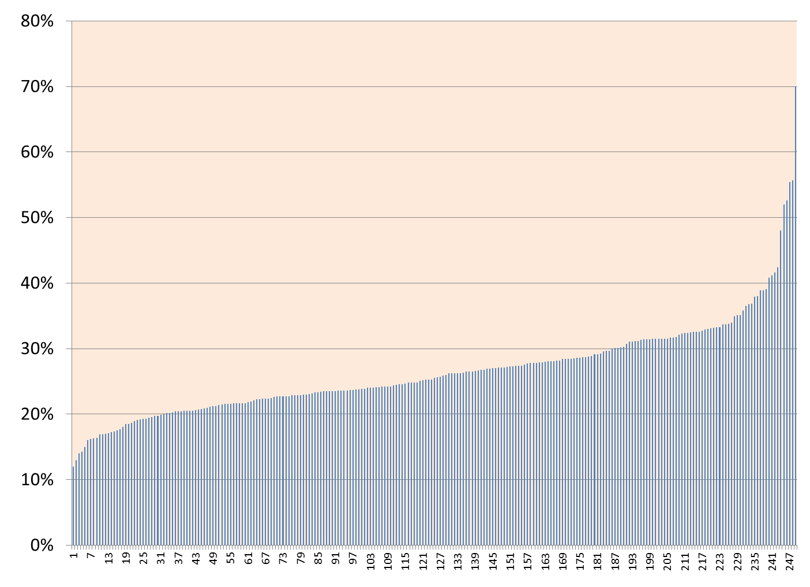
NTSV CS Rate Among CA Hospitals: 2014
(Nulliparous Term Singleton Vertex)
Risk Adjustment did not reduce the variation
Range: 12%—70%
Median: 25.3%
Mean: 26.2%
National Target =23.9%
40% of CA hospitals meet national target
Large Variation =
Improvement Opportunity
Hospitals
12
Notes:
Getting back comparing NTSV cesarean rates between facilities, on this graph each column represents a single California maternity hospital. As you can see, even after adjusting for NTSV, large variation still exists between hospitals, with a range of 12-70%
Variation in rates exists between regions, hospitals, and providers. It also exists between “like” facilities with a similar mix of patients and between providers at the same facility with the same case mix. This unexplained, within-group variation tells us that patient risk level is not driving cesarean rates. Rather, practice style, the overall culture of the labor and delivery environment, and clinical training and decision making are likely at play. Such a large variation means improvement is possible.

Slide 13
What Indications Have Driven the RISE in CS?
 | Percent of the Increase in Primary Cesarean Rate Attributable to this Indication
Cesarean Indication | Yale (2003 v. 2009) (Total: 26% to 36.5%) Focus: all primary Cesareans | Kaiser SoCal (1991 v. 2008) (Primary: 12.5% to 20%) Focus: all primary singleton Cesareans
Labor progress complications (CPD/FTP) | 28% | ~38%
Fetal Intolerance of Labor | 32% | ~24%
Breech/Malpresentation | <1% | <1%
Multiple Gestation | 16% | Not available
Various Obstetric and Medical Conditions (Placenta Abnormalities, Hypertension, Herpes, etc.) | 6% | 20% (Did not separate preeclampsia from other complications)
Preeclampsia | 10%
“Elective” (variously defined) | 8% (Scheduled without “medical indication”) | 18% (Those “without a charted indication”)
60%!
13
Notes:
So where can we focus our improvement efforts?
The indications that have driven the rise in cesarean are an increase in the diagnosis of labor complications such as failure to progress, and fetal intolerance of labor. 60% of the increase in primary cesarean are due to these two indications! It is not more breeches or more previas. Even elective deliveries make a small contribution.
These indications highlight:
The leading indicators are provider-dependent diagnoses (meaning highly dependent upon provider discretion). Further solidifies that variation in cesarean rates is due in part to clinical decision making and culture of the unit.
Also shows the need to improve labor support in order to improve labor progress and prevent dysfunctional labor.
A main focus of educational efforts within your hospital should involve a variety of topics around labor management and labor support. These should include areas for both nursing and physician/providers.

Slide 14
What Indications Drive the VARIATION in CS?
CS Indication | Proportion of Overall CS Rate | Proportion of Primary CS Rate | CS Rate for this Indication
Repeat (prior) | 30-35% | --- | 90+%
“Abnormal Labor” (CPD/FTP) | 25-30% | 35-45% | Highly variable
Fetal Intolerance of labor | 10-15% | 15-20% | Highly variable
Breech/Transverse | 10% | 15-20% | 98%
Multiple Gestation | 5-9% | 10-15% | 60-80%
Other: Placenta Previa, Herpes, etc | ~5% | ~10% | 90%
60%!
14
Notes:
Likewise, the most common indicators for cesarean (abnormal labor and fetal intolerance) account for the greatest variation in rates between hospitals. Again, these diagnoses leave a lot to provider and nurse discretion, which means improvement in possible.

Slide 15

Importance of the First Birth
If a woman has a Cesarean birth in the first labor, over 90% of ALL subsequent births will be Cesarean births
A classic example of
path dependency
If a woman has a vaginal birth in the first labor,
over 90% of ALL subsequent births will be vaginal births
15
Notes:
Finally, the importance of focusing on the first birth cannot be understated. A woman who has a first birth cesarean has a 90% or greater chance of having subsequent cesareans. Similarly, a first birth vaginal delivery pretty much guarantees subsequent vaginal births. Protect the first birth!

Slide 16
Why should we care about CS rates?
16

Slide 17
Why Should We Care?
Rise in total CS rate without maternal or neonatal benefit
  6% in early 70’s
  20% in mid 80’s
  33% in 2010
  Cerebral Palsy rates,
  neonatal seizure rates
  unchanged since 1980
17
Notes:
Until recently, there has been a relentless rise in cesareans without baby or mother benefit. CP rates, neonatal seizures unchanged since 1980. Overall, no benefit for long-term urinary continence, and increased maternal and neonatal morbidity.

Slide 18
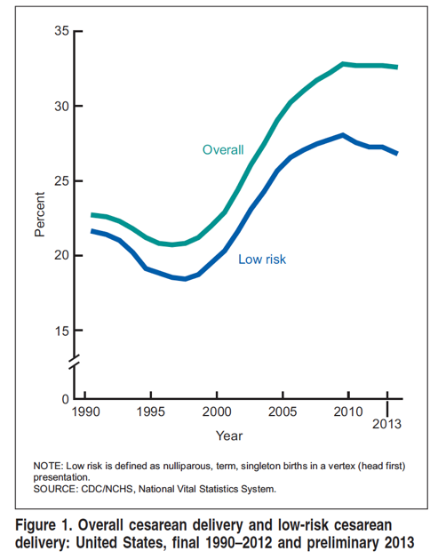
NTSV & Overall Cesarean Delivery Rates in the
United States
50% rise in CS rates over a 10 year period
In CA and the US, cesareans account for 1/3 of all births
(NTSV)
Cesarean is the most common hospital surgery in the US!
Osterman M etal, NVSR vol 63, num 6, Nov 2014
Notes:
There was a sharp increase in overall and NTSV cesareans starting in the late 90s until about 2010 (approximately a 50% increase in CS rates in roughly a 10 year period). California, being the state with the most annual births, tends to mirror what is happening nationally, with cesareans making up a third of all births. Cesarean is now the most common hospital surgery in the US!

Slide 19
Cesarean: Maternal Risks
Acute
Long Term &
Subsequent Births
Common:
Longer hospital stay
Increased pain and fatigue
Postpartum hemorrhage (transfusions ~2%)
Slower return to normal activity and productivity
Delayed or difficult breastfeeding
1/100 to 1/1000
Anesthesia complications
Wound infection
Deep vein thrombosis
1/100 to 1/1000
Abnormal placentation (previas and accretas)
Uterine rupture
Surgical adhesions
Bladder surgical injury
Bowel surgical injury
Bowel obstruction
We perform over 160,000 Cesareans every year in California
19
Notes:
Many of us are familiar with the acute risks of surgery, such as increased pain and fatigue, hemorrhage, and clotting risks. Since the first cesarean is fairly commonplace, relatively quick to perform, and since these acute risks are rare, we don’t often think about the risk to later births. In fact it is the long term risks and risks for subsequent births that are worrisome. The risk of uterine rupture, uterine atony, placenta previa, placenta accreta, and surgical adhesions all increase with each cesarean. By the third cesarean, the risk of placenta previa nearly triples, and roughly 40% of these women with placenta previa will also have placenta accreta. Abnormal placentation results in a step-wise increase in life-threating hemorrhage with every cesarean, and increased risk of hysterectomy.
Many of these serious complications are uncommon, <1%, but since there are over 160,000 cesarean births EVERY year in California, they do add up quickly.
This is particularly true now that we are seeing women with multiple prior CS where the risks do increase significantly.

Slide 20
Maternal Psychological Risks
ACUTE
Delayed and/or ineffective bonding with neonate
Maternal anxiety
LONGER TERM
Post traumatic stress disorder (PTSD)
Postpartum anxiety and depression
20
Notes:
Additionally, psychological stress, anxiety, and post-traumatic stress disorder (PTSD) have been identified as potential risks of cesarean. This is a good tme to mention shared decision making during prenatal, intrapartum care (covered in Part I, or the “Readiness” section, of the Toolkit). We can decrease the loss of control and anxiety women may associate with the cesarean through effective communication.

Slide 21
Cesarean: Neonatal Risks
Increased neonatal morbidity
  Impaired neonatal respiratory function
  Increased NICU admissions
  Affects maternal-newborn interactions including breastfeeding
  No reduction in cerebral palsy rates
21
Notes:
Neonates have not faired much better. With the exception of fetuses in breech presentation, neonates have reaped few benefits with the rising rate of cesarean birth. Cerebral palsy rates have remained unchanged in the past 15 years, and recent evidence indicates that significant health consequences, including higher rates of serious respiratory complications, higher admission to the NICU. A recent study by Black et al, published in December 2015, showed a significantly increased risk in childhood asthma requiring inhaler use and hospitalization. Furthermore, cesarean birth remains a barrier to early breastfeeding support, delays the first feeding, and delays or completely interferes with early skin-to-skin contact, all of which adversely affect the ability to exclusively breastfeed

Slide 22


The Cost… Another Important Reason to Reduce Unnecessary CS
Notes:
Finally, there is the monetary cost to the health system. Studies of actual payments to hospitals and providers indicate that vaginal births cost about 5,000 to 10,000 less than cesarean births. Value in health care = outcomes / cost. The cost of unnecessary cesareans (both economic and human) far outweigh the benefits gained. Achieving high-value maternity care on a statewide or national level (where patient outcomes are prioritized above all else) will prove unachievable if the environment of care remains status quo.
Refs: Pacific Business Group on Health. Report: variation in NTSV c-section rates among California hospitals. 2015. http://www.pbgh.org/storage/documents/PBGH_C-Section_NTSV_Variation_Report_Oct_2015.pdf. Accessed February 7, 2016

Slide 23
Summary of Issues
Extreme variation among hospitals
Rapid rise of rates without neonatal or maternal benefits (indeed can have complications)
Significant consequences for future pregnancies
Monetary cost, combined with the human cost of unnecessary cesarean, undermines the ongoing nationwide effort to provide high value maternity care for all women
But, cesarean births are also life-saving and they have an absolute role in Obstetrics—
making the message to patients:
“They shouldn’t be taken lightly”
23

Slide 24

Why has Cesarean Birth Reduction been so Hard?
Direct challenge to MD autonomy
Complex issue with many contributing factors
Timing just hasn’t been right
Need for professional societies to lead the way
Fear of liability is a big reason!
24
Notes:
Direct challenge to MD autonomy
Complex issue with many contributing factors (including but not limited to culture of the birth unit, provider and nurse education/training, consumer involvement, poor quality of labor support, payment reform, etc.). The toolkit identifies over 20 drivers of unnecessary cesareans!
Timing just hasn’t been right. There is now a consumer and provider driven movement statewide and nationally to reduce rates.
Need for professional societies to lead the way, which they are now doing in collaboration with one another (AIM, ACOG, ACNM, AWHONN, etc)
Liability – see next slide

Slide 25
OB Quality Improvement and Safety Efforts Help to Decrease Liability
Utilize evidence-based best practice protocols that follow national consensus
(e.g. oxytocin)
Utilize expert-vetted standardized approaches
for labor and fetal heart rate abnormalities
Communication techniques which engage the patient in “shared decision making” creates a strong deterrence to lawsuits
Reducing primary cesareans, protects against
post-cesarean complications and poor outcomes during future care
25
Notes:
While we acknowledge that the fear of liability is a real fear, CMQCC has been working with the major liability carriers who stress that the principles of OB quality and safety actually help to decrease liability. These principles should serve as a your guide for a safe cesarean reduction program. Additionally, the release of the ACOG guidelines for safe reduction of primary cesareans is very helpful in this matter.

Slide 26

It takes a Village to Reduce Unnecessary Cesareans
Insurers/Employers
Public Policy/Medicaid
Data-driven QI Projects
Public Advocates/ Consumers
Prof Orgs (Natl and Local)
Notes:
It truly does take a village to reduce cesareans. A collective impact approach is needed, and CMQCC has been working hard to engage all stakeholders. [click mouse for animation] Today we are focusing only on clinical efforts in the hospital setting but it is important to note that this is only one part of a bigger picture. Nonetheless, your role as providers and nurses is the most important of all of these things because the buck stops with you. Change starts with you.

Slide 27
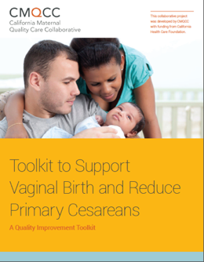
The CMQCC Toolkit
Comprehensive, evidence-based “How-to Guide” to reduce primary cesarean delivery in the NTSV population
Will be the resource foundation for the CA QI collaborative project
The principles are generalizable to all women giving birth
Released on the CMQCC website April 28, 2016
Has a companion Implementation Guide
27
Notes:
Important to note: although geared towards first birth cesarean, the principles are generalizable to most women giving birth.

Slide 28
CMQCC Supporting Vaginal Birth Taskforce
Writing Group
Obstetricians
MFMs
Certified Nurse Midwives
Registered Nurses
Educators
Doulas
Hospital Leaders
Public Health
Review Group
ACOG leaders
AWHONN leaders
ACNM leaders
SOAP (Society of Obstetric Anesthesia Providers) leaders
California Hospital Association
Medical Liability providers
Several Hospital Systems
Over 50 Contributors
28
Notes:
Over 50 expert writers and advisors.
Multidisciplinary group for writing and reviewing.
We wanted all who are caring for laboring women to participate!

Slide 29
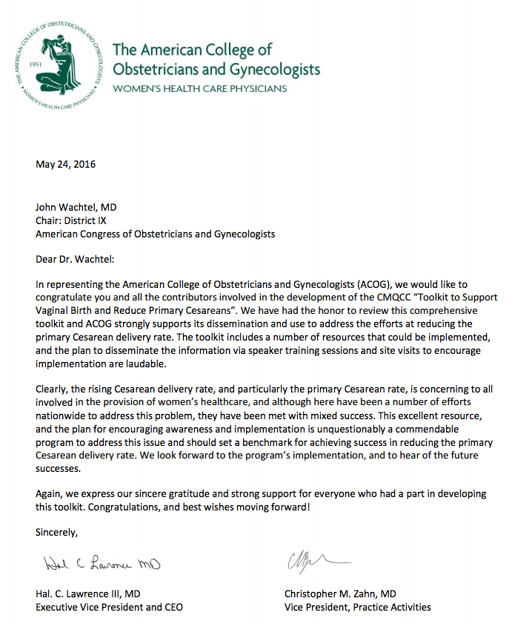
We have had the honor to review this comprehensive toolkit and ACOG strongly supports its dissemination and use to address the efforts at reducing the primary Cesarean delivery rate.
This excellent resource, and the plan for encouraging awareness and implementation is unquestionably a commendable program to address this issue and should set a benchmark for achieving success in reducing the primary Cesarean delivery rate.
29
Notes:
Pleased to have support from our professional organizations. Letter of support from ACOG National is shown here. This is truly exceptional as they almost never support materials not internally created.

Slide 30

When using a toolkit, you don’t need to use every tool, you just need to pick the right ones for the job
Notes:
So let’s get into the toolkit. First, a couple caveats.
First… understandably, QI programs for cesarean reduction will differ between facilities. The expectation is not that each facility will implement every tool or concept introduced in the toolkit. Rather, each facility should implement and/or adapt the tools and concepts that will best improve NTSV cesarean rates according to the unique needs of the organization.

Slide 31

First and foremost, it should be understood that a labor support and cesarean reduction program seeks to reduce unnecessary cesarean births. The program’s charter must clearly recognize that timely and well-chosen cesareans are sometimes necessary to prevent avoidable fetal and maternal harm.
31
Notes:
Secondly, a safe cesarean reduction should not aim to reduce cesareans at all costs! Well-chosen cesareans are necessary to prevent avoidable fetal and maternal harm.

Slide 32
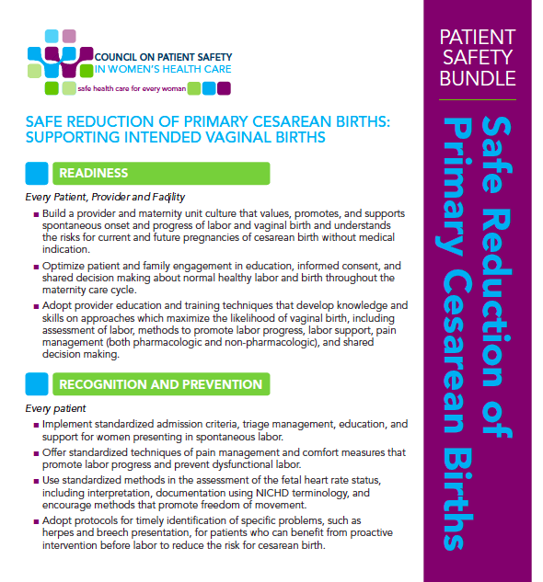
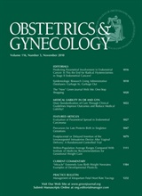
The Toolkit is Aligned with the ACOG/SMFM Consensus Statement and the AIM Patient Safety Bundle
  Readiness
  Recognition and Prevention
  Response to Every Labor Challenge
  Reporting
Notes:
AIM, the Alliance for Innovation on Maternal Health, is a multi-stakeholder collaboration between many organizations, including ACOG, ACNM, AWHONN, American Academy of Family Physicians, and many others. Over the years, they’ve created various maternity safety bundles. The AIM bundle is basically a roadmap, or a small set of evidence-based practices that, when performed all together, improve patient outcomes.
The Toolkit translates the AIM Safety Bundle into an easy-to-use “menu” of tools and practical approaches. Each section of the toolkit mirrors the 4 domains of the AIM Bundle: Readiness, Recognition and Prevention, Response, and Reporting.

Slide 33

READINESS
Developing a maternity culture that values, and supports intended vaginal birth
33

Slide 34
Strategies to Improve Readiness
Readiness
Create a unit culture to support intended vaginal birth
Improve access and quality to modern childbirth education
Improved shared decision making at critical points
Bridge provider knowledge and skills gap
Payment reform: Transition from paying for volume to paying for value
34
Notes:
The toolkit identifies these four strategies to improve Readiness.
What is the culture of your unit?
CMQCC is creating a survey to measure attitudes/beliefs of the nursing physician staff. This will be used in two fold manner – to help hospitals determine what areas of their culture need attention to support intended vaginal birth as well as an overall assessment of the relationship between unit personnel attitudes and beliefs in relation to their NTSV rate.
Since a decreasing number of hospitals are directly involved with their childbirth education classes, it is important to meet often with community led classes to ensure information is current in relation to your facility and evidence.
Because a first cesarean is quite safe by today’s standards, the future risks of multiple repeat cesareans, such as the considerable step-wise increase in life threatening hemorrhage, may not be fully appreciated or considered by some providers

Slide 35
Examples of Readiness Tools included in Toolkit
Readiness
Sources of best childbirth education tools
Tools/policies/concepts of “mother friendly” hospital
Approaches to shared decision making and training aspects
35
Notes:
The toolkit outlines several critical times for communication with the woman and creates the opportunity for shared decision making. Some of these key points include:
Choice of provider and/or facility for prenatal care and care at time of birth
Timing of admission to hospital (admission to labor and delivery while still in the latent/early phase is associated with an increased risk of cesarean)
Choice of fetal monitoring method (continuous monitoring is associated with an increased risk of cesarean)
Whether to have continuous labor support by a trained caregiver like a doula (continuous labor support improves chances of having a vaginal birth)
Induction of labor without medical indication (depending on the provider and facility)

Slide 36
Sharing in decision making:
The SHARE Model
S
Seek
Readiness
Seek the patient’s participation
H
Help
Help her explore each option and
the corresponding risks and benefits
A
Assess
Assess what matters most to her most
R
Reach
Reach a decision together and arrange
for a follow up conversation
E
Evaluate
Evaluate her decision (revisit the decision and assess whether it has been implemented as planned)
The SHARE approach. Agency for Healthcare Research and Quality Website. http://www.ahrq.gov/professionals/education/curriculum-tools/shareddecisionmaking/index.html. Accessed December 1, 2015.
36
Notes:
Shared decision making is a collaborative process between the provider and patient that “takes into account the best available scientific evidence, as well as the individual’s values and preferences, to determine the right course of care.” Shared Decision Making requires a cultural change in how care is delivered and includes specific communication techniques.
At a minimum, providers and nurses should understand that there are FIVE critical decision points that occur during the prenatal and intrapartum period that impact the risk of cesarean and that each woman should be prepared to decide in a shared fashion with her provider and nurse. Obviously, prenatal preparation for this is very important.
By identifying the major decision points that most impact the risk for cesarean birth, providers can markedly improve the patient’s knowledge deficit and decision making.

Slide 37
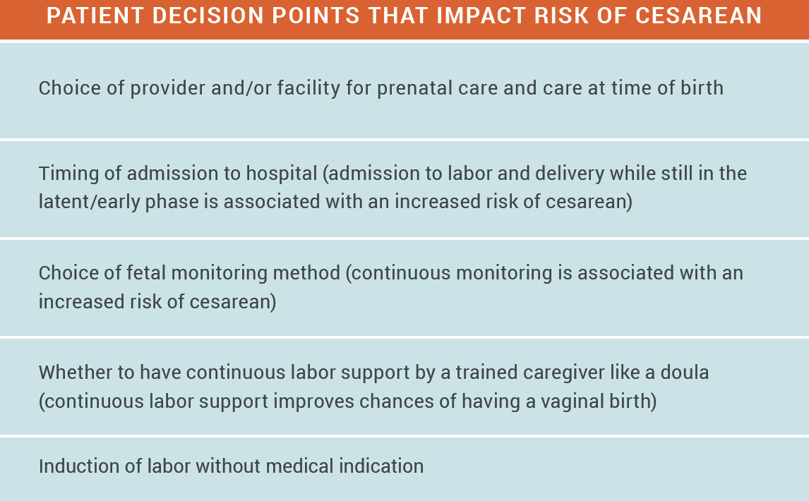
Shared Decision Making (continued)
Notes:
Various patient/consumer decision points may impact risk of cesarean. “Shared decision making at critical points in care” means targeting various prenatal discussions (well before the onset of labor!), or honing in on opportunities for patient engagement that promote discussion on these major decision points, which include: timing of admission to labor and delivery, choice of fetal monitoring for low-risk patients, the choice to have/bring continuous labor support, and induction of labor without medical indication. Every woman should be made aware that these choices impact the risk of cesarean.

Slide 38
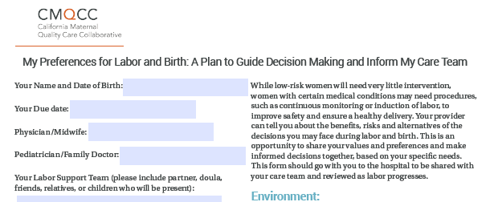
Birth Preferences Worksheet
Collaborate with healthcare provider to determine birth preferences
Tailor choices to what is available at each facility
Readiness
Example available in the toolkit
38
Notes:
To that end, one of the tools included in the toolkit is a “Birth Preferences Worksheet” (or birthplan). Included in this plan are questions that specifically ask about the critical decision points.

Slide 39
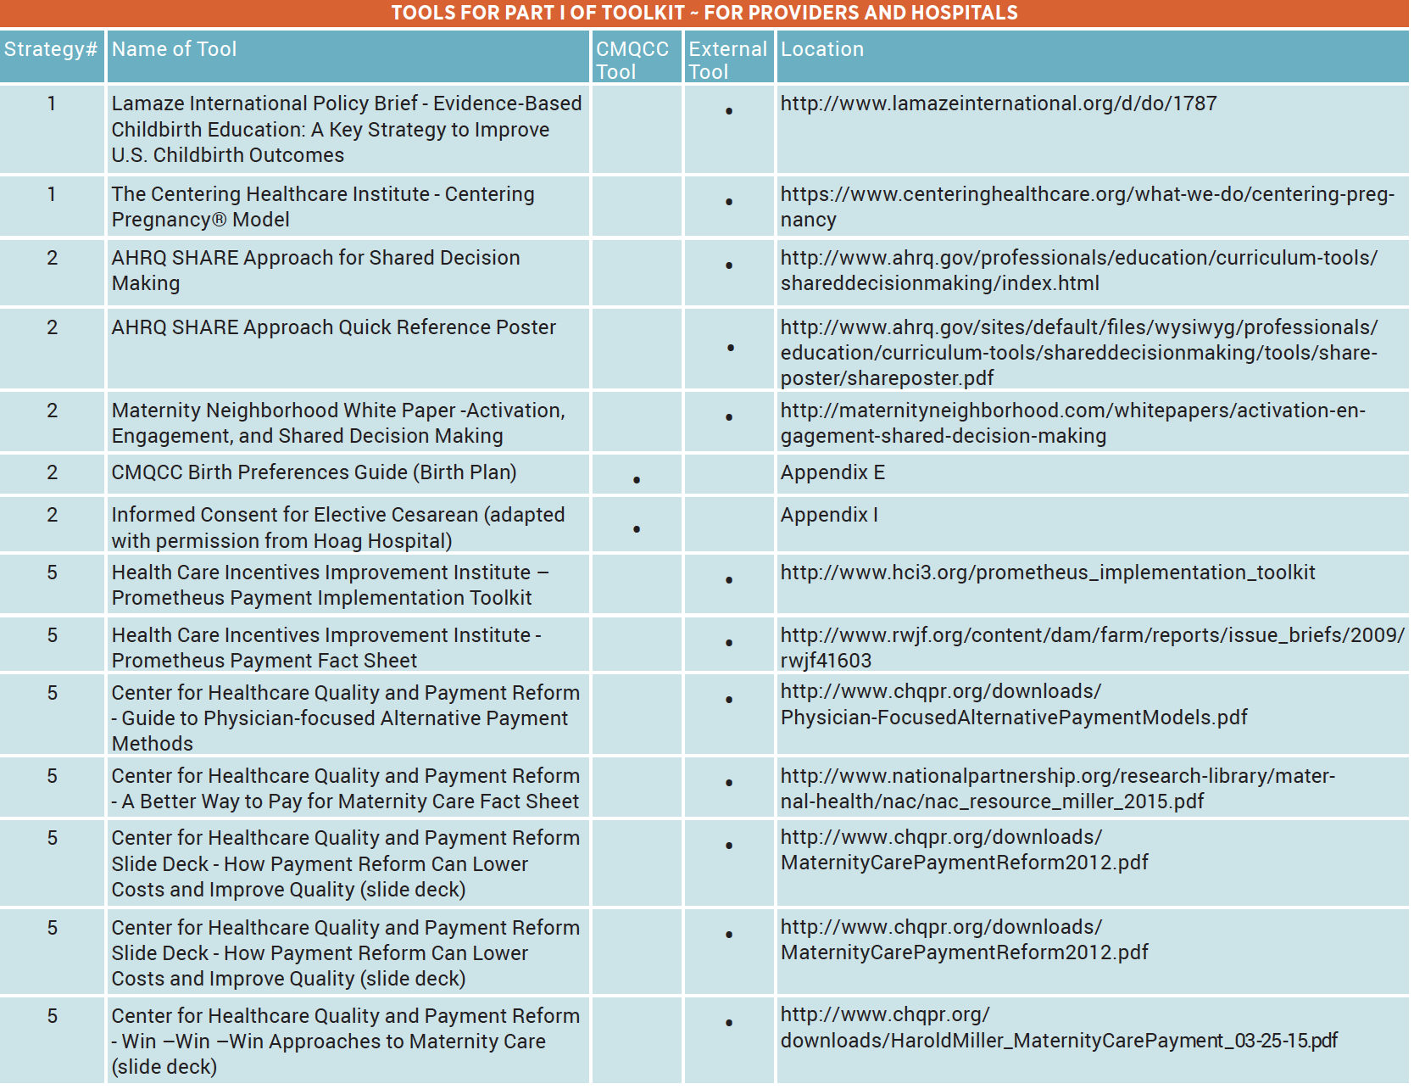
Many More Tools in this Section… Over 20
Readiness
Notes:
\

Slide 40



What about women who request a Primary Cesarean Birth?
It is important to communicate early and often during the prenatal period to alleviate any fears related to incomplete information
Fear of pain is a common concern. Work with her to identify good labor support personnel
Provider guidance is critical. Different approaches and attitudes reflect different rates
Incidence is less than 1%
Notes:
While a very small portion of women may desire a pre-labor cesarean, data from this Listening to Mother’s survey do not support the suggestion that maternal requests for cesareans contribute significantly to the high cesarean rate. To the contrary, the evidence indicates that women prefer vaginal birth — less than 1% of women reported choosing a non-medically indicated cesarean for their first birth. In Appendix I of the toolkit is a very detailed informed consent for women desiring elective cesarean. It outlines, in detail, the risk of the 1st surgery and the subsequent risks with each cesarean.

Slide 41
RECOGNITION AND PREVENTION
Key Strategies for Supporting
Intended Vaginal Birth
41

Slide 42
Strategies to Support Intended Vaginal Birth
Implement policies that reduce routine intervention and support normal processes
Implement early labor management and supportive care policies for the early labor period
Utilize other labor support personnel (e.g. doulas)
Improve supportive care overall (RN labor support, infrastructure/equipment)
Utilize best practices for regional anesthesia
Implement protocols for intermittent monitoring
Implement protocols for modifiable conditions like HSV and breech position
Recog/Prevent
42

Slide 43
Examples of Recognition/Prevention Tools included in Toolkit
Recog/Prevent
Model policies for intermittent monitoring, freedom of movement, early labor support, etc.
Recommendations and guidelines for supporting normal progress in labor
Coping with labor algorithm
Guidelines for working with doulas
Patient education and decision guides
Over 30 tools/guides in this section alone
43
Notes:
Previous educational webinars through CMQCC collaborative also complement these tools including webinars in:
Intermittent Auscultation and Intermittent Monitoring
Implementing the Coping with Labor Algorithm
The Benefits of Doula support during Labor

Slide 44

“Pregnancy and birth are physiologic processes, unique for each woman, that usually proceed normally. Most women have normal conception, fetal growth, labor, and birth and require minimal-to-no intervention in the process.”
Notes:
Despite the fact that most women are at low-risk for complications, the vast majority of women who deliver in hospitals are faced with liberal use of common obstetric interventions and procedures, including:
routine use of pitocin
continuous fetal monitoring
induction of labor.
This suggests that many providers may not fully appreciate their role in preventing cesarean through a more judicious use of interventions. Early labor tends to be where many providers routinely intervene.

Slide 45
Why Support of Early Labor is Important
Physiologic onset of labor is critical to the success in labor, and introduces moms and babies to protective hormonal pathways
Women admitted in early labor are more likely to have a cesarean and more likely to have routine interventions e.g. oxytocin even if not clinically necessary
Translation: Early labor at home. Let labor start on its own!
Recog/Prevent

Slide 46
Tools and Recommendations for Early Labor Support included in the Toolkit
Recog/Prevent
Checklist/algorithm for spontaneous labor and recommendations for active labor admission policies
Recommendations for latent labor support if admitted, and therapeutic rest as alternative to admission
Patient education materials and specific guidance for partners and family members as to how to best support the woman in early labor

Slide 47

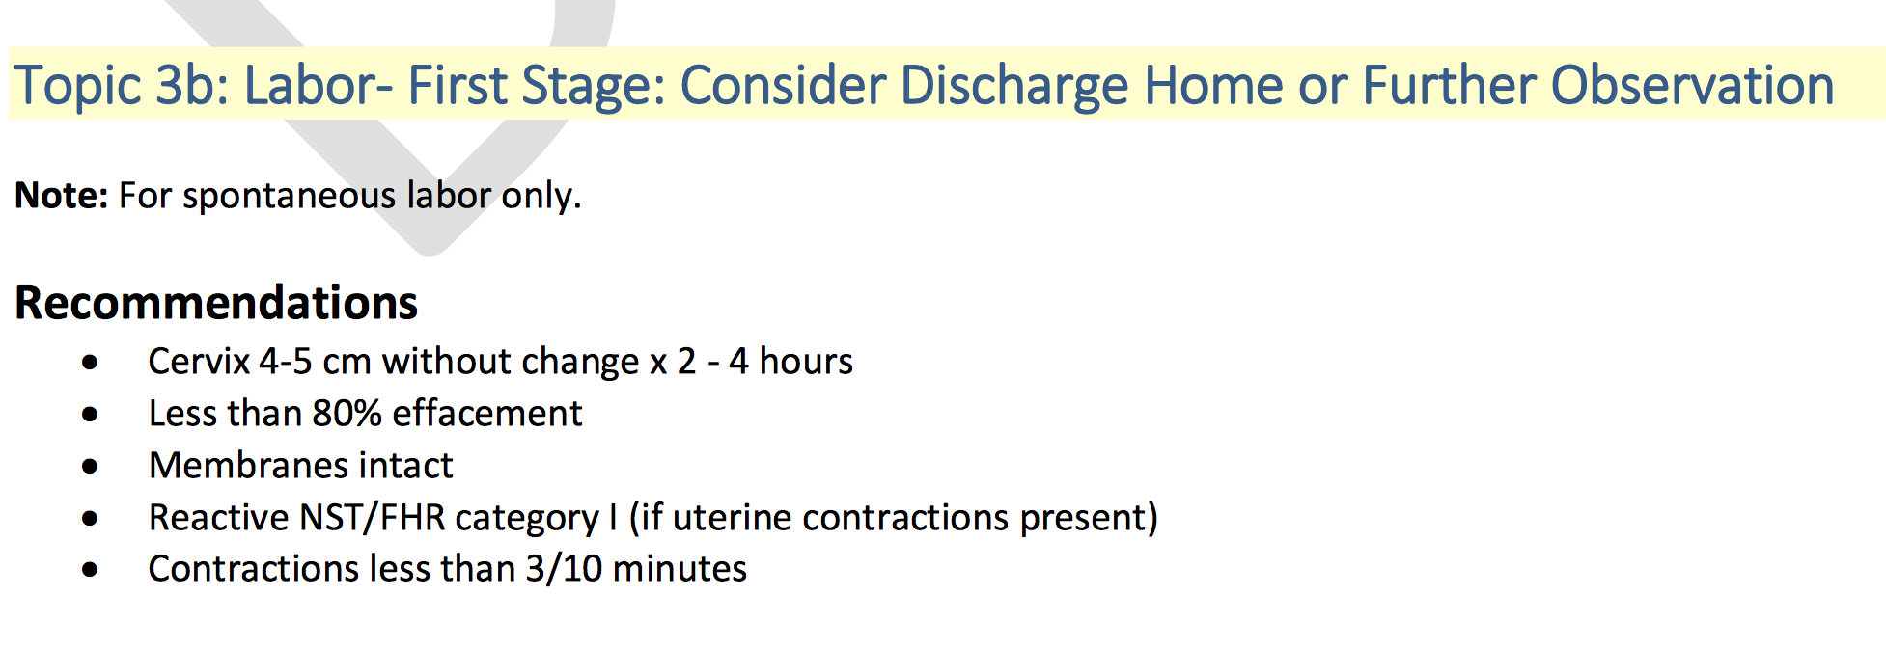
Toolkit contains weblinks to resources that support early labor and establish criteria for active labor admission
Recog/Prevent
Notes:
The toolkit contains MANY weblinks to open-source, vetted clinician and patient information that will assist with policy creation, such as the Safe Deliveries Roadmap from Washington State Hospital Assocation, and more.

Slide 48

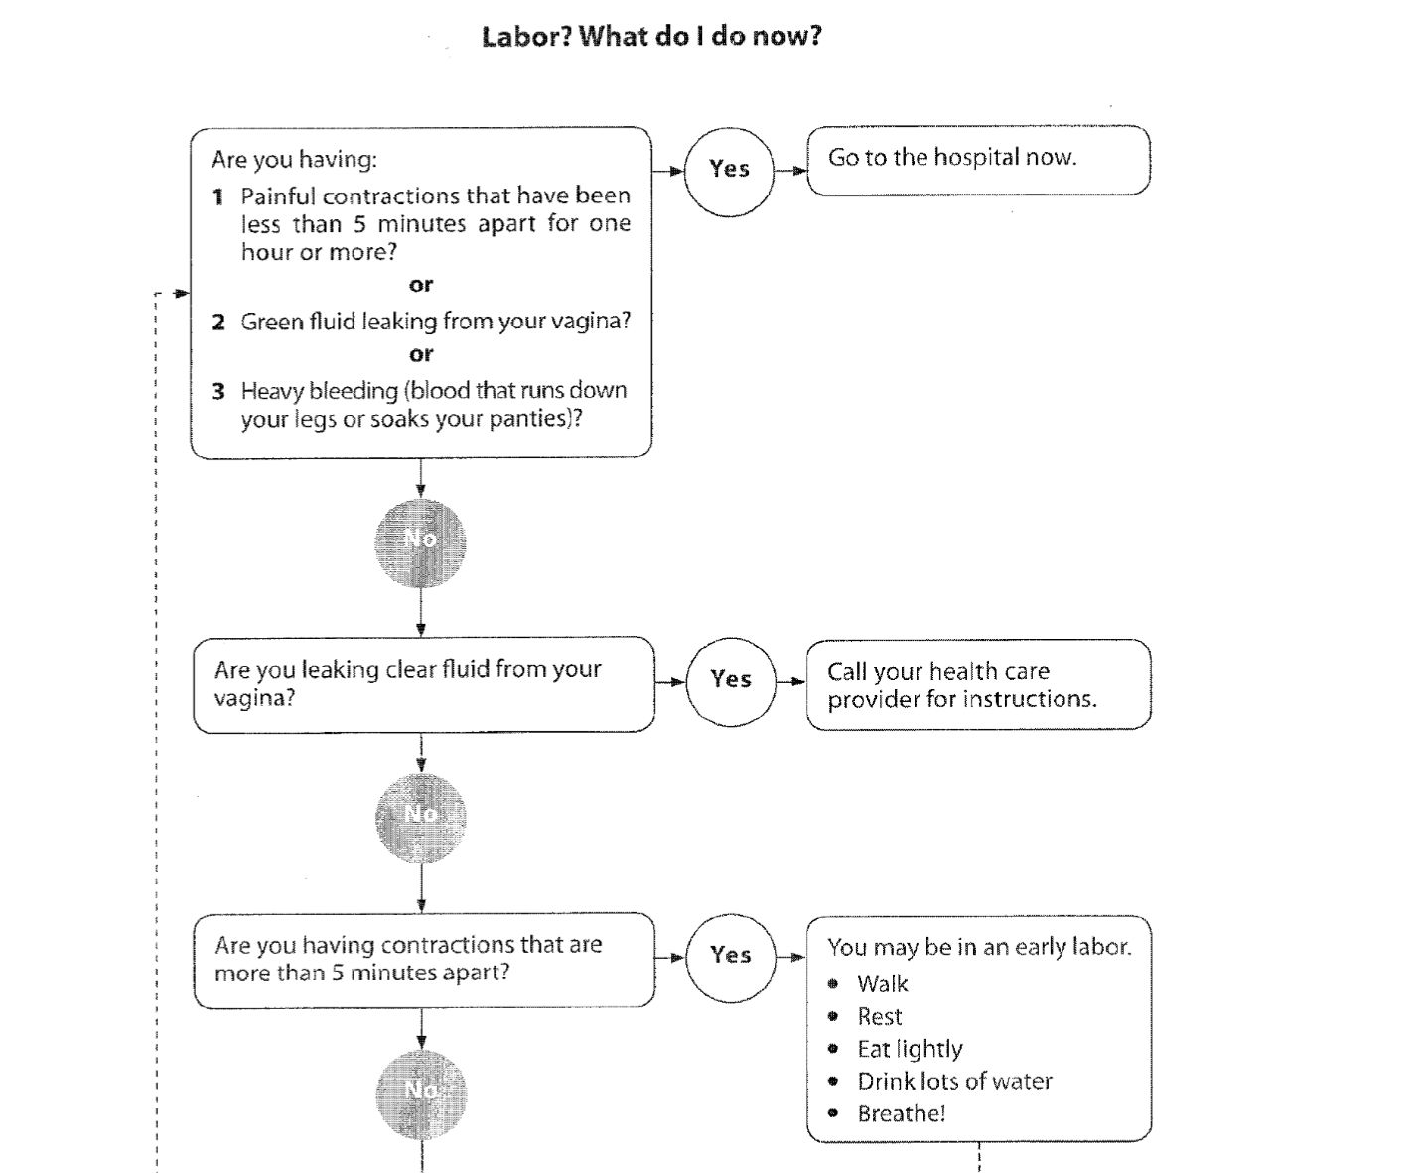

Many patient resources and decision aids for
early labor
Recog/Prevent
Notes:
Right: Lamaze infographic that can be distributed to patients in clinic or on the unit. Bottom: ACNM’s algorithm for early labor, to be used by patients as a decision aid.

Slide 49

Provide Continuous Labor Support
Recog/Prevent
Less likely to have a cesarean birth
Slightly shorter labor
Improved patient satisfaction
Less likely to need vac/forceps
Less likely to use pain medication
Better Apgar scores
Notes:
Improved labor support is key to reducing cesarean birth. Many studies have outlined the benefit of continuous labor support. Specifically as it relates to cesarean reduction, the ability to improve comfort and decrease anxiety according to each woman’s unique needs and preferences is fundamental to promoting progress and reducing dysfunctional labor.
Refs: Hodnett ED, Gates S, Hofmeyr GJ, Sakala C, Weston J. Continuous support for women during childbirth. Cochrane Database Syst Rev. 2011(2):CD003766)
Photo used with permission from Jennifer Winfrey photography http://jenniferwinfrey.com]

Slide 50
Key Components of Labor Support
Freedom of movement
Techniques and tools to facilitate fetal rotation, flexion, and descent
  Know what your labor beds can do
  Birthing balls / peanut balls
  Upright and ambulatory positioning
  Nonpharmacologic comfort measures
Intermittent monitoring, or telemetry if continuous monitoring is necessary
Recog/Prevent
Notes:
The toolkit outlines the key components of labor support.
Important talking point: Nonpharmacologic comfort measures are beneficial to every woman. These concepts apply to women with and without epidural anesthesia. In many cases, nonpharmacologic measures like positioning to prevent or treat malposition are even more important in the epiduralized woman who has a 2-4x higher likelihood of a malpositioned fetus than a woman without epidural anesthesia.

Slide 51
Key Components of a Supportive Physical Environment
Recog/Prevent
  Low lighting and privacy
  Comfortable space with adequate room for movement and walking
  Adequate availability of non-pharmacologic coping tools such as tubs or showers, rocking chairs, birthing balls, squat bars, and peanut balls
  Freely available snacks with high nutritional value
Notes:
Labor support is important, and the physical environment is just as important.

Slide 52
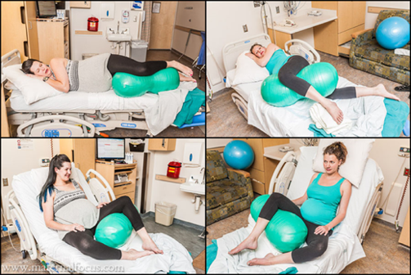
Peanut Ball
Recog/Prevent
Decreased length of labor
Decreased CS rate in patients
with epidurals
Tussey, C. M., Botsios, E., Gerkin, R. D., Kelly, L. A., Gamez, J., & Mensik, J. (2015). Reducing length of labor and cesarean surgery rate using a peanut ball for women laboring with an epidural. The Journal of Perinatal Education, 24(1), 16-24. http://dx.doi.org/10.1891/1058-1243.24.L16
52
Notes:
Peanut Balls are particularly useful among women with epidurals to help prevent/treat OP presentations. Just one of the tools discussed in the toolkit.

Slide 53
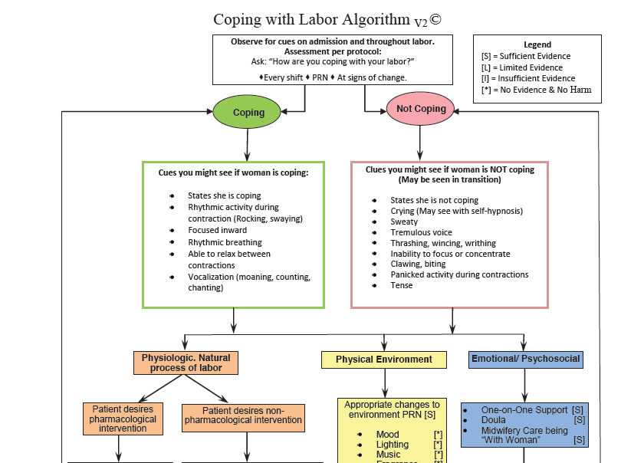
Coping with Labor Algorithm
Full size version
in the toolkit
Recog/Prevent
Notes:
The Coping with Labor Algorithm is meant to take the place of the standard numeric pain scale. Rather than telling a pain score, it allows the nurse to asses whether a patient is coping or not coping. If not coping, the algorithm gives suggestions for what to try next. In some cases, this might be epidural or narcotic. In many cases it includes nonpharmacologic methods. A webinar recording for the implementation of the Coping with Labor Algorithm, presented by the algorithm’s creator, is located on the CMQCC website.

Slide 54
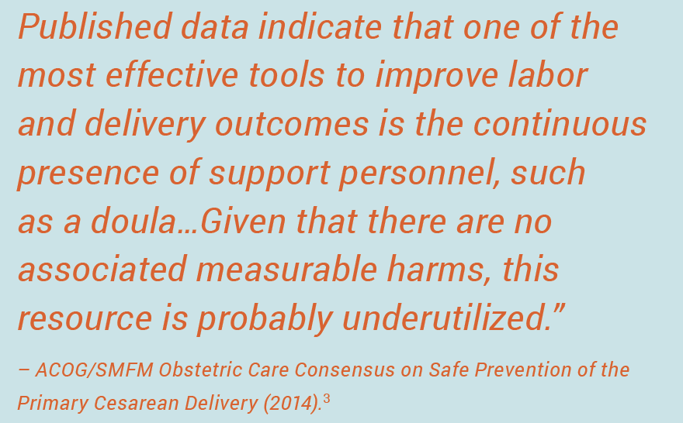
Doulas
Recognition
Notes:
Nurses in this day and age cannot provide continuous labor support. And in some cases, nurses are underprepared to provide effective labor support. Regardless of the reason, doulas offer an effective tool for reducing cesareans and are significantly underutilized.
Check out the Doula webinar recording on the CMQCC website. More doula webinars will be coming soon, with a focus on how to better utilize community based doula services and how to implement hospital based volunteer programs.

Slide 55

Implement Intermittent Monitoring for Low-risk Patients
Continuous monitoring:
Increases the likelihood of cesarean
Has not been shown to improve neonatal outcomes e.g. reduce rates of CP
Restricts movement (and normal physiologic processes and coping)
Potentially reduces nursing interaction/ labor support
Recognition
Notes:
The toolkit aims to create intermittent monitoring as the default method of monitoring for all patients who do not meet certain exclusion criteria/risk factors. This would in essence make it necessary for providers to write an order for continuous monitoring, the opposite of what is currently required at most facilities. The toolkit includes model polices, how to implement a program of intermittent monitoring for low-risk patients, and exclusion criteria for intermittent monitoring.

Slide 56
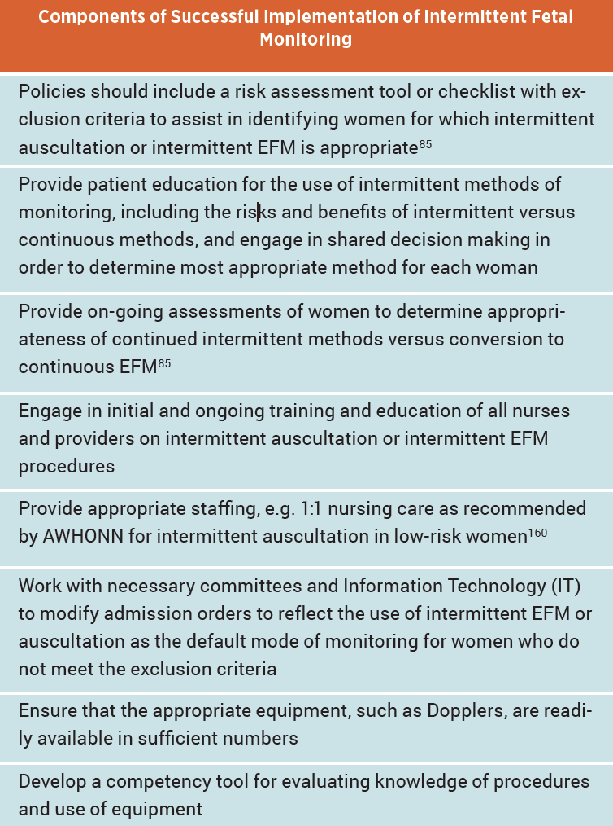
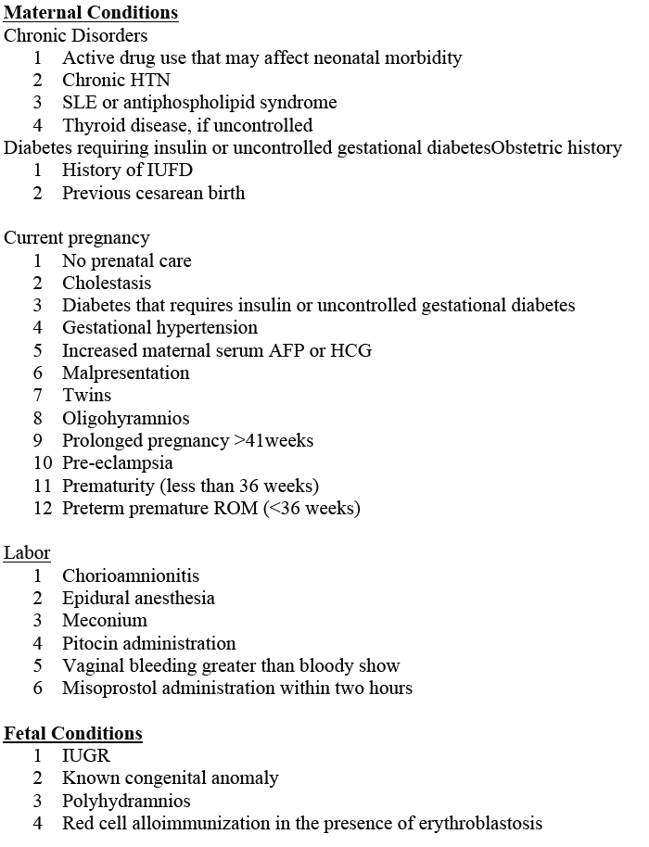
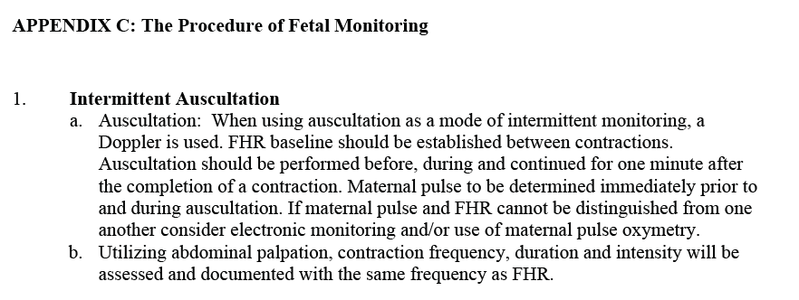
Toolkit includes policies and guidelines for Intermittent Monitoring
Recognition
Notes:
Screenshot of the various policies, exclusion criteria, and other guidance included in the toolkit for intermittent monitoring.
Also, the webinar recording on the CMQCC website for implementation of intermittent monitoring is a valuable tool.

Slide 57
RESPONSE
Management of Labor Abnormalities
57

Slide 58
Strategies for the Appropriate Management of Labor Abnormalities
Response
Create highly reliable teams and improve interdisciplinary communication
Adopt standard definitions and approaches for labor and FHR abnormalities
Utilize operative vaginal deliveries in appropriate cases
Identify malposition and perform manual rotation
Develop alternative coverage patterns such as hospitalist/midwives
Develop systems that facilitate the safe transfer of care from the out-of-hospital environment
Avoid defensive medicine: focus on quality and safety!
58

Slide 59
Labor Management Tools included in the Toolkit
Spontaneous labor algorithms/dystocia checklists
Induction algorithms/checklists/policies for timing, scheduling, and proper selection
Algorithms for standard intervention for FHR changes
Model policies for oxytocin
Tools for effective communication
Response
Approximately 30 tools available in this section
59

Slide 60
Toolkit outlines Four Specific Areas of Standardization
Response
Diagnosis of labor dystocia
Safe use of oxytocin
Response to abnormal heart rate patterns
Induction of labor
Notes:
The toolkit recognizes four specific areas where standardization could significantly improve safety and quality, guide decision making for appropriate use of cesarean birth, and promote patience and vigilance when indications for cesarean are not present. [click mouse for animation] Since time is limited, we will discuss only the tools and recommendations for labor dystocia.

Slide 61
patience
Response
“Slow but progressive labor” in the first stage is not an indication for cesarean
“Prolonged latent phase” as defined by previously by Friedman is not an indication for cesarean
6 is the new 4 (Zhang/Consortium on Safe Labor)
Longer pushing times may be necessary (epidural; malposition)
Notes:
It is easy to over-diagnose labor dystocia if the incorrect parameters are used. New guidelines regarding contemporary labor patterns make it clear that greater clinical patience is needed, and this is reflected in the ACOG/SMFM Consensus Statement for cesarean reduction. Despite the findings by Zhang et al and the Consortium on Safe Labor, general institutional acceptance of this new labor curve has been slow. Various maternal factors should also be considered before making the diagnosis of labor dystocia. For example, longer labors are more likely in older women, obese women (BMI equal to or greater than 30), and those with epidural anesthesia. Bottom line: have more patience! How do we reinforce this on the unit? [see next slide..]

Slide 62
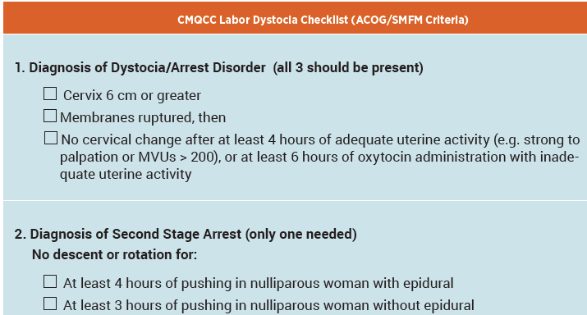
Example of ACOG/SMFM Labor Dystocia Checklist in toolkit
Response
62
Notes:
To help guide the provider and nurse in deciding whether a patient’s labor is truly prolonged or stalled, various dystocia checklists and pre-cesarean checklists are included in the toolkit, which are basically the ACOG guidelines reduced to a case review checklist.
[Another possible talking point: this checklist would also be a good way to begin to evaluate your NTSV cases prior to any QI implementation efforts. A form to assist your hospital in this audit is available on the CMQCC website under “Collaborative Resources” and additional support is built into the CMQCC Maternal Data center. Instructions for completion are in the Implementation Guide which is also available on the CMQCC website.]

Slide 63
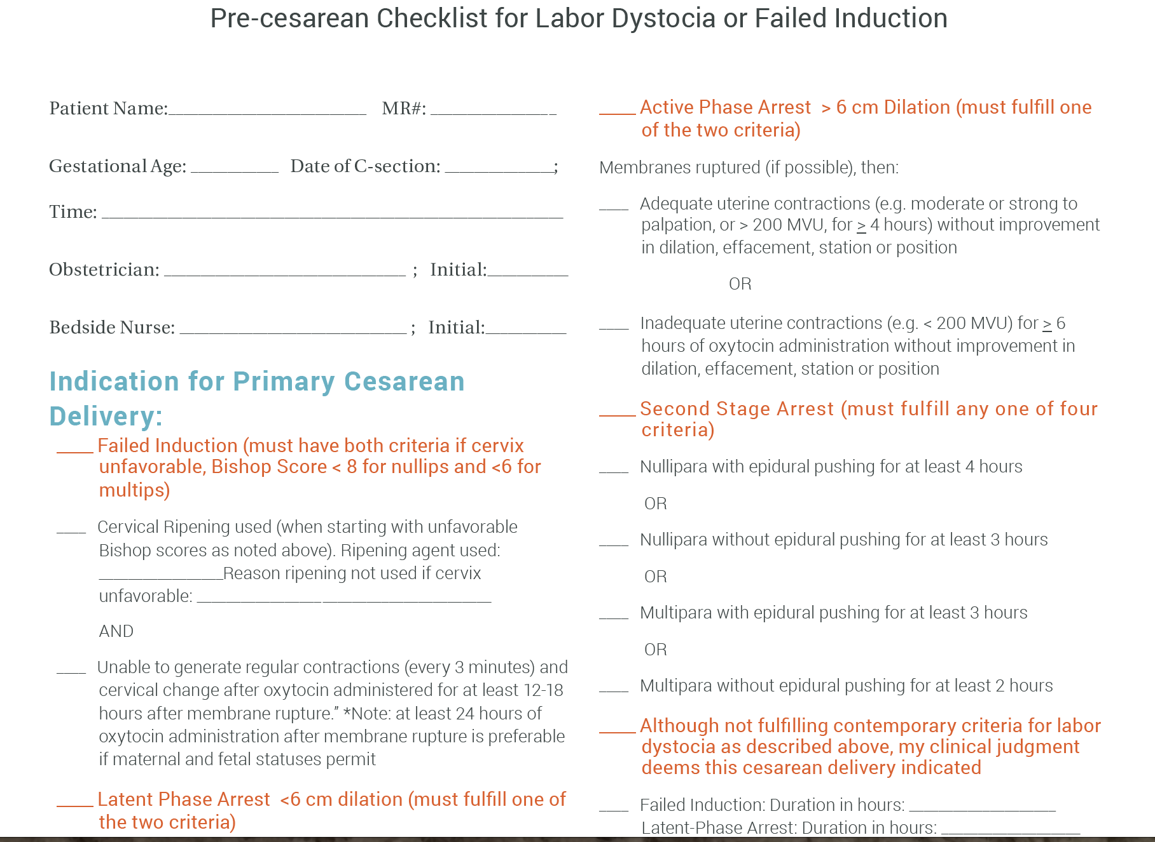
Pre-Cesarean Checklist for Labor Dystocia available in Toolkit
Notes:
Pre-cesarean checklist can easily be used as a decision-making and communication tool before surgery and later as an audit tool when cases are reviewed.

Slide 64
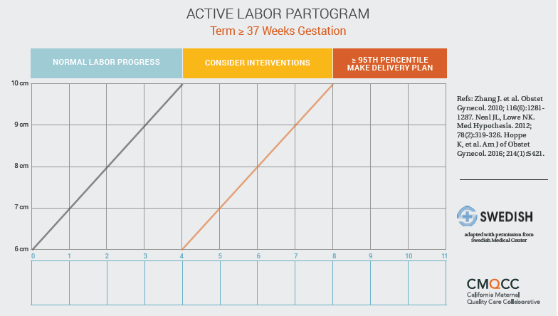
Active Labor Partogram
Available in Toolkit
Response
64
Notes:
Easy-to-use partogram is in the toolkit. Most partograms are underutilized because of perceived difficulty for use. This is one is easy to understand!

Slide 65
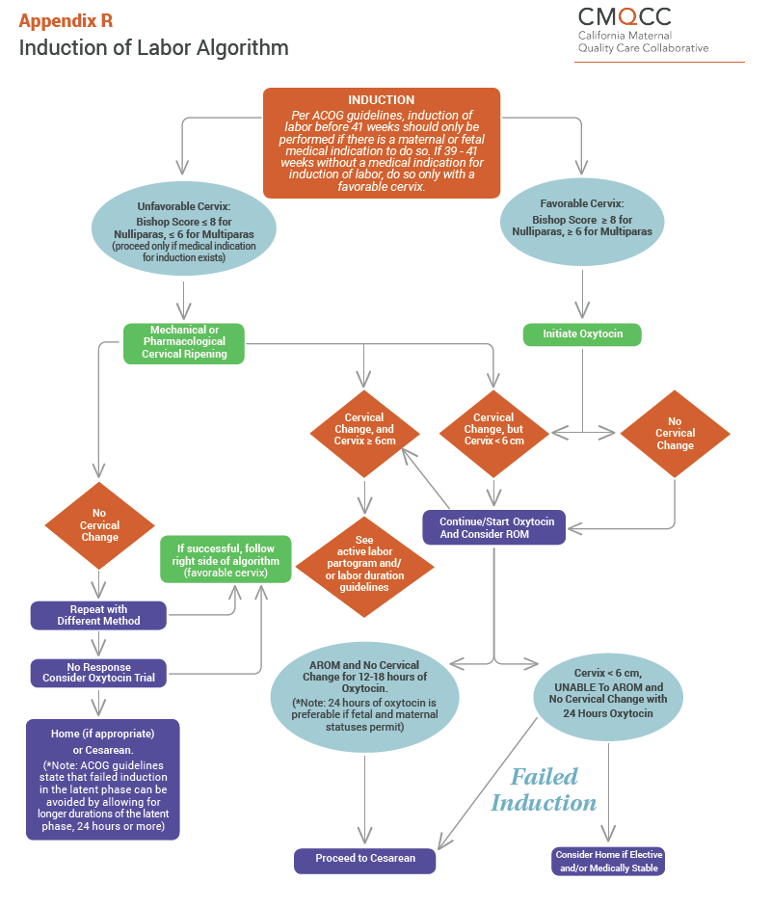
Notes:
Other very useful tools in Response section of the toolkit…
Induction of Labor Algorithm to help determine if an induction is truly a failed induction.
There is also a Spontaneous Labor Algorithm in the toolkit.

Slide 66
Prevention and Management of Malposition
Avoid routine early amniotomy
Employ preventive measures for women with epidural anesthesia
Intrapartum maternal/fetal positioning
Consider pushing positions
Support maternal psyche and body
Manual rotation
Patience, patience, patience!
Response
Notes:
There is an entire appendix (Appendix G) dedicated to prevention and treatment of malposition.

Slide 67
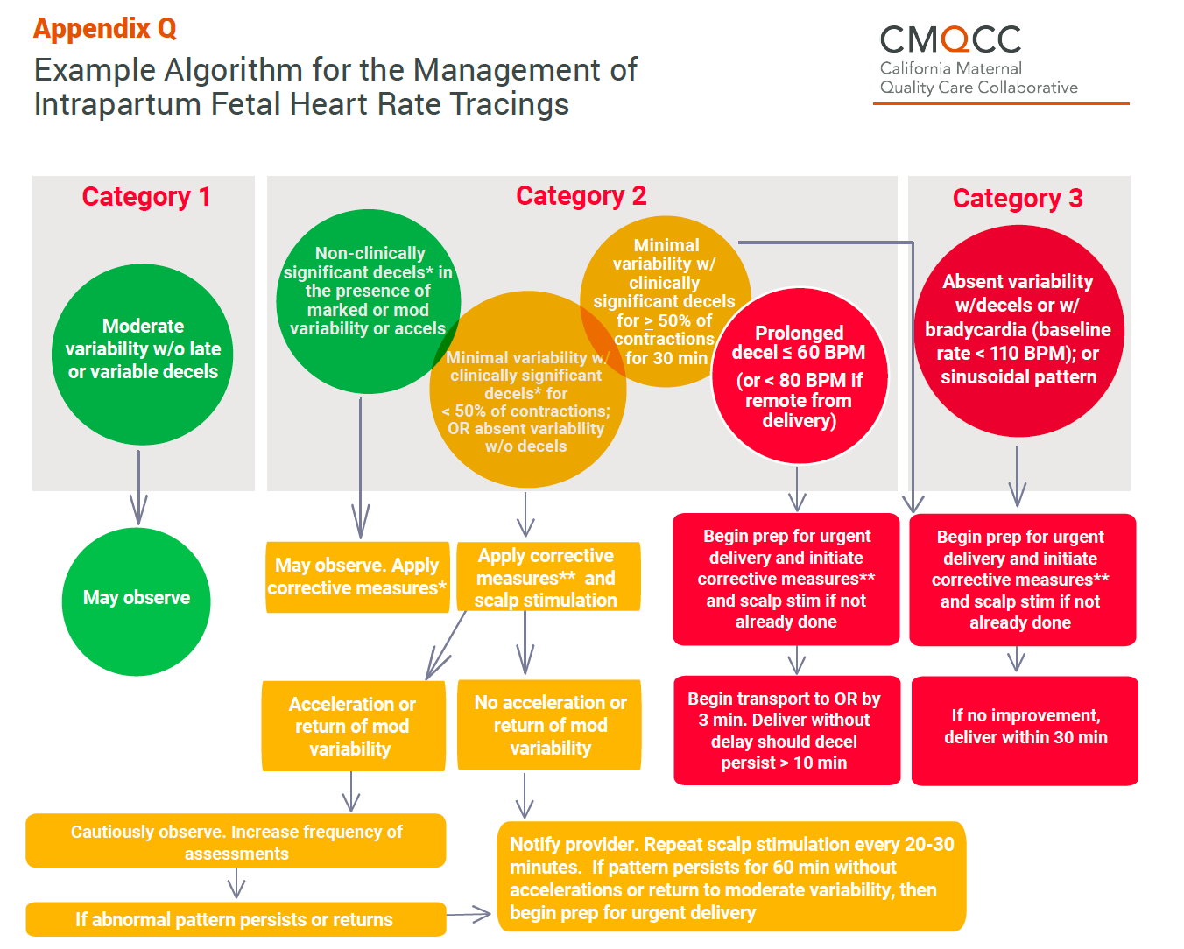
Response
Notes:
Other tools in Response section…

Slide 68
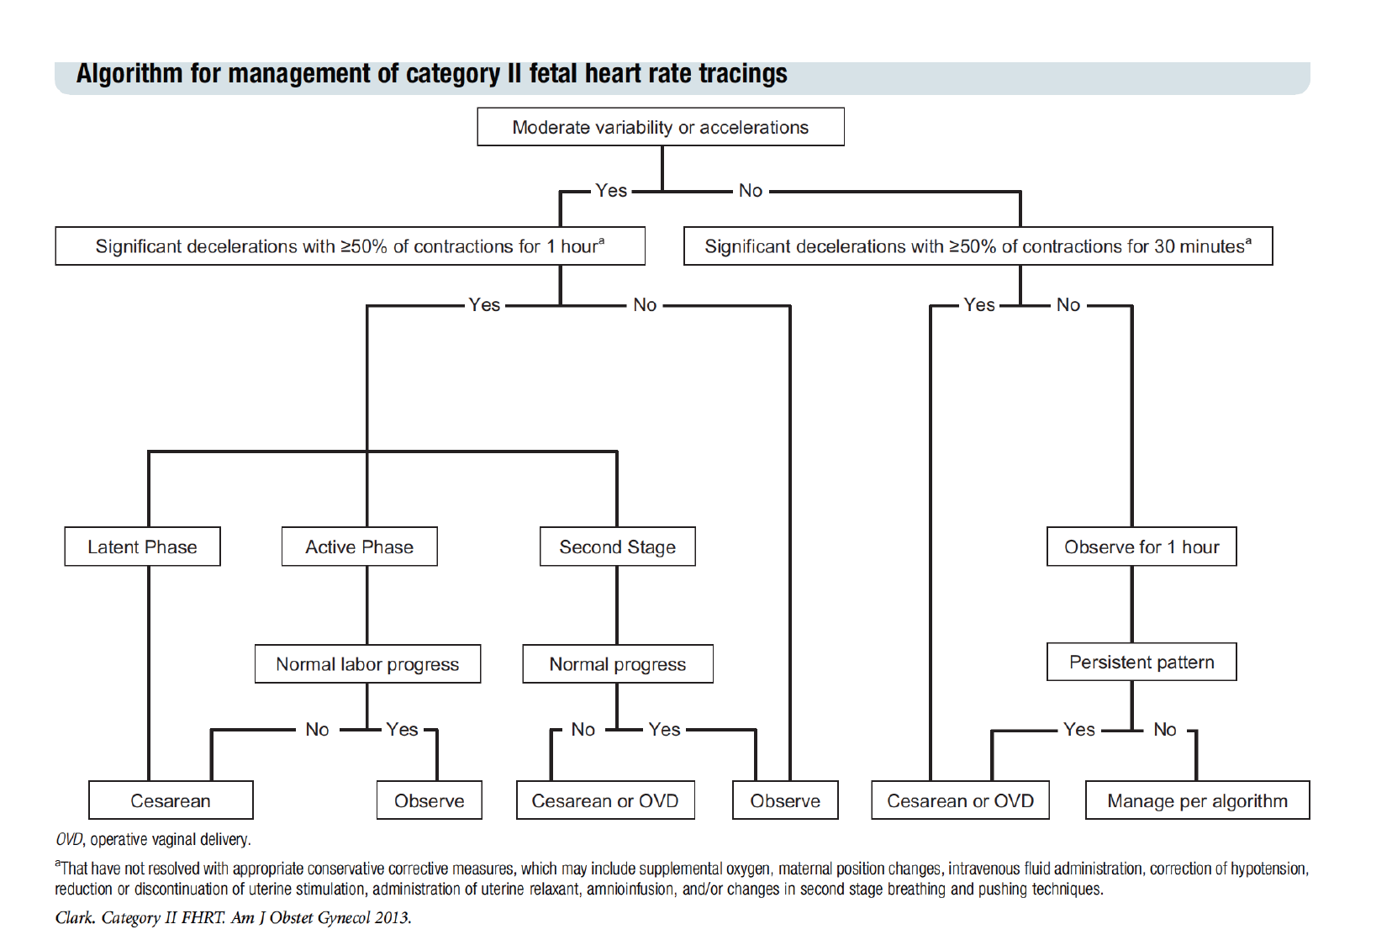
Clark’s Algorithm for Management of Cat II Tracings
Available in Toolkit
Response

Slide 69
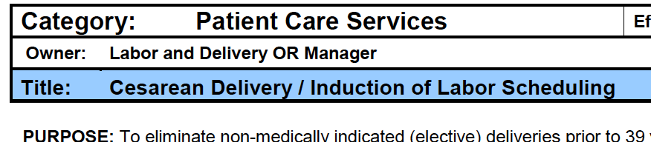

Model Polices for Induction of Labor, Induction of Labor Scheduling, and Safe Use of Oxytocin
Response
Notes:
Hard stops and scheduling procedures for IOL.

Slide 70
REPORTING/SYSTEMS
Using Data to Drive Improvement
70

Slide 71
Strategies for Using Data to Drive Improvement
Provide timely feedback in persuasive manner
Use comparative data which conveys a sense of urgency
Present data for both hospital and providers
Set achievable goals
Tie descriptive “cold” data with patient stories and other successes
Reporting
71
Notes:
Many hospitals have used group and provider level data to examine the large variation seen among providers.
Provider level data is not perfect for many reasons but they provide the ability to give feedback and comparisons within your department. Attribution comes from the provider named on the Birth Certificate. In some cases the attribution is not accurate because, for example, laborists might be doing all of the cesareans for the midwives, family practice physicians, and even other OBs on their unit. In these cases, data from the medical group as a whole and/or department level data are more accurate and can be used effectively for quality improvement. However, CMQCC is currently piloting the ability to name a “labor provider” for each case, in order to better parse out who the cesarean “belongs to.”
We are not supporting public release of provider level data at this time. Nonetheless, it can and should be shared with your providers in order create transparency and drive change.

Slide 72
Use Strategies to Engage Women, Employers and the General Public in the Improvement Project
Reporting
Public release of selected hospital-level measures that have been well-vetted
Provide a lay explanation of the measures
Widely distribute these measures through multiple media channels to capture the greatest attention
72
Notes:
Consumers play a huge role in quality improvement in that they are an integral part of a positive feedback cycle. If they know where quality care is being delivered, they will seek out quality facilities and providers.

Slide 73

3 Pilot Quality Improvement Projects Informed the Development of the Toolkit
Hoag Hospital,
Newport Beach CA
Miller Children’s and Women’s Hospital,
Long Beach CA
Saddleback Memorial Medical Center,
Laguna Hills CA
73
Notes:
These sites were chosen due to:
High birth rates
Higher than state average NTSV cesarean rates
Strong leadership
Readiness to engage in the project
Employer concerns about potentially unnecessary cesareans for the large number of employees receiving care at those particular facilities

Slide 74



Pilot QI Project Components: 2014-15
Data Measurement
Support
Quality Improvement
Support
Payment
Reform
Notes:
Data measurement support: Use of CMQCC Maternal Data Center (MDC), Physician-level data was analyzed to identify drivers of cesarean. allowed the hospital to tailor their individual programs to the needs of that facility. The data also allowed for physician-level comparisons and an understanding of variation between providers. With this data, balancing measures were also monitored e.g. Term Unexpected Newborn Complications (NQF metric), to monitor for any unintended consequences of cesarean reduction
QI improvement support: After identification of cesarean “drivers” at each facility, CMQCC and hospital, administrative, physician, and nursing leaders spearheaded efforts to identify strategies to reduce or eliminate the drivers, such as implementing: Simple algorithms, Easy checklists, Induction of labor scheduling policies. They also focused on the nursing component of labor support, and frequently reported unblinded physician-level cesarean rates in order to address variation between physicians and to give specific support to outlier physician s. Many of these pilot tools were adapted and are included in the toolkit
Payment Reform: Health plan partners were identified that agreed to pay a “blended rate” for births, meaning the resulting reimbursement rate was above the typical reimbursement rate for vaginal birth, but below typical reimbursement for cesarean. The change signaled to hospital systems that major payers were actively reducing any financial incentives for cesarean. The actual payment change did not occur until 9 months into the project. Nonetheless, the proposed payment changes, and employer concerns, motivated the hospital leadership and providers to change the status quo.
Refs: Pacific Business Group on Health. Case study: maternity payment and care redesign pilot. http://pbgh.org/storage/documents/TMC_Case_Study_Oct_2015.pdf. Published October 2015. Accessed January 12, 2016

Slide 75

Impressive Results: within 6 months
24.2 % Reduction
22.1% Reduction
19.5% Reduction
Baseline – 32.6%
After QI – 24.7%
Baseline – 31.2
After QI – 24.3%
Baseline – 27.2%
After QI – 21.9%
75
Notes:
Between the three facilities, there was an average 20% reduction in NTSV cesarean rates. And it happened quite quickly.
Hoag
Miller
Saddleback

Slide 76
CMQCC Data-Driven QI: NTSV CS
QI Project Started:
Jan 2014
National Target for NTSV CS = 23.9%
76
Notes:
Here is an example run chart from one of the pilot hospitals. As you can see, the QI project started in Jan 2014. By March they were close to being at target of 23.9%. By May they were below target. While still having some months above target, the average quarterly rates for this facility have remained well below where it was at the start of the project.

Slide 77
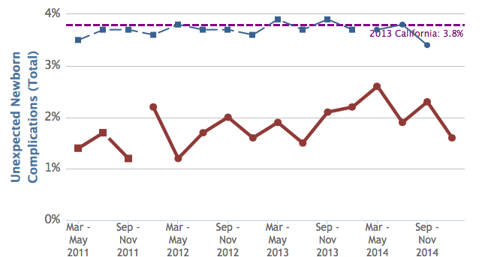
No Change in Baby Outcomes:
Rate of Unexpected Newborn Complications
Screen Shot from the CMQCC Maternal Data Center
Remains significantly below State mean
Hoag Hospital
Intervention Period
Dec -
Feb
2015
77
Notes:
What about babies? If we successfully decrease cesareans, how are we monitoring that babies are not being harmed. As a balancing measure, the data center also track unexpected newborn complications. In this example, you can see that the unexpected newborn complication rate at this facility was well below state average of 3.8%. During the intervention period, not only did newborn complication rate state below state average, it actually came down a bit from where it started, and remains quite low.

Slide 78
Take-home Lessons from the
Pilot Hospitals
The power of provider-level data! Was the single most important tool that finally started to “move the needle”
Key role of nurses for leading the charge
There needs to be a reason to change
Use national guidelines as your playbook for safe care and to ease fears of liability
Needs “constant gardening”
Medical and nursing champions are essential for success of project
78
Notes:
Provider-level data was the critical information that finally began to “move the needle.”
Nurses have a key role as leaders and champions in advocating for cesarean reduction, leading the change, and challenging team to improve labor support
Most people simply need a reason to change. In most cases, this comes down to showing them the data.
National guidelines provide a roadmap and should reduce fear regarding liability concerns.
Constant gardening – this is not a “one time” QI project and all is solved. It will be an ongoing endeavor.
Nurse and physician champions with tenacity and longevity will ensure the project’s success.

Slide 79
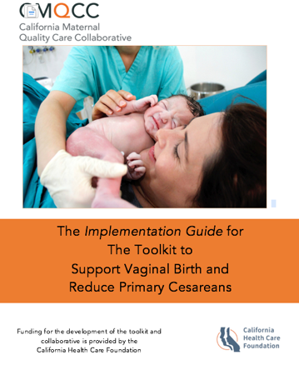
Implementation Guide
“How-To Guide”
  Translates recommendations from the toolkit into practical advice for implementation
Provides methodology to identify:
  Your key focus areas
  Strategies to implement first
  Process design for sustainability
  Key QI principles
79
Notes:
The toolkit is a huge document and the most common question is where do we start? To help with this, go to the Implementation Guide!
Available for download on the CMQCC website.

Slide 80
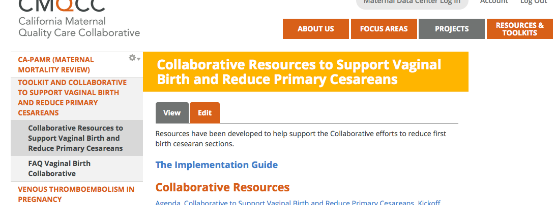
Available for Download
Notes:
The Collaborative Resources tab on the website also has a lot of great tools for download.
[ if asked, can explain how to navigate there from home page. Got Projects in top toolbar → Collaborative to Support Vaginal Birth→ Click tab on left “Collaborative Resources”]

Slide 81
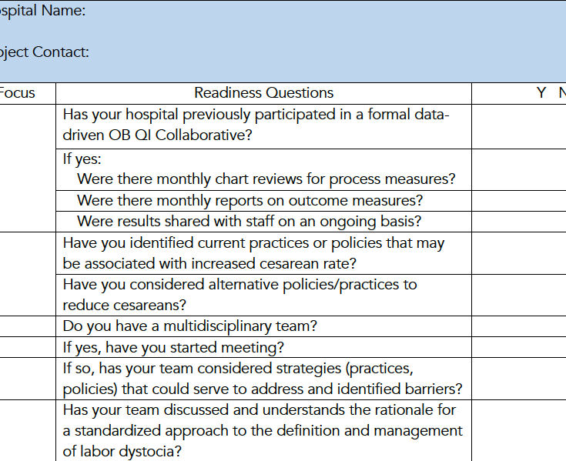
Readiness Assessment
Available in the Implementation Guide and on www.cmqcc.org
Notes:
A readiness assessment in the Implementation Guide is a valuable tool for knowing where to focus your efforts.

Slide 82

READINESS: Build a provider and maternity unit culture that values, promotes, and supports intended vaginal birth and optimally engages patients and families
Create a team of providers (e.g. obstetricians, midwives, family practitioners, and anesthesia providers), staff and administrators to lead the effort and cultivate maternity unit buy-in
Develop program for ongoing staff training for labor support techniques including caring for women regional anesthesia
Develop a program positive messaging to women and their families about intended vaginal birth strategies for use throughout pregnancy and birth
82
Notes:
The Top 10 list and Next 9 will guide you where to start first.

Slide 83
RECOGNITION AND PREVENTION: Develop unit-standard approaches for admission, labor support, pain management and freedom of movement
Implement protocols and support tools for women who present in latent (early) labor to safely encourage early labor at home
Implement Policies and protocols for encouraging movement in labor and intermittent monitoring for low-risk women
83

Slide 84
RESPONSE: Develop unit-standard approaches for prompt identification and treatment of abnormal labor and fetal heart patterns
Implement standard criteria for diagnosis and treatment of labor dystocia, arrest disorders and failed induction
Implement training/procedures for identification and appropriate interventions for malpositions (e.g. OP/OT)

Slide 85
REPORTING AND SYSTEMS LEARNING: Utilize local data and case reviews to present feedback and benchmarking for providers and to guide unit progress
Share provider level measures with department (may start with blinded data but quickly move to open release)
Perform monthly case reviews to identify consistency with dystocia and induction ACOG/SMFM checklists
Establish a project communications plan (at least monthly education and progress updates
85

Slide 86
Next steps
Participate in the CMQCC Maternal Data Center
  If not already a member, please contact Anne Castles
  acastles@stanford.edu
Download Implementation Guide
  Evaluate your readiness – take the readiness assessment
Evaluate your own process:
    Audit 20 charts for women with NTSV for “labor dystocia” (audit tool available on www.cmqcc.org collaborative resources page)
If interested in joining collaborative, contact Valerie Cape vcape@stanford.edu
Questions about Toolkit, contact Valerie Cape (see above) or Holly Smith hsmith@cmqcc.org

Slide 87

Thank You!
Visit: CMQCC.org

