Slide 1

Low-Dose Aspirin (LDA) Campaign to Reduce Preeclampsia and Related Preterm Birth
Your Hospital or
Health System Logo

Slide 2

Funding for this project is generously supported by the March of Dimes

Slide 3
This slide set is considered an educational resource but does not define the standard of care in California or elsewhere. Readers are advised to adapt the guidelines and resources based on their local facility’s level of care and patient populations served and are also advised to not rely solely on the guidelines
presented here.

Slide 4
Prevent Harms to Mothers and Infants
From Preeclampsia
Our goal is to reduce maternal and infant harms from preeclampsia by identifying mothers at risk of preeclampsia early in gestation and encouraging use of daily Low-Dose Aspirin (LDA) for the duration of the pregnancy.
The reduction of harms can be substantial, decreased by 20 to 60%.

Slide 5
What is Preeclampsia?
New hypertension in pregnancy with direct effects on both the mother and fetus
  Often has protein in the urine and may lead to seizures and severe injuries to the liver, kidneys, heart and brain.
  The fetus is sometimes delivered preterm (with possible long-term complications), undersized and admitted to the Neonatal Intensive Care Unit and in severe cases, even stillborn.

Slide 6

How can we prevent preeclampsia?

Slide 7
Many attempts to prevent preeclampsia have not worked
Vitamin
C
Vitamin
E
Co-
Enzyme
Q
Folic
Acid
Relaxation
Therapy
Calcium
Selenium

Slide 8
Low-dose aspirin (LDA) is the only known way to reduce preeclampsia and mother/infant harms.

Slide 9
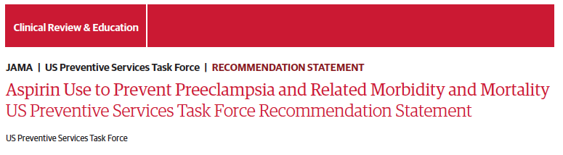

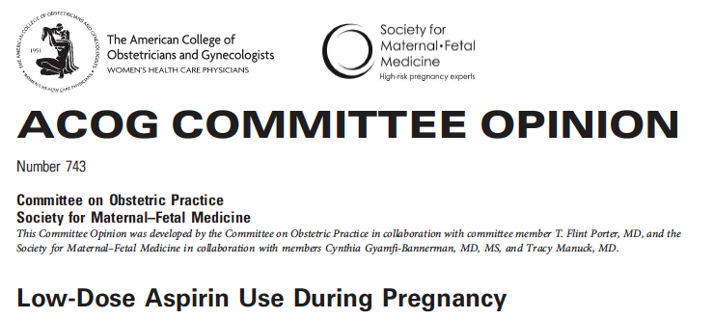
2014 and re-Endorsed in 2021
Recommended by national medical and patient organizations:
Daily use of Low-Dose Aspirin starting between 12-16 weeks of gestation has substantial benefits for both mother and infant.
July 2018

Slide 10
LDA given to those at risk for preeclampsia
Reduces:
Preeclampsia by 15%
Preterm birth by 20%
Fetal growth restriction by almost 20%
Perinatal mortality by more than 20%
This translates to healthier moms and healthier babies.
US Preventative Task Force Recommendation, Journal of the American Medical Association (JAMA)

Slide 11
LDA in pregnancy can support healthy placenta development, preventing changes that can lead to high blood pressure.
Those taking aspirin are more likely to deliver at full term and less likely to have preeclampsia.

Slide 12
...but these recommendations have been slow to become widely used!
Multiple studies find that less than 25% of eligible women are offered or take LDA.
Women with chronic hypertension are the highest utilizing group but among them only ~50% take LDA.
Among Black pregnant people who are eligible, only 10% received LDA.
Parrinella K, Wong MS, Wells M, Gregory KD. Identification of criteria missed by clinicians among patients not prescribed aspirin prophylaxis for preeclampsia. SMFM, 2022.
US Preventative Task Force Recommendation, Journal of the American Medical Association (JAMA)
Notes:
US Preventative Task Force Recommendation, Journal of the American Medical Association (JAMA)

Slide 13

Who is at increased risk of preeclampsia and should receive low-dose aspirin?
Let's start with background information….

Slide 14
Risk factors for preeclampsia
Those with one high-risk factor should receive LDA:
  preeclampsia in a prior pregnancy
  multifetal gestation (twins plus)
  chronic hypertension
  type 1 or 2 diabetes mellitus
  renal disease
  autoimmune disease (lupus, etc.)

Slide 15
Risk factors for preeclampsia
Those with two or more moderate-risk factors should receive LDA:
nulliparity (first birth) obesity (BMI>30 kg/m²) mother or sister with history of preeclampsia exposure to anti-Black racism financial hardship | 35+ years old prior low birthweight or small-for-gestational age baby previous adverse pregnancy outcome 10+ years since last delivery

Slide 16
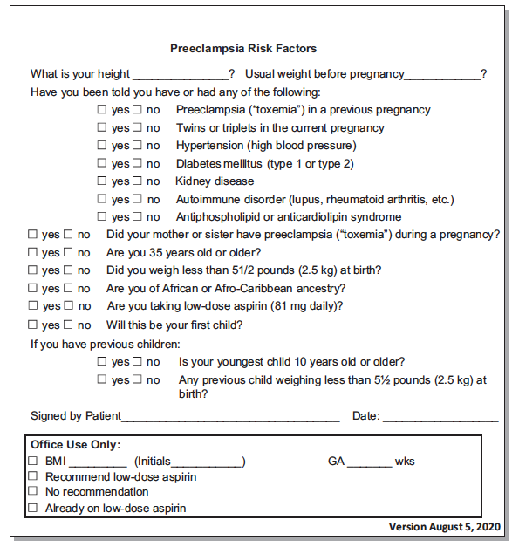

An example of a self-administered Checklist for Eligibility for Low-Dose Aspirin
Am J Obstet Gynecol. 2020 Sep;223(3):B7-B11.

Slide 17
There Are Very Few Reasons Not to Take LDA
Contraindications:
  Allergic to aspirin or other nonsteroidal anti-inflammatory drugs (NSAIDS)
  Nasal polyps
  Aspirin-induced acute bronchospasm
May not be the right treatment if history of:
  Gastrointestinal bleeding or stomach ulcers
  Low platelets (<100,000) or conditions that cause impaired blood clotting
  Gastric bypass surgery
  First trimester bleeding

Slide 18
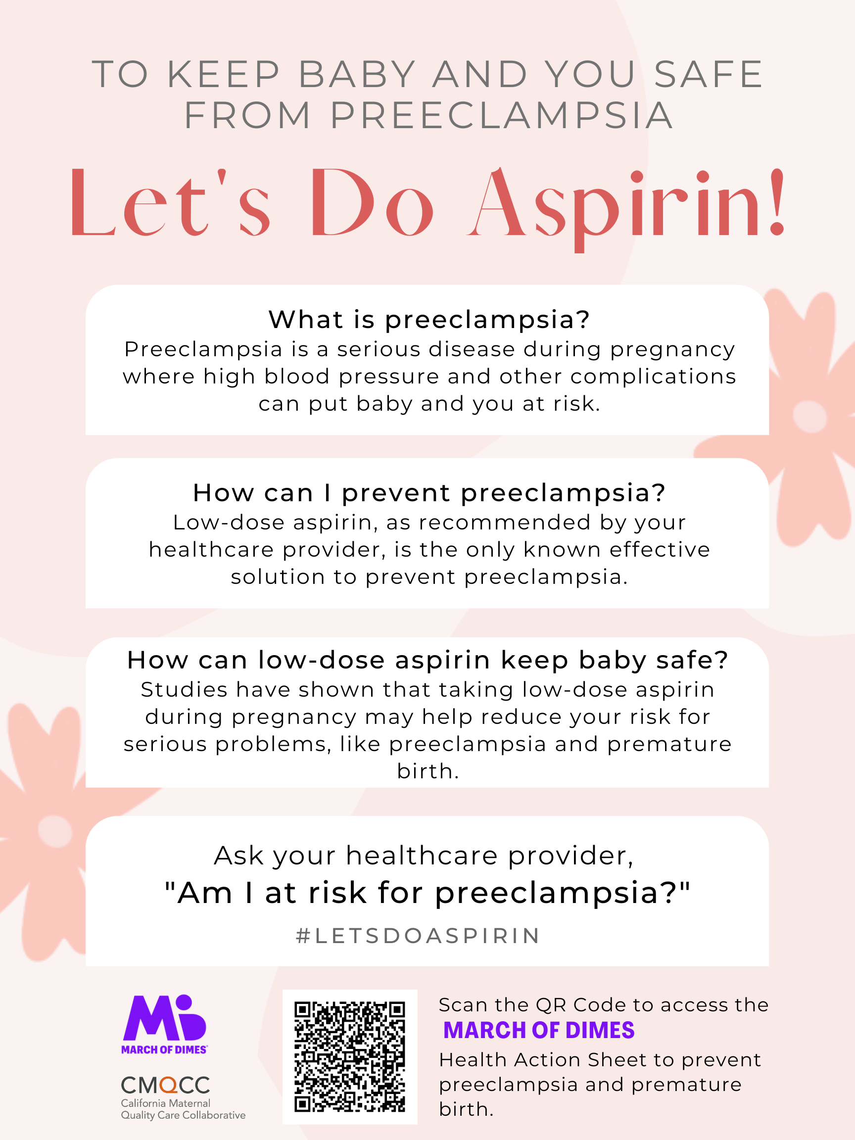
Let’s Do Aspirin Campaign
Loma Linda University
Riverside University Medical Center
Scripps Health Care
UC San Diego
Mercy San Juan
Funding support by MOD

Slide 19
This campaign is about how to increase LDA use
Key Elements of the Campaign
Make it easier for providers to screen and prescribe LDA.
Increase patient awareness of the benefits and lack of risk for LDA.
Increase community awareness of the benefits of LDA to support women in their LDA decisions.
Educational outreach to pharmacies/pharmacists for the benefits of LDA.

Slide 20
What you can do…
Learn more yourself.
Educate your patients, family, friends about LDA and about preeclampsia symptoms.
Key messages to share when patients ask about LDA.
  LDA is very safe to take, safely used in all races and ages
  LDA can make pregnancies last longer and keep moms and babies safer
  If taking LDA, it is important to take it daily

Slide 21
Frequently Asked Questions

Slide 22
Is Low-Dose Aspirin Safe in Pregnancy?
Yes, LDA is safe!
LDA: No higher rates of maternal harms
  Abruption, hemorrhage not increased
LDA: No higher rates of fetal harms
  Congenital malformations, premature ductal closure, bleeding not increased
The concerns for aspirin in pregnancy are related to full adult doses (2 x 325mg or 650mg) which have different biochemical effects. Even these effects are modest.

Slide 23
What is the Optimal Dose of LDA?
No trial directly compares doses. Despite over 45 randomized trials there is still no consensus between 81mg (1 pill) vs 162mg (2 pills)
Why? They had differing criteria:
  Included different trials, different doses (50-150mg), different gestational ages to start, and most importantly had different inclusion criteria.
  Use of historical risks versus biochemical tests or uterine doppler studies.

Slide 24
What is the Optimal Dose of LDA?
The largest single trial (ASPIRE, NEJM 2017) included 1776 women at very high preeclampsia risk based on biochemical and biophysical tests; 150 mg showed benefit. However, in the US, we do not screen using biochemical or biophysical testing.
1 tablet (81 mg) daily is currently recommended by USPSTF, ACOG, and SMFM; but physicians can individualize dosage.

Slide 25
When should LDA be started and stopped?
Greatest benefit is seen with start time 12 – 16 weeks (some studies found modest benefit seen up to a start time of 28 weeks).
Most recommendations for those taking a single pill (81 mg) continue daily use until delivery.
US Preventative Task Force Recommendation, Journal of the American Medical Association (JAMA)
If taking the higher dose (2 pills, 162 mg), in practice many recommend stopping at 36 weeks to avoid anesthesiologist worries over possible epidural complications.

Slide 26
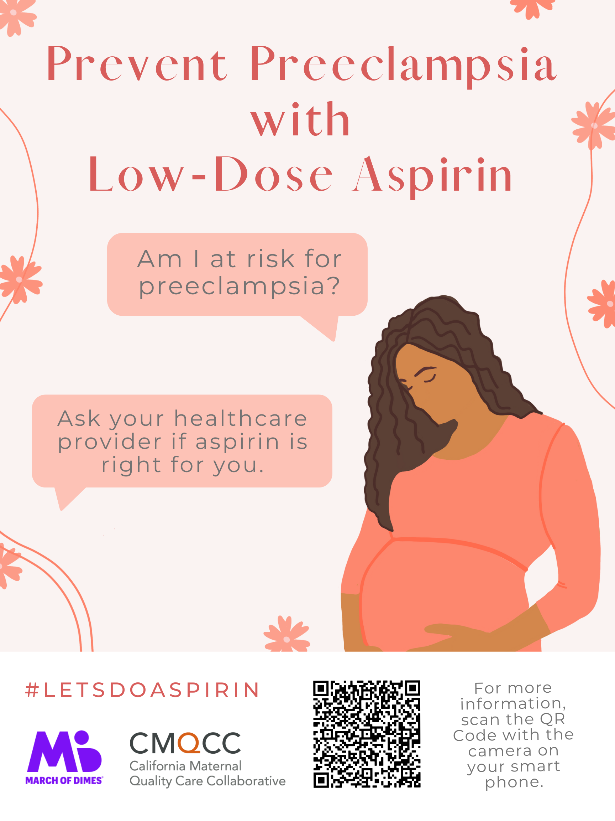
Questions?

Slide 27
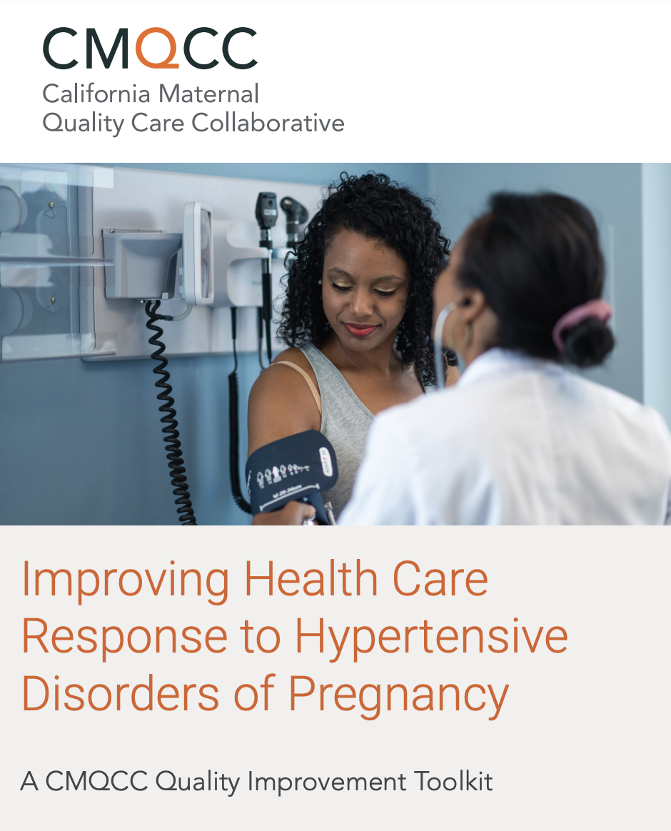
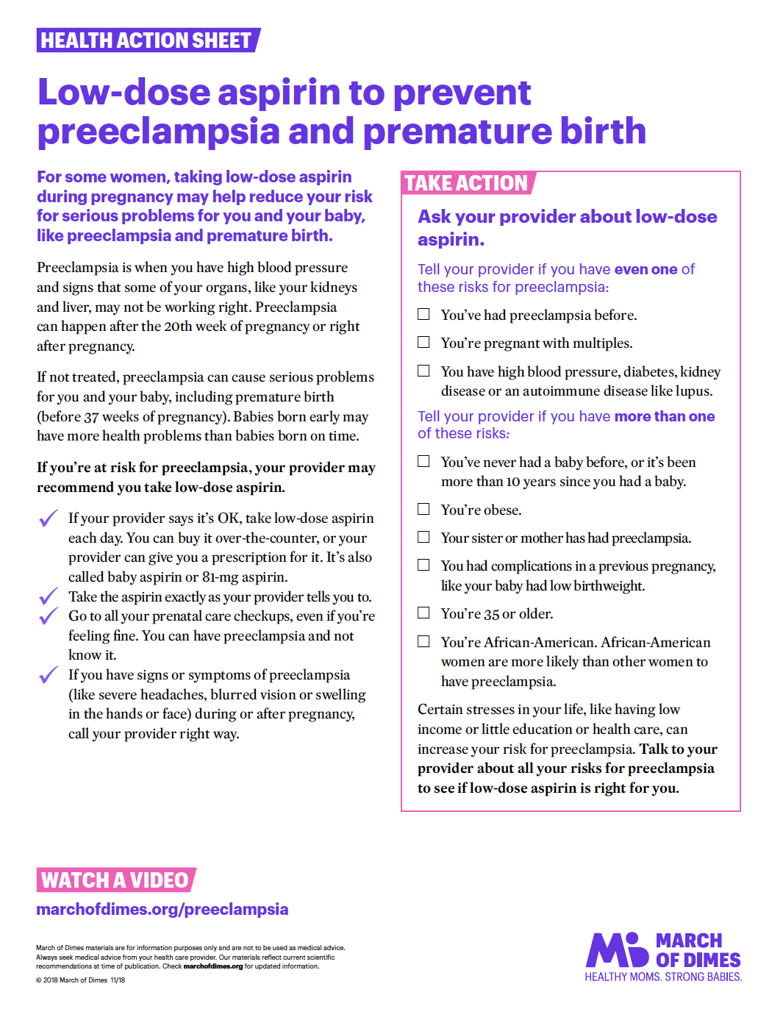
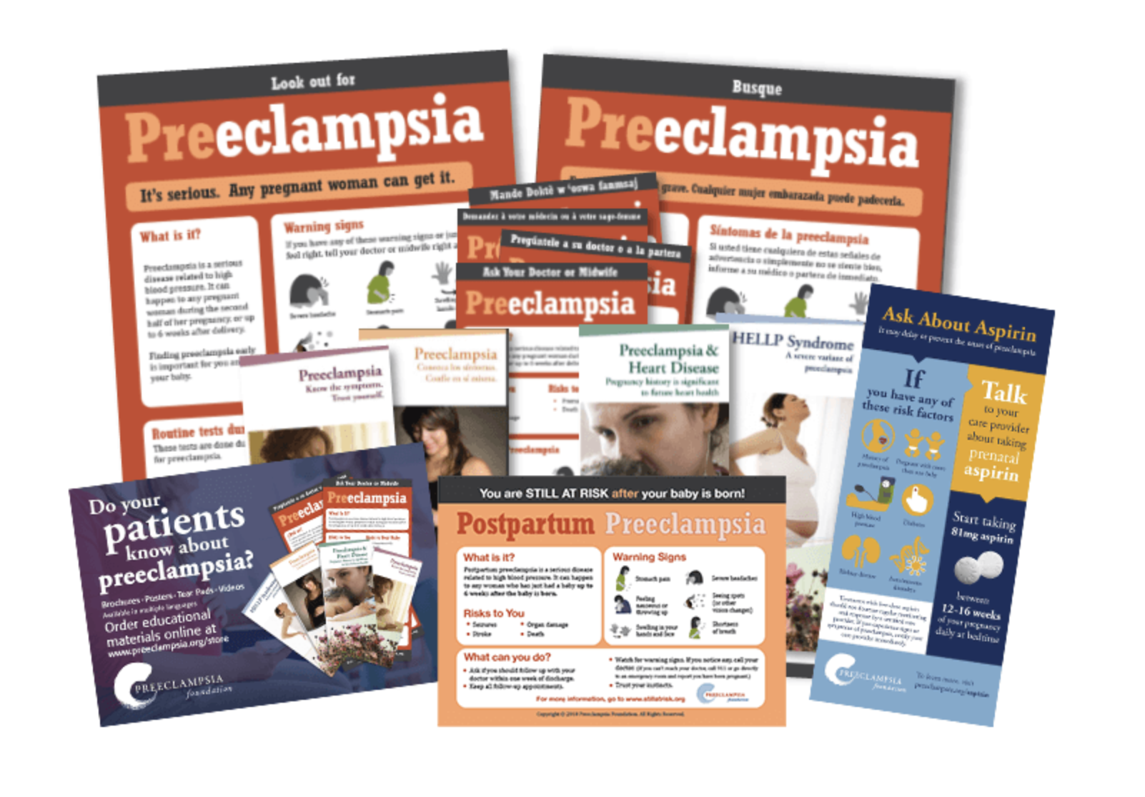
Tools and Resources: Patients and Providers
CMQCC Hypertension/Preeclampsia Quality Improvement toolkit: Supports hospitals in managing labor & delivery patients presenting with high blood pressures.
March of Dimes and Preeclampsia: To help patients understand preeclampsia and the benefits of taking low dose aspirin during pregnancy.
Preeclampsia Foundation Patient Education Materials: Guidelines for providers on what to consider when education patents on preeclampsia.

