Slide 1
The Next Step in California's Quality Improvement Journey:
Integrating Midwives, Doulas, & Community-Based Birth Care
Holly Smith, MPH, CNM, FACNM
Michelle Sanders, CD, CLEC
Nikki Schuster, MSN, CNM
Notes:
1

Slide 2
Instructions
You are welcome to use any of the slides provided for educational purposes
If you modify or add a slide, please substitute your institutional logo and do not use the CMQCC logos
We welcome your feedback and recommendations for improving the slide

Slide 3
Objectives
Specific Objectives:
Introduce the NEW content (Part V) of the Toolkit to Support Vaginal Birth and Reduce Primary Cesareans
Describe team-based care and its potential for improving patient experience and birth outcomes
Explain the benefit of integrating midwives and doulas as a necessary component of pregnancy and birth care (and the strategies to accomplish this).
Describe the value of community birth and how to promote safe, respectful transfer.

Slide 4
Midwifery and Doula Integration Task Force
Cynthia Banks,MSN, CNM
Priya Batra, MD, MS, FACOG
Darynée Blount, LM
Theresa Cunningham, MA, PHR
Martha Franco, CD
Ann Fulcher, CLE, CD(DONA)
Mashariki Kudumu, MPH
Emily McCormick, MPH, RNC-MNN, C-ONQS, IBCLC
Samsarah Morgan, CD, DD, LC
Eva Goodfriend-Reaño, CNM, WHNP, IBCLC
Christa Sakowski, MSN, RN, C-ONQS, C-EFM, CLE
Michelle Sanders, CD, CLEC
Madeleine Wisner, LM, CPM
Mayra Lizzette Yñiguez, MPH, MSN, CNM, WHNP

Slide 5
The Elephant in the Zoom
A values “check-in” around midwives, doulas, and community birth
Patient-Centered Care: “Providing care that is respectful of and responsive to individual patient preferences, needs, and values and ensuring that patient values guide all clinical decisions.” – Institute of Medicine | Institute for Health Care Improvement
There is no singular intervention that will reduce CS rates or eliminate birth disparities – we must utilize all the tools in the toolbox
Midwifery training for CPMs and CNMs in the US meets or exceeds International Confederation of Midwives (ICM) standards
Community birth is safe:
provided by trained, skilled providers
risk assessment is ongoing
within an integrated system of care where higher levels of care and medical consultation is easily accessible
Respectful maternity care
IS A CHOICE
Doulas are patient advocates and connectors to services in addition to supportive care givers; their expertise is desperately needed in a system where disparate outcomes are the norm

Slide 6
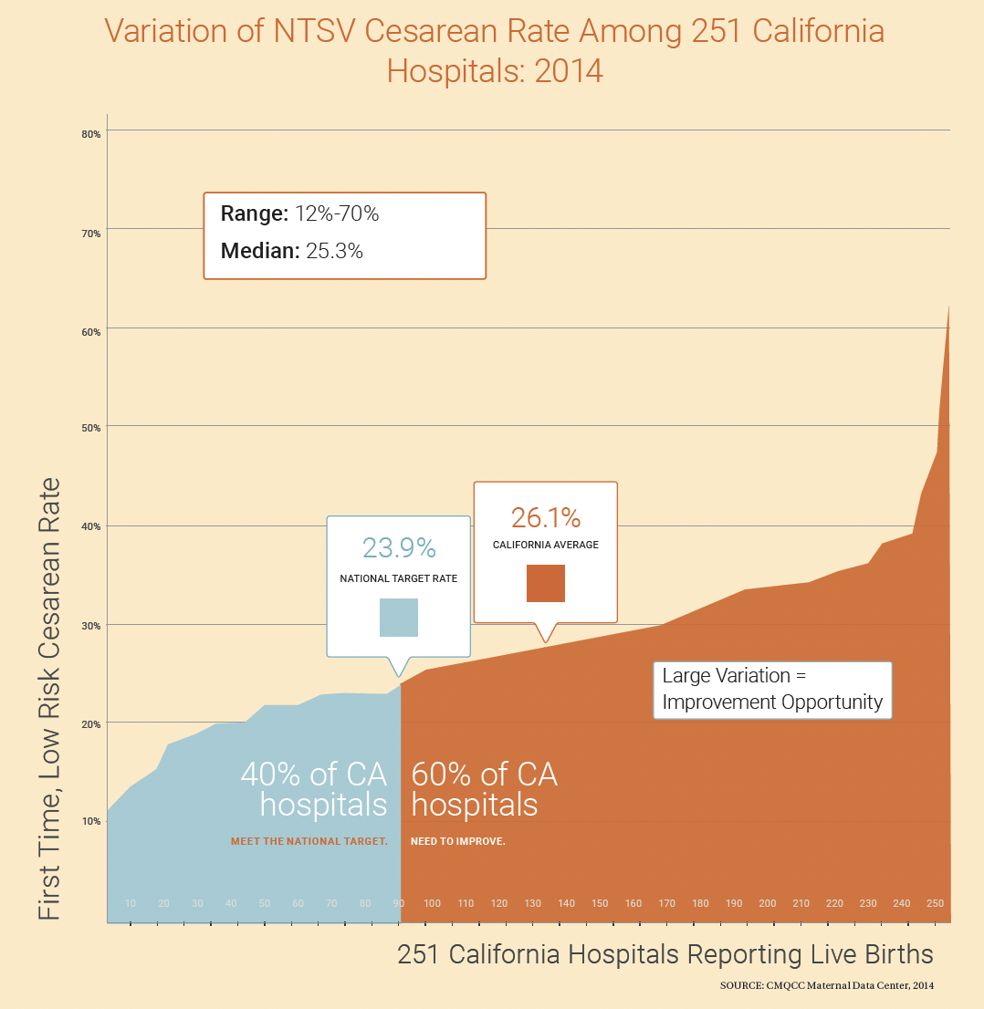
Cesarean Birth in California (2014)
Image source: CMQCC Toolkit to Support Vaginal Birth and Reduce Primary Cesareans

Slide 7
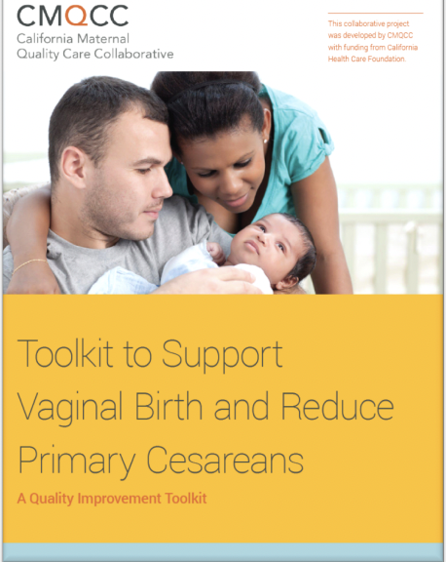
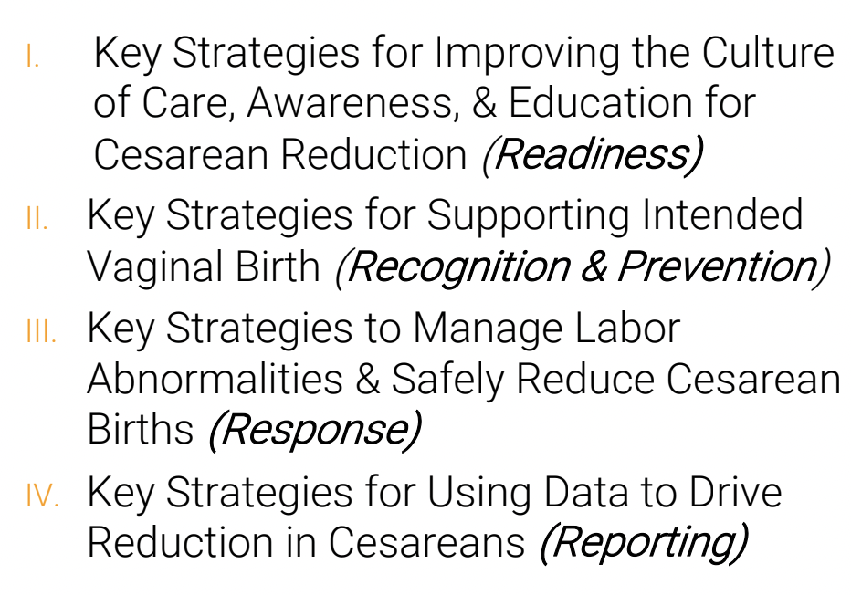
Toolkit to Support Vaginal Birth and Reduce Primary Cesareans – Published in 2016

Slide 8
Statewide Hospital Collaborative to Support Vaginal Birth
24 Hospitals
91 Participating Hospitals
(89 with starting NTSV rates > 24%)
Group 1
May 2016
Oct 2016
42 Hospitals
Group 2
Jan 2017
Jun 2018
25 Hospitals
Group 3
Nov 2017
May 2019

Slide 9
Mentor Model
CMQCC
Clinical Lead
Mentor Physician
Mentor Nurse
Hospital Implementation Teams

Slide 10
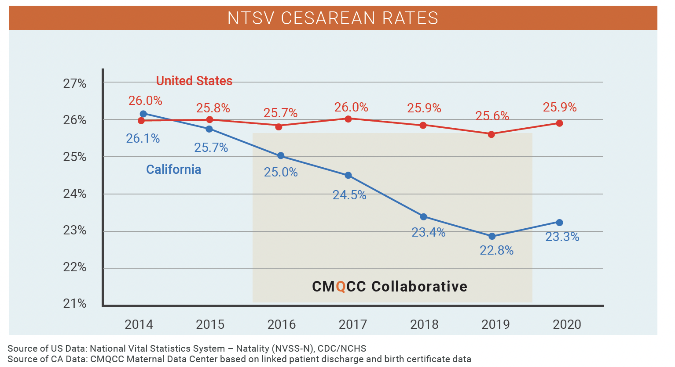
Landscape of Cesarean Birth in California (compared to United States, pre- and post- collaborative)
Image source: CMQCC Toolkit to Support Vaginal Birth and Reduce Primary Cesareans

Slide 11
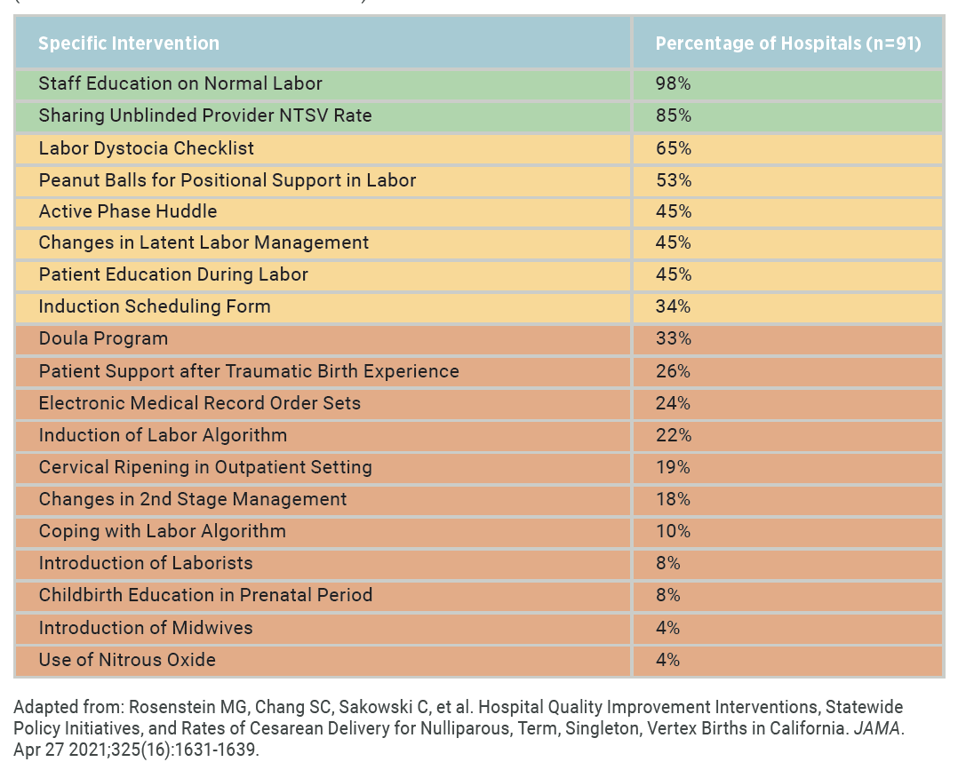
Most Frequently Utilized Interventions by Participating Hospitals
Image source: CMQCC Toolkit to Support Vaginal Birth and Reduce Primary Cesareans

Slide 12
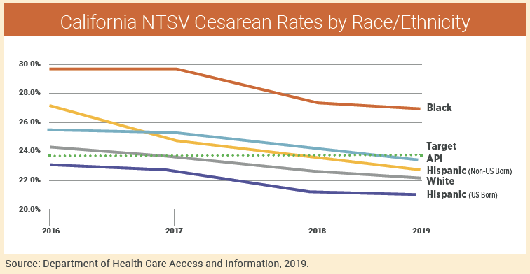
Cesarean Disparities by Race and Ethnicity
Image source: CMQCC Toolkit to Support Vaginal Birth and Reduce Primary Cesareans

Slide 13
Birth Equity
“The assurance of the conditions of optimal births for all people with a willingness to address racial and social inequalities in a sustained effort.”
– Joia Crear Perry, MD, FACOG
Founder, National Birth Equity
Collaborative

Slide 14
Achieving Birth Equity Means
Utilizing strategies that consider the root causes of disparities
Considering community needs/wants in the approach to quality improvement (patient and community-centeredness)
Humility to accept that what we are doing right now isn’t working for everyone
Bringing all quality improvement pressure points to bear; using all the tools in the toolbox

Slide 15
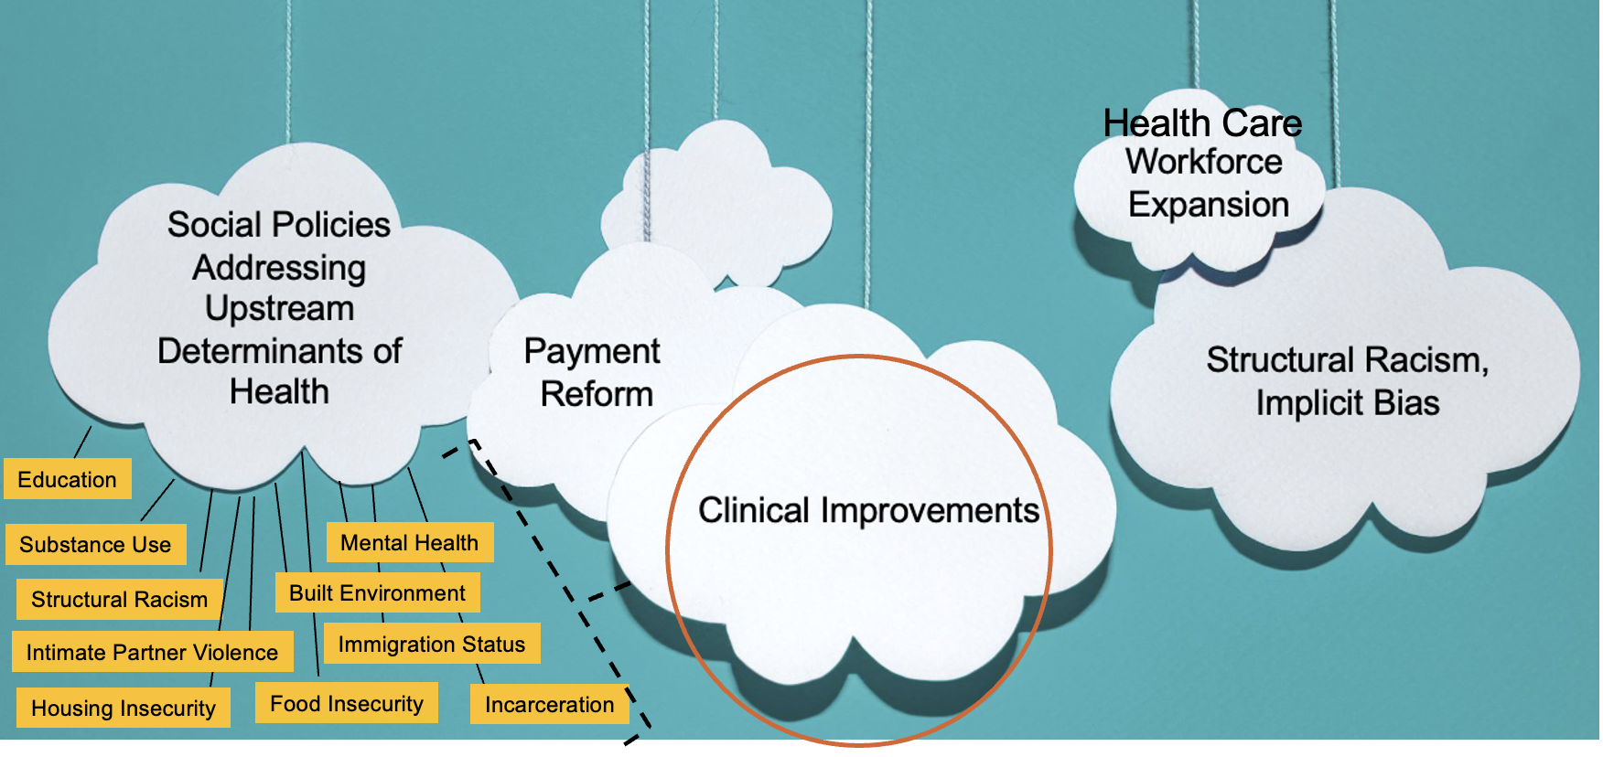
Quality Improvement Ecosystem

Slide 16
Clinical Strategies that Consider Root Causes of Disparities
Team-Based Care
Midwifery Integration
Partnering with Doulas

Slide 17
Team-Based Care

Slide 18
What is Team-Based Care?
“A team-based model of care is one that strives to meet patient needs and preferences by actively engaging patients as full participants in their care while encouraging all health care providers to function to the full extent of their education, certification, and experience….
Relationships are governed by negotiated shared norms and visions…
Each team member has knowledge and skills that contribute to the work, service, and problem solving that are the purpose of the team."
ACOG, Collaboration in Practice – Implementing Team-Based Care
Notes:
tion

Slide 19
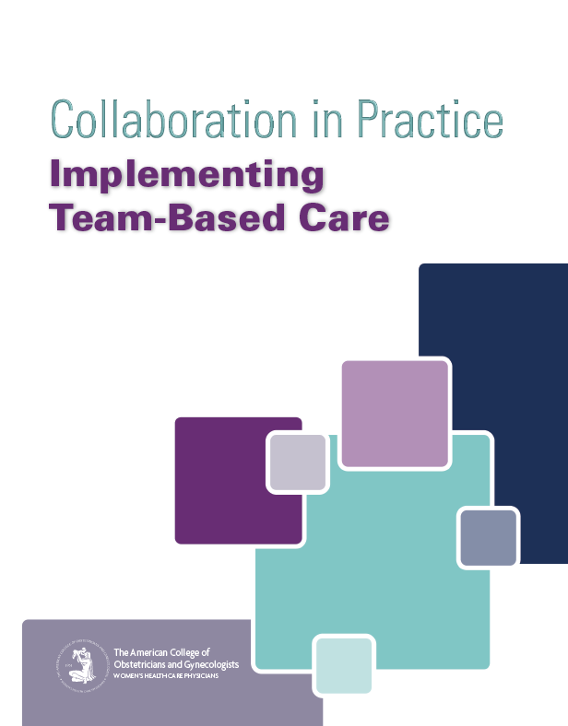
Key Principles of Team-Based Care
Patients and families are at the center and are integral parts of the team
The team has a shared vision
Role clarity is essential to optimal team functioning
All team members are accountable for their own practice and to the team
Effective communication is key
Team leadership is situational and dynamic

Slide 20
Systemwide Integration of Midwifery and Doula Care

Slide 21
Midwifery
The midwifery model of care is standard in all countries that have better birth outcomes
Patient empowerment is a central theme of midwifery care
“Whole-person” care that considers all the patient’s needs (physical, emotional, SDOH, personal values, cultural needs)
Midwifery is defined as “skilled, knowledgeable and compassionate care for childbearing women, newborn infants and families across the continuum from prepregnancy, pregnancy, birth, postpartum and the early weeks of life.”
– World Health Organization

Slide 22
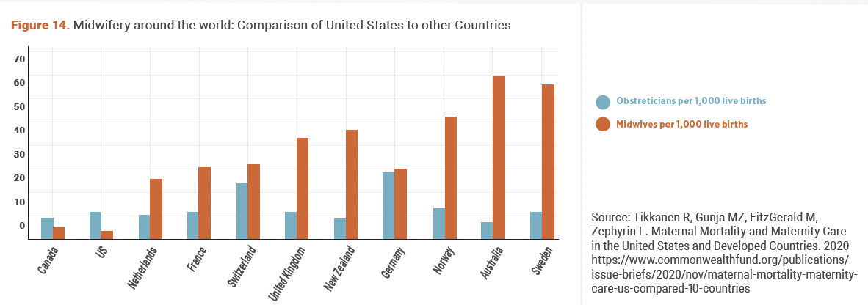
Midwifery Around the World
Image Source: CMQCC Toolkit to Support Vaginal Birth and Reduce Primary Cesareans

Slide 23
The Secret Sauce…
Midwifery philosophy has long preserved three immutable elements
Patient-centeredness,
“The therapeutic use of the human presence”¹
Nonintervention unless necessary for the health and
well-being of the pregnant person and/or fetus
1. Akileswaran CP, Hutchison MS. Making Room at the Table for Obstetrics, Midwifery, and a Culture of Normalcy Within Maternity Care. Obstet Gynecol. Jul 2016;128(1):176-80. doi:10.1097/aog.0000000000001493

Slide 24
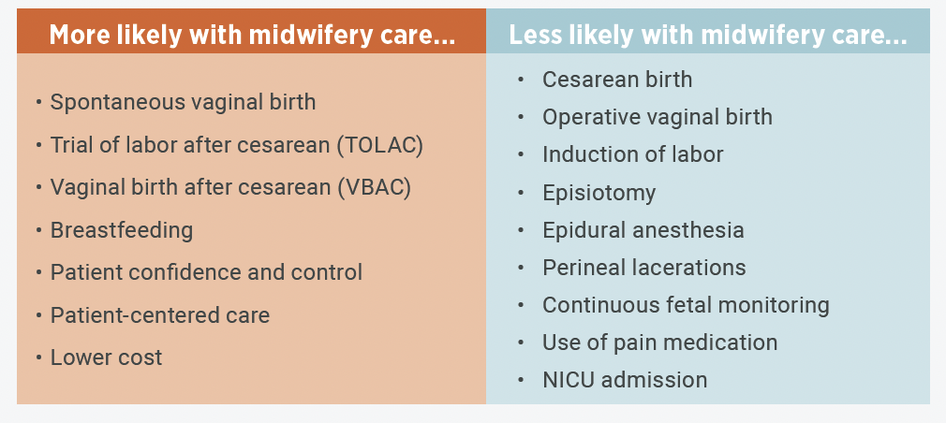
Benefits of Midwifery Care
Image Source: CMQCC Toolkit to Support Vaginal Birth and Reduce Primary Cesareans

Slide 25
Midwifery Certification in the United States
Certification
Training
Certifying Board/Agency
Certified Nurse-Midwife (CNM)
American Midwifery Certification Board
(AMCB)
Nursing then
midwifery training
Certified Midwife (CM)
American Midwifery Certification Board
(AMCB)
Direct to midwifery training
Certified Professional Midwife (CPM)
Direct to midwifery training
North American Registry of Midwives (NARM)

Slide 26
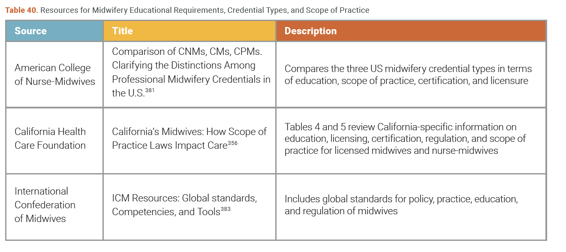
Resources for Understanding Midwives in the U.S. and California – Available in Toolkit
Image Source: CMQCC Toolkit to Support Vaginal Birth and Reduce Primary Cesareans

Slide 27
Community Birth
Home Birth and birth in freestanding birth centers
People who choose community birth do so for variety of reasons
The safety of community birth is well-documented
Safety studies of community birth in the US are complicated by study quality and difficulty of interpretation
Professional viewpoints on community birth informed by certain lower-quality and older studies that formed the basis of ACOG and AAP position statements on homebirth

Slide 28
Community Birth is Safe When:
Appropriate risk selection and ongoing assessment
Well-integrated system of maternity care between birth settings
Easy access to consultation and collaboration as needed when a higher level of care is needed
Transfer that is efficient, respectful, and seamless across birth settings
Birth attendant meets training and competency standards of the International Confederation of Midwives (ICM)

Slide 29
Toolkit Includes Many Community Birth Resources
Integration improvement resources
Transfer improvement resources
Links to CEs for improved community birth integration and safety
Real clinical stories and vignettes that amplify the strategies outlined in the toolkit

Slide 30
Integration Resources from Our Partners
https://www.pbgh.org/program/transform-maternity-care/

Slide 31
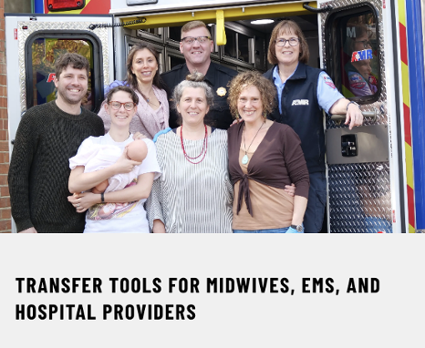
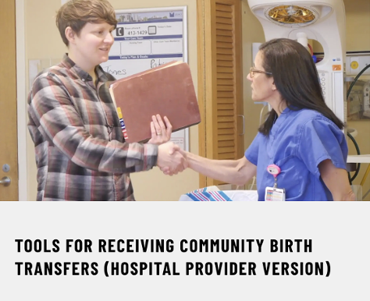
HiveCE
https://www.hivece.com/pages/ipe-for-community-birth-transfers
Example of resource in toolkit for CEs related to community birth transfer

Slide 32
What Does Midwifery Integration Look Like?
Culture of interprofessional partnership (easy access to physician consultation and collaboration)
Valuing midwifery and physician care as equals (right care at the right time philosophy)
All midwifery credential types recognized in your state and regulated according to the standards of the International Confederation of Midwives
Guidelines for safe, efficient, respectful transfer exist and are created through a collaborative process
Birth centers are licensed, accredited, or meet equivalent standards
Professional midwifery associations are well-established, respected, and interact collegially with medical associations toward joint goals
Birth outcomes data are readily accessible
Community and hospital midwives are both represented in the state perinatal collaborative
Midwives can prescribe according to their education and training
State scope of practice laws allow for midwives to practice to full extent of education and training
Midwives have admission and discharge privileges and/or medical staff membership
All midwives trained to the highest standards
Midwifery education is accessible and attainable
Sustained growth of community midwives, BIPOC midwives, and midwives committed to serving in geographic areas of need
Reimbursement is equal across provider types
Equitable coverage for midwives and birth centers by all payers
Source: CMQCC Toolkit to Support Vaginal Birth and Reduce Primary Cesarean

Slide 33
Midwifery Integration HASN’T Been Achieved If….
Midwives in your region have a restricted scope of practice below their actual education and training
State agencies do not meet the licensing and regulatory standards of the International Confederation of Midwives
Midwives are privileged at your facility but function as an extension of physicians
Hospitals in your region refuse community birth transfers
CNMs are licensed in your state but not CPMs and CMs
Valuing or trusting one midwifery licensure type over another
Ok with hospital midwifery but uncomfortable with community midwifery
Policy and practice founded on supervision rather than collaboration among colleagues
Refusal to believe that diverse care models are critical to addressing the root causes of health care disparities
Midwives can’t admit or discharge their own patients, and/or require notes to be co-signed
Midwives can’t be members of organized medical staff
Patients receive disrespectful care or judgment when transferring to hospital from community birth setting
Home birth transfers are viewed as “failed home births”
Insurers don’t cover community birth (midwives are not easily accessible to the public)
Midwives can’t prescribe or access the medications they need to provide safe care
Source: CMQCC Toolkit to Support Vaginal Birth and Reduce Primary Cesarean

Slide 34
Strategies for Midwifery Integration
For Hospital Based Providers, Nurses, and Administrators
Divided into Administrative, Educational, and Clinical Strategies for your setting
Found in Table 42, Part V of Toolkit

Slide 35
Strategies for Integration and Improved Safety Across Birth Settings
Utilized the expertise of our taskforce members and a variety of state resources from other perinatal collaboratives and community birth organizations
Table 43, Part V of Toolkit

Slide 36
Profile of Santa Rosa Birth Center
Nikki Schuster, CNM, MSN

Slide 37
Partnering with Doulas

Slide 38
What is a Doula?
A doula is a trained, non-medical professional who supports and protects the patients physical, emotional, and informational needs during labor
Doulas also have an important role during pregnancy and postpartum
Some doulas provide support during/after miscarriage or abortion
There are even “end-of-life doulas” who support people in hospice or other times as they prepare for end-of-life

Slide 39
Benefits of Doula Care
Image source: CMQCC Toolkit to Support Vaginal Birth and Reduce Primary Cesareans

Slide 40
Doula Care
What Doulas Do
What Doulas Do Not Do
Prenatal teaching & childbirth ed
Comfort care & physical support
Culturally congruent advocacy & informational assistance
Preserve & support respectful care, privacy, and dignity
Support for epidural & give comfort care for breakthrough pain
Patient positioning to assist fetal descent and rotation
Support for lactation during “Golden Hour”
Typically remain with the patient throughout labor & “Golden Hour”
Postpartum support (infant feeding & infant care; recognition of postpartum symptoms that need attention)
Connection to social resources
Clinical care such as physical assessments or “catching” the baby
Nursing care such as fetal monitoring or medication administration
Diagnose conditions or give medical advice
Make decisions for the patient or pressure the patient into certain decisions
Source: CMQCC Toolkit to Support Vaginal Birth and Reduce Primary Cesarean

Slide 41
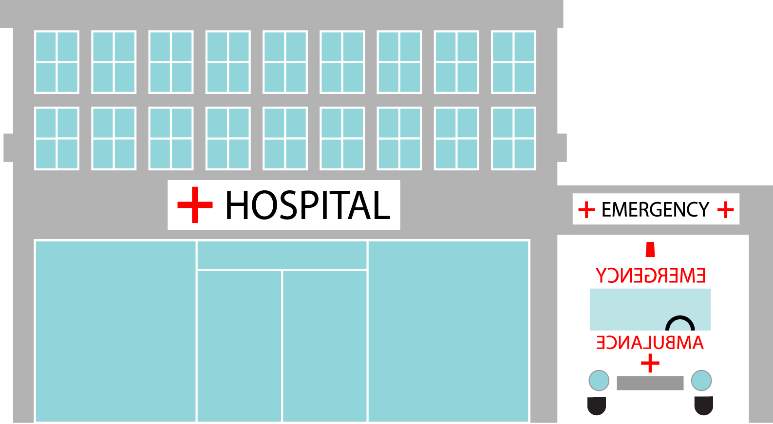
Types of Doula Programs
Hospital-Based Doulas Community Doulas

Slide 42
Strategies for Partnering with Doulas
For Hospital Based Providers, Nurses, and Administrators
Divided into Administrative, Educational, and Clinical Strategies for your setting
In Table 45, Part V of Toolkit

Slide 43
Profile of AAIMM Community Doula Program
Los Angeles County African American Infant and Maternal Mortality (AAIMM) Prevention Project
Michelle Sanders, Certified Doula, CLEC

Slide 44
CMQCC clinical leads and data center
Data questions
datacenter@cmqcc.org
Clinical improvement questions or questions about toolkit
csakowski@cmqcc.org
Questions about midwifery and doula care in California
holly@midwiferyrising.org

