Slide 1
Discussing Risk Respectfully:
Low-Dose Aspirin (LDA)
Campaign Webinar Series
Thursday, December 7, 2023

Slide 2
Logistics & Slide Deck
All attendees are muted upon entry.
Please use the Q & A function – we will do our best to answer questions during the webinar.
You are welcome to use any of the slides provided for educational purposes.
If you modify or add a slide, please substitute your institutional logo and do not use the CMQCC logos.
We welcome your feedback and recommendations for improving future webinars.

Slide 3
Inclusive Language Notice
Currently recognized identifiers such as “birthing people,” “mother,” “maternal,” “they,” “them,” “she,” “her.” and “pregnancy-capable person” are used in reference to a person who is pregnant or has given birth.
We recognize that not all people who become pregnant and give birth identify as mothers or women and will use the above-recognized terms interchangeably to represent all those present in this space receiving care for pregnancy services. All persons are equally deserving of respectful patient-centered care that helps them attain their full potential and live authentic, healthy lives. The healthcare team should respect individual patient preferences regarding gendered language throughout the course of their care.
The term “family” is used to refer to any persons the pregnant or postpartum patient designates as such (alternatives: partners, husbands, wives, support persons, loved ones).
The term “clinician” is used to denote nursing and medical staff, whereas the term “provider” refers to a clinician with diagnosing and prescribing authority.

Slide 4
Continuing Education Notice
To receive contact hours (RN) for this webinar, please complete the evaluation via the link, which will be sent to you 48 hours after this webinar.
You must be in attendance* on the webinar for a minimum of 50 minutes, and signed in under your own account, for a contact hour to be awarded.
We do not offer Contact hours for on-demand webinar viewing.

Slide 6
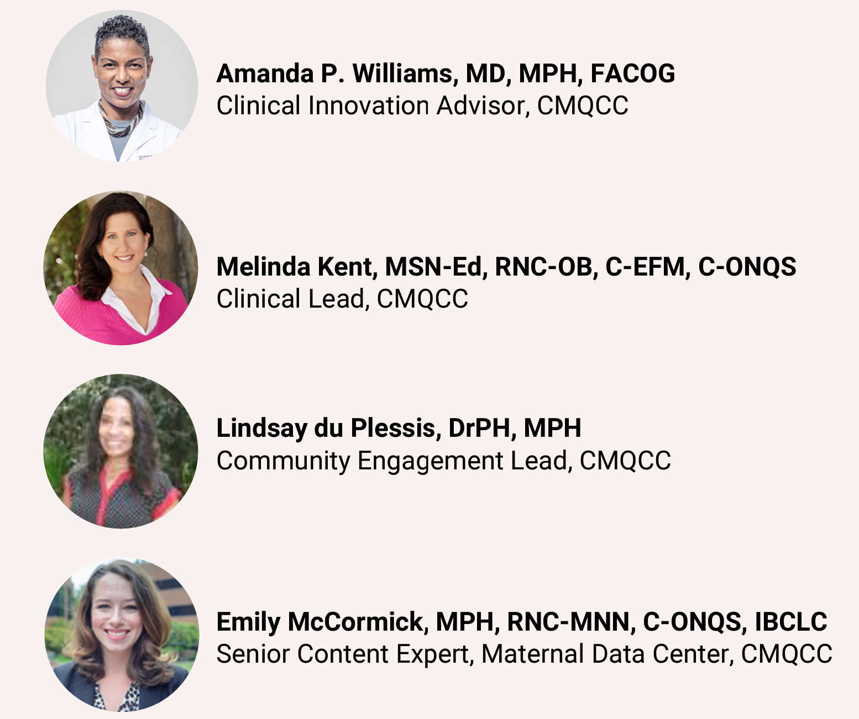
Today’s Speakers
Notes:
Combs et al., 2023
SMFM Patient Safety and Quality Committee, et al., 2019
Singh, et al., 2023

Slide 7
INTRODUCTION

Slide 8
Introduction
An Overview of Facts
Hypertensive disorders of pregnancy (HPD) complicate between 13 to 16% of all pregnancies nationally, while preeclampsia complicates 3 to 4% of pregnancies yearly, causing maternal and newborn morbidity and mortality.
LDA commenced between 12 and 16 weeks and taken daily through delivery for those who meet the criteria is still in need of wide implementation in a standardized fashion nationwide.
Prophylactic LDA (81 mg) for those who have screened at risk reduces fetal growth restriction, preeclampsia, preterm birth, and perinatal death, and is the only intervention for the primary prevention of preeclampsia
Screening for preeclampsia risk provides the ability for early intervention, prevention, and closer monitoring during pregnancy when indicated
The development of preeclampsia increases the risk of chronic hypertension and cardiovascular disease later in a birthing patient’s and the offspring’s life.
In 2021, the U.S. Preventive Services Task Force (USPSTF), American College of OBGyn (ACOG), and Society for Maternal-Fetal Medicine (SMFM) made a joint recommendation for daily prenatal LDA for birthing patients with any high-risk preeclampsia factor, or >1 moderate risk factor.
Notes:
Combs et al., 2023
Boakye & Obisesan, 2021
SMFM Patient Safety and Quality Committee, et al., 2019
Singh, et al., 2023

Slide 9
Risk Factor Screening
When?
Screening is recommended at the patient’s 1st prenatal care appointment with LDA initiation at 12 -16 weeks gestation (up to 28)

Slide 10
Risk Factor Screening
When?
Which Patients?
Screening is recommended at the patient’s 1st prenatal care appointment with LDA initiation at 12 -16 weeks gestation (up to 28)
Risk factor screening for all prenatal care patients whether deemed or viewed as low or high-risk

Slide 11
Risk Factor Screening
When?
Which Patients?
By Whom?
Screening is recommended at the patient’s 1st prenatal care appointment with LDA initiation at 12 -16 weeks gestation (up to 28)
Risk factor screening for all prenatal care patients, whether deemed or viewed as low or high-risk
All prenatal care providers to screen at the first prenatal care appointment
Even if a low-risk provider: patients still may have multiple risk factors and be seeing a low-risk prover. i.e., black race, nulliparity, and lower income

Slide 12
1
or more
more than
1

Slide 13
Best Practices for Respectful
Compassionate Discussions with Patients
Our Responsibilities
Ensure patients feel:
empowered
well-informed
equipped to make the best decisions for themselves and their baby

Slide 14
Best Practices for Respectful
Compassionate Discussions with Patients
Our Responsibilities
Explain
Ensure patients feel:
empowered
well-informed
equipped to make the best decisions for themselves and their baby
The risk factor screening process benefits
can help identify those at higher risk for developing preeclampsia
provides opportunity for prevention

Slide 15
Best Practices for Respectful
Compassionate Discussions with Patients
Our Responsibilities
Explain
Review and Discuss
Ensure patients feel:
empowered
well-informed
equipped to make the best decisions for themselves and their baby
The risk factor screening process benefits
can help identify those at higher risk for developing preeclampsia
provides opportunity for prevention
ALL risk factors with ALL patients
explain each risk factor fully
assure questions are encouraged and patients verbalize their understanding

Slide 16
African American/ Black Race
Exposure to Systemic Racism Risk Factor
Related to . . .
This risk factor . . .
environmental, social, and historical inequities shaping health exposures, access to healthcare, and unequal distribution of health resources; not from genetic predisposition, nothing inherently wrong with the patients
has been well-established and studied; acknowledging and discussing this factually and respectfully is the best practice; Non-Hispanic Black women are disproportionately affected by preeclampsia along with being most likely to experience related complications
Structural racism . . .
The exact reasons . . .
is recognized as a mediator of health outcomes and has impacted preeclampsia rates
for the increased risk of preeclampsia in Black patients in the United States is not fully understood; it is believed to be due to toxic stress from a history of racism and discrimination in American healthcare and throughout history
Notes:
Boakye & Obisesan, 2021

Slide 17
Obesity / Pre-pregnancy BMI>/greater than 30
Risk Factor
Pre-Pregnancy BMI Categories
Healthy Weight 18.5-24.9
Overweight 25.0-29.9
Obesity: 30.0 and above
The Systemic Racism Risk Factor is not biological; however, the Obesity Risk Factor is
An important part of pregnancy planning is healthy nutrition and physical activity
Beginning a pregnancy with a healthy weight helps provide the optimum environment for pregnancy development
Obtaining and maintaining a healthy weight may be critical for both a patient and their fetus. Therefore, it is vital for those with a pre-pregnancy BMI greater than 30 to be educated about and have a proper diet and physical activity (when not contraindicated) encouraged and supported
About 50% of pregnancies in the U.S. begin with a BMI category of Overweight or Obese; associated pregnancy complications of these weight categories include gestational hypertension and preeclampsia
l
Gestational hypertension and preeclampsia are also recognized for increased risk of development of cardiovascular disease and diabetes later in life for both the pregnant patient and their child
Notes:
Poniedziałek-Czajkowska et al., 2023

Slide 18
Obesity / Pre-pregnancy BMI>/greater than 30
Risk Factor
Conversation approach . . .
Provide strength . . .
nonjudgmental, understanding, and empathetic
help your patients feel supported and stronger than before they talked with you; help and encourage them to take control of their health and make positive change towards a healthier lifestyle
Information . . .
Be a resource . . .
clear and honest; about Body Mass Index measurement rather than scale weight measurement
provide resources for proper nutrition, support, and tracking weight gain during pregnancy such as:
https://www.cdc.gov/reproductivehealth/maternalinfanthealth/pregnancy-weight-gain.htm#trackers

Slide 19
Factors to Consider During Preeclampsia Patient Education
Less than half of pregnant patients know the signs and symptoms of preeclampsia
Ask about specific signs and symptoms rather than asking if there are any signs and symptoms your patient would like to report

Slide 20
Knowledge is Power; Let’s Empower Our Patients!
We Must Educate & We Must Listen
Patients have historically reported a lack of understanding about their preeclampsia
Patients and their family/friends often are the first responders; education is power
Knowing preeclampsia signs and symptoms is the first line of defense for early diagnosis and treatment
Understanding how severe preeclampsia can be may improve reporting and treatment compliance
The disease process can progress rapidly; patients understanding the signs and symptoms that require immediate reporting can save lives
Patient education improves clinical outcomes
Notes:
Preeclampsia.org, 2022

Slide 21
Knowledge Level
Written Pt. Education
Educate to the 4th – 6th grade level
Simple words and short sentences
Only evidence-based information
Include pictures when able to
Notes:
Preeclampsia.org, 2022

Slide 22
Knowledge Level
Written Pt. Education
Verbal Pt. Education
Educate to the 4th – 6th grade level
Simple words and short sentences
Only evidence-based information
Include pictures when able to
Educate the patient’s knowledge level
Assure the patient’s understanding by repeat back and time for the patient to converse about the topic, encouraging them to ask questions
If providing instructions, have the patient or family demonstrate
Notes:
Preeclampsia.org, 2022

Slide 23
Knowledge Level
Written Pt. Education
Verbal Pt. Education
Resources
Educate to the 4th – 6th grade level
Simple words and short sentences
Only evidence-based information
Include pictures when able to
Educate the patient’s knowledge level
Assure the patient’s understanding by repeat back and time for the patient to converse about the topic, encouraging them to ask questions
If providing instructions, have the patient or family demonstrate
Provide sustainable resources, i.e.:
March of Dimes www.marchofdimes.org/find-support/topics/pregnancy/preeclampsia
Preeclampsia Foundation www.preeclampsia.org/signs-and-symptoms
Notes:
Preeclampsia.org, 2022

Slide 24
PATIENT STORY

Slide 26
CLOSING STATEMENTS

Slide 27
Our mission at CMQCC is to end preventable morbidity, mortality, and racial disparities in maternity care. We create tools, including scripts and education materials, and improve outcomes through data-driven quality improvement. We all must listen with our hearts and minds, and remember that the more different someone is from us, the harder we need to listen!

Slide 28
The Low-Dose Aspirin to Prevent Preeclampsia
Project

Slide 29
CMQCC and the LDA Project
Engagement with California:
Pilot hospitals
Community clinics
Community-based organizations (CBOs)
Patients with lived experience

Slide 30
The ‘Let’s Do Aspirin’ Campaign
Pilot Hospital Sites:
Loma Linda University Children’s Hospital (3 clinics)
Riverside University Health System Medical Center (7 clinics)
UC San Diego (3 clinics)
Scripps Chula Vista (3 clinics)
Mercy San Juan Sacramento (3 clinics)
Partners:
Kaiser Permanente Northern California

Slide 31
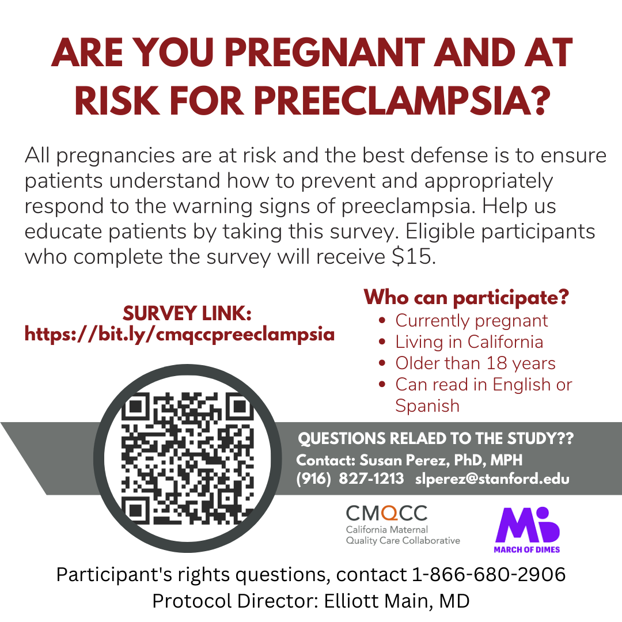
LDA Implementation:
Research and Hospital/ Clinic Outreach
Surveys
Patient Surveys
Provider Surveys

Slide 32
LDA Implementation:
Research and Hospital/ Clinic Outreach
Surveys
QI Collaborative Meetings
Patient Surveys
Provider Surveys
Hospital site Leads
Clinic champions
Community-based organizations (CBOs)
Patient Advisory Committee (PAC)

Slide 33
LDA Implementation:
Research and Hospital/ Clinic Outreach
Surveys
QI Collaborative Meetings
MDC Data Collection
Patient Surveys
Provider Surveys
Hospital site Leads
Clinic champions
Community-based organizations (CBOs)
Patient Advisory Committee (PAC)
Data gathered in the hospital during the med reconciliation process
Will be reviewed by our MDC team in a few minutes

Slide 34
LDA Implementation:
Research and Hospital/ Clinic Outreach
Patient Education Materials (English & Spanish)
Information Sheet
Poster
Patient Risk Assessment Scoreboard
Other Outreach Opportunities include videos, patient advisory committee, press releases, community fairs and other events

Slide 35
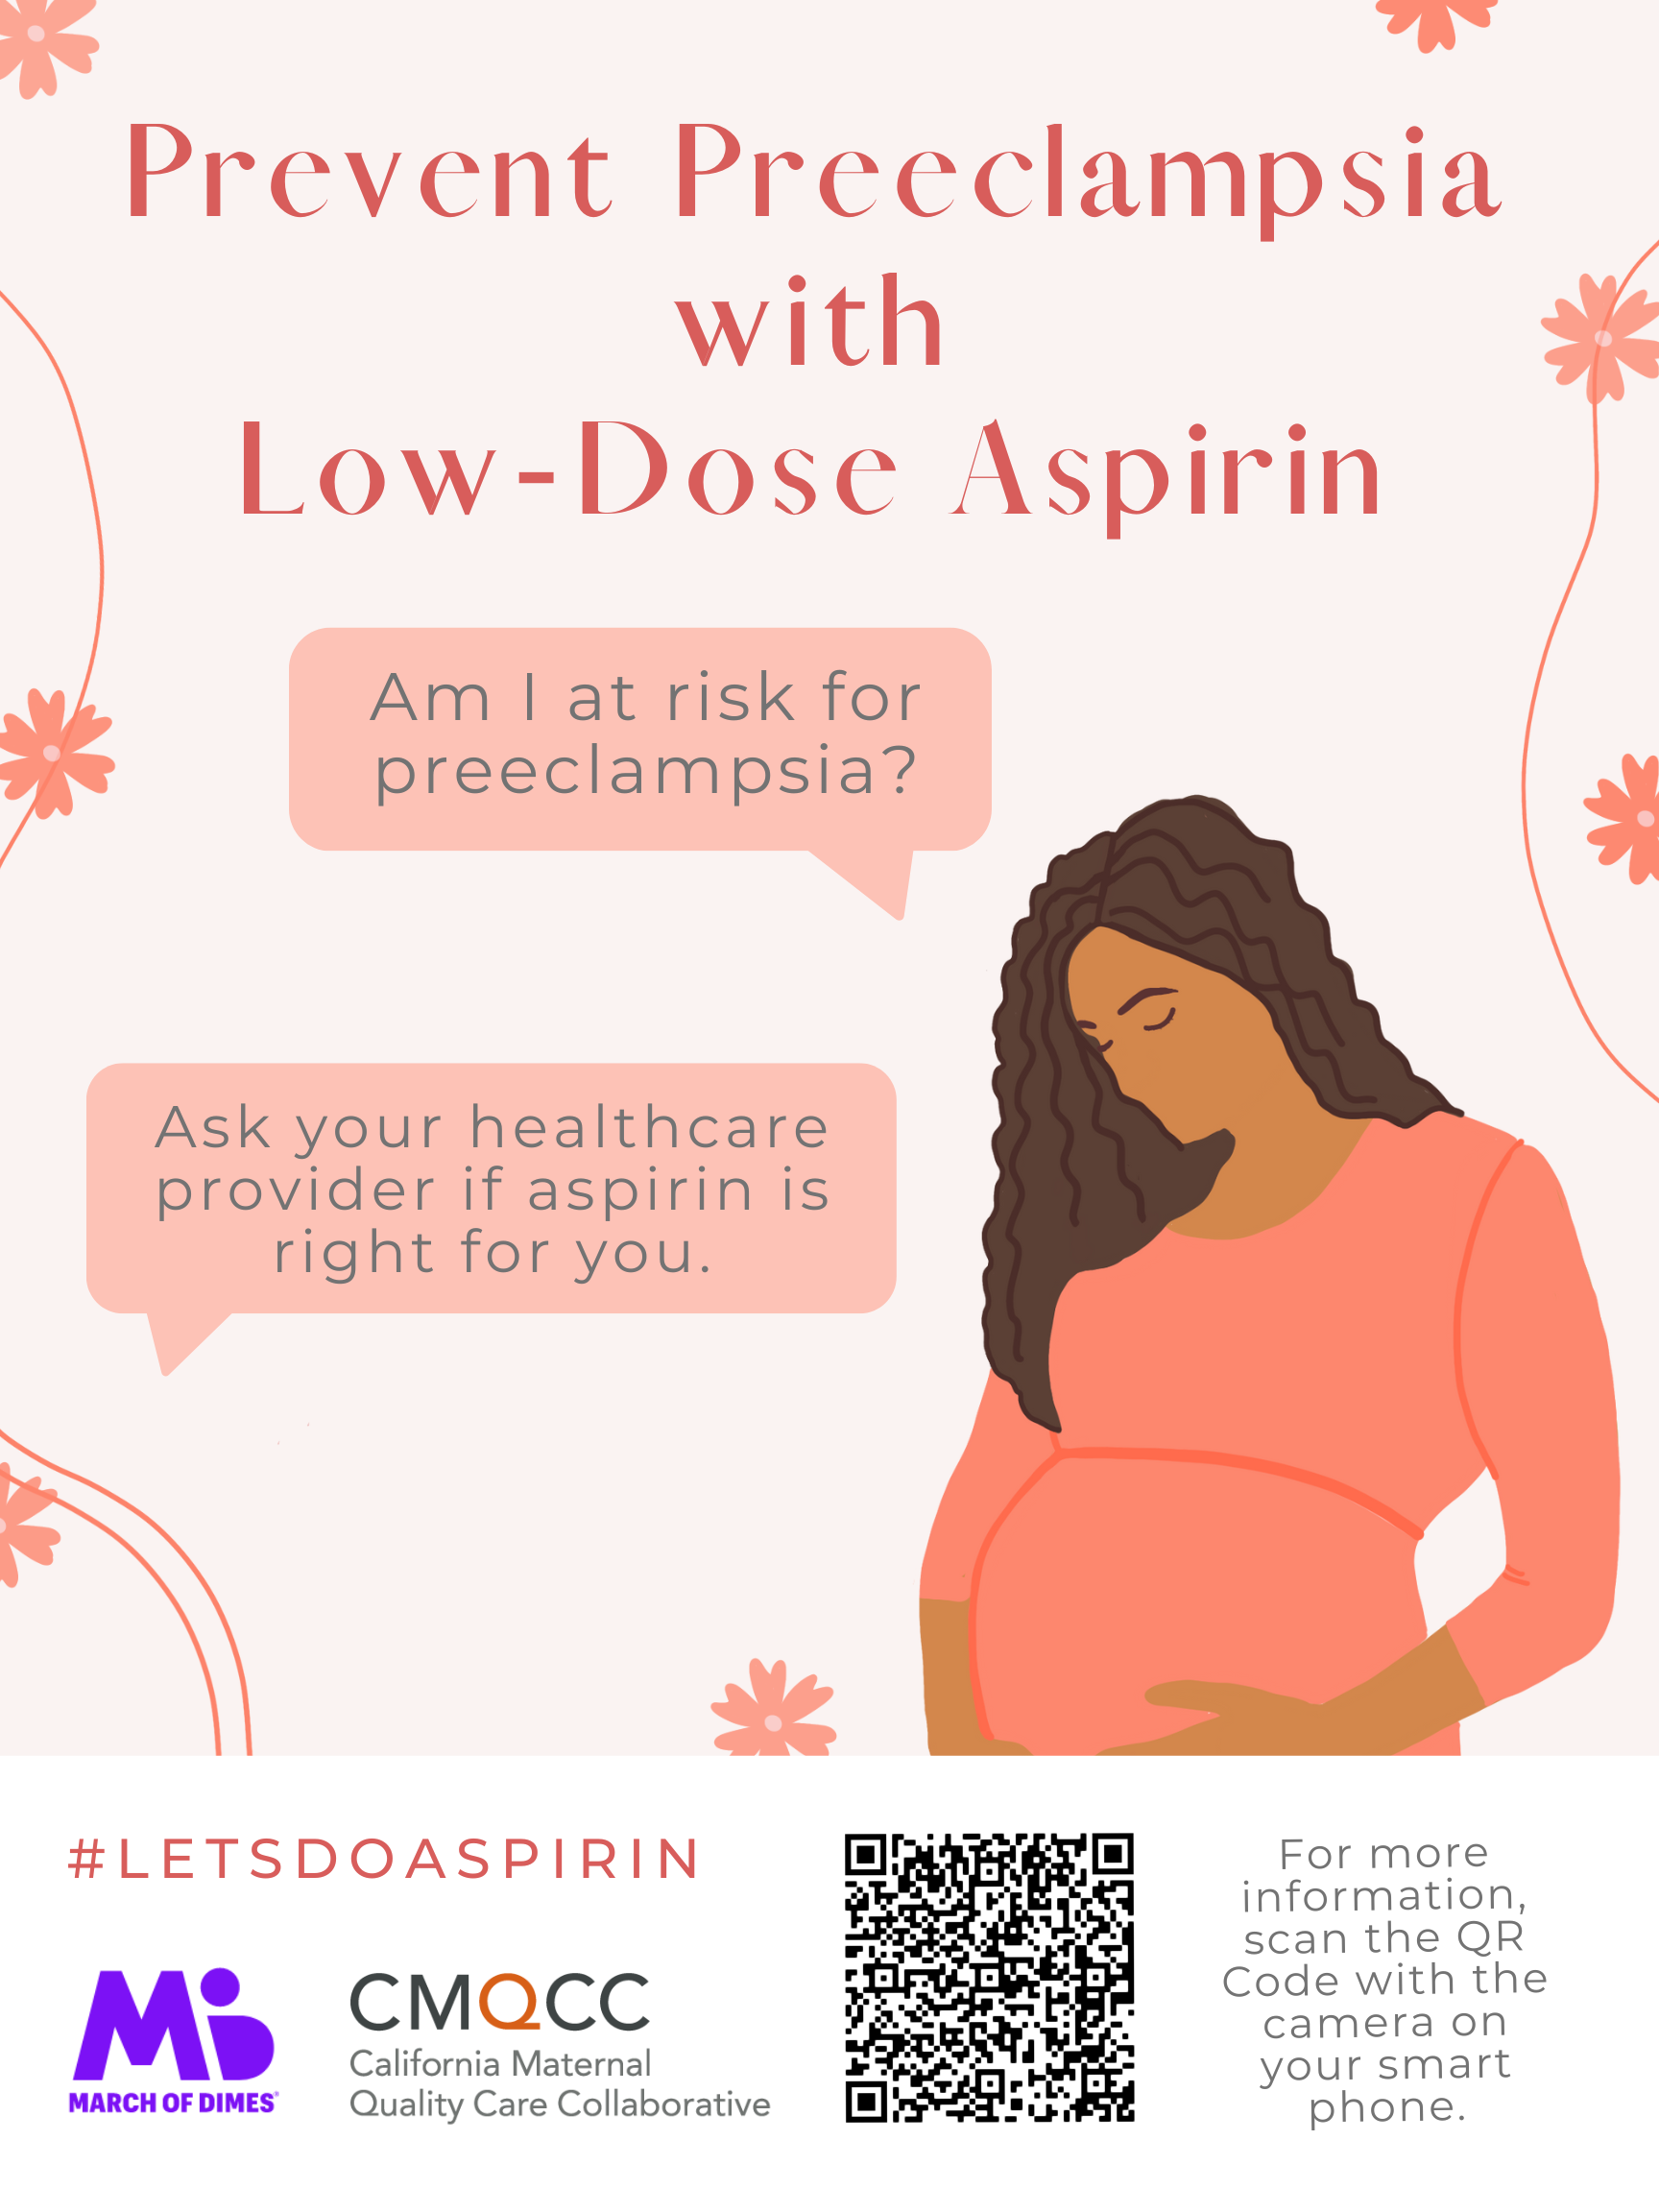
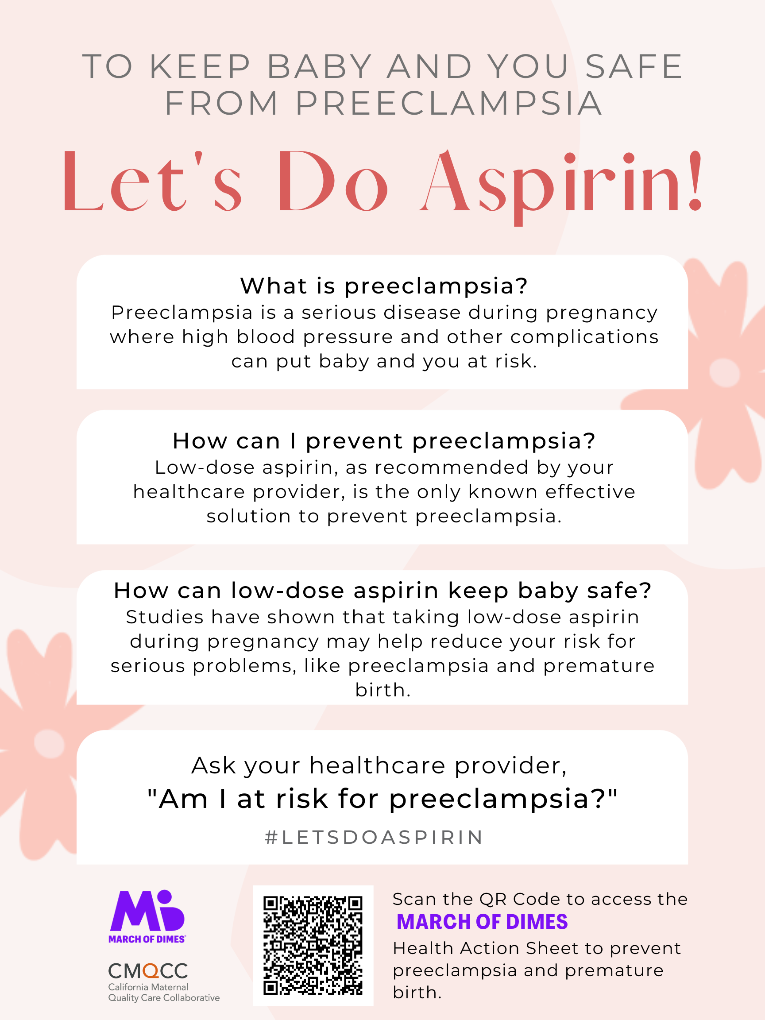

Slide 36
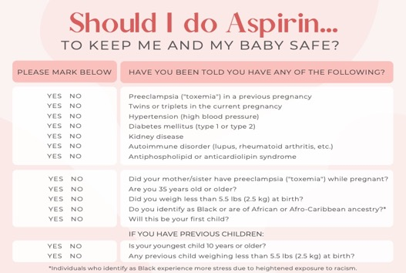
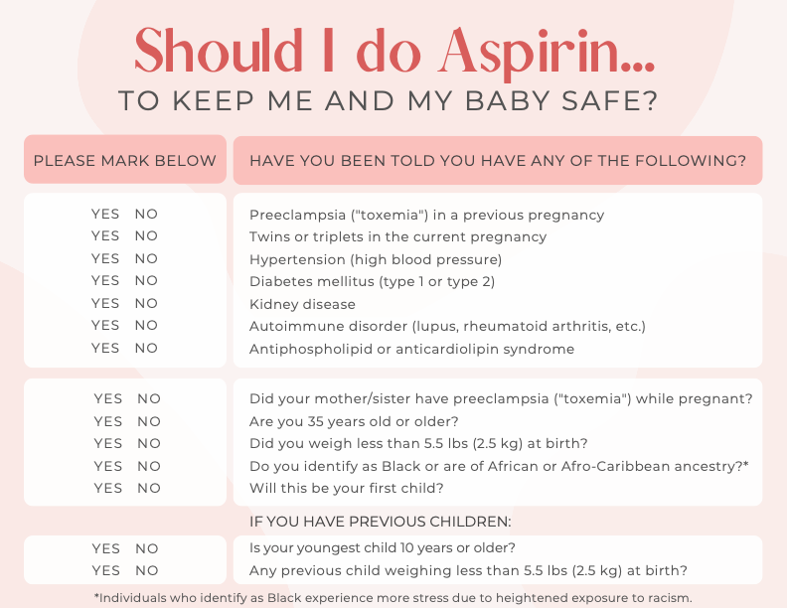
LDA Campaign Patient Scorecard Created
The original preeclampsia risk screening tool was created in collaboration between the US Preventive Services Task Force (USPSTF), the American College of Obstetricians and Gynecologists (ACOG), and the Society for Maternal-Fetal Medicine (SMFM)
Notes:
This is an example of patient education materials with the prior information in a patient centered format, that we have been providing to our pilot hospital systems on behalf of the MOD, along with the information sheet and poster that you just saw.

Slide 37
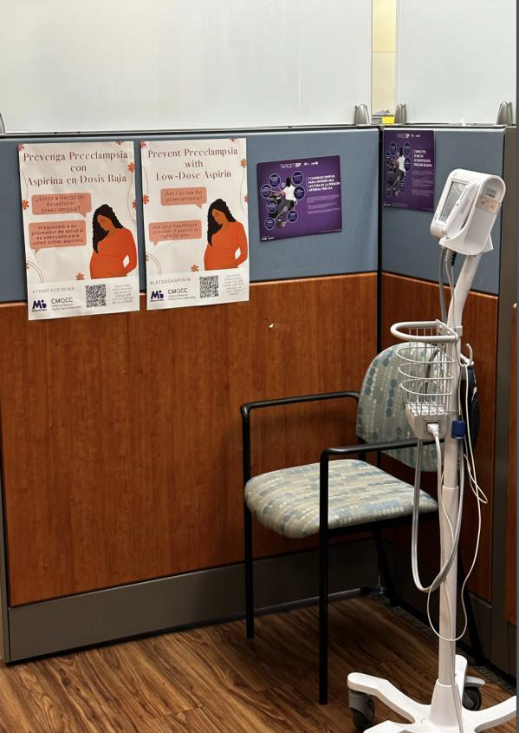
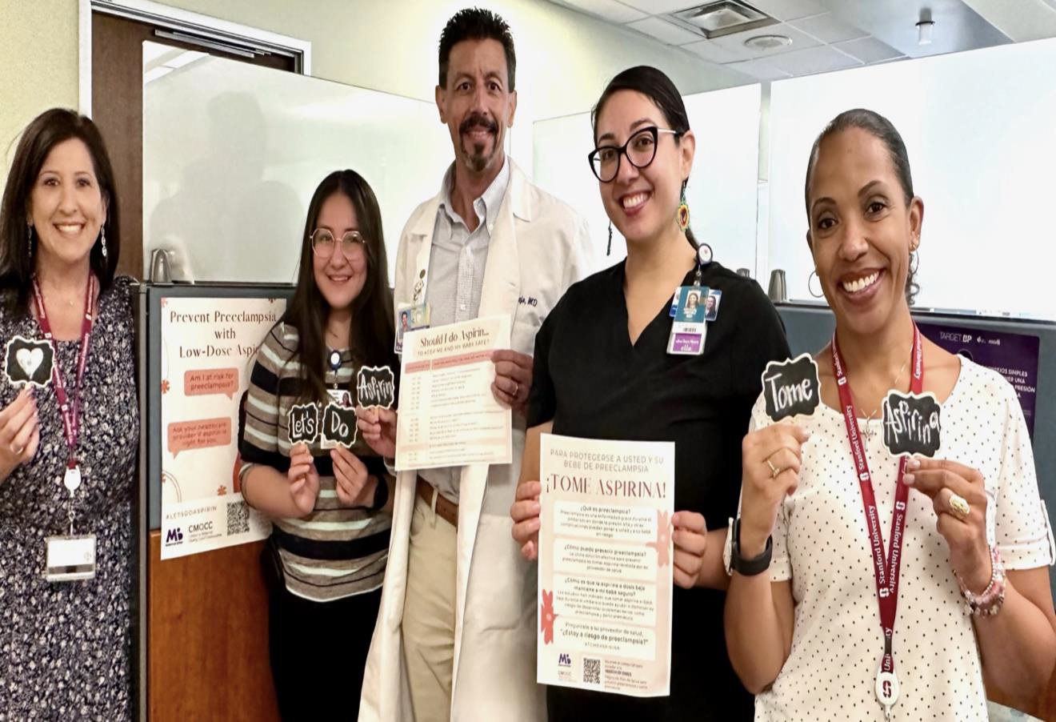
Site Visits

Slide 38
Cohort 2
Send out invitation letters to invite select hospitals to participate in the “Expanded LDA Pilot” (2024)
Continue to shape Clinic-to-Clinic QI planning and implementation
Recruit a risk-stratified (by preeclampsia and preterm birth rates), high-volume delivery sample of hospitals and affiliated clinics across CA regions
Monthly QI collaborative meetings, patient and provider education tools, community engagement, patient advisory committee, and more

Slide 39
LDA Tools in CMQCC’s Maternal Data Center
(MDC)

Slide 40
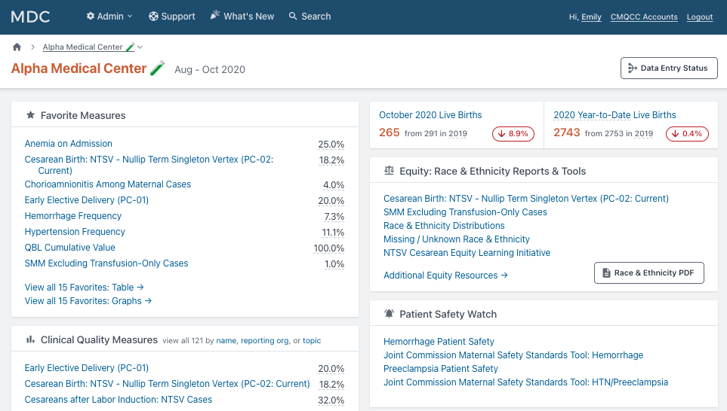
CMQCC Maternal Data Center
Tools to Support Low-Dose Aspirin (LDA) Initiative
CMQCC’s Maternal Data Center (MDC) is a confidential tool designed to support hospitals’ quality improvement efforts. Almost every hospital in CA participates in the MDC.

Slide 41
MDC Tools to Support LDA Initiative
All now available in the MDC
LDA Usage Among Those at Risk of Preeclampsia*
Preterm Birth Among Those at Risk for Preeclampsia
Preeclampsia Among Those at Risk for Preeclampsia
Preterm Preeclampsia Rate
All of these measures can be stratified by race & ethnicity, payer, delivery method, gestational age, prenatal care group*, and more.
Preeclampsia Rate
*requires supplemental data submission

Slide 42
MDC Tools to Support LDA Initiative
To track LDA usage in the Maternal Data Center, click on Data Entry Status in the upper right-hand corner of the MDC landing page.
Go to the row LDA Usage and select a month to review!
Don’t see a row labeled LDA Usage? Click the “Select Measures” button to see the list of measures you can display on this screen. You may need to add it!

Slide 43
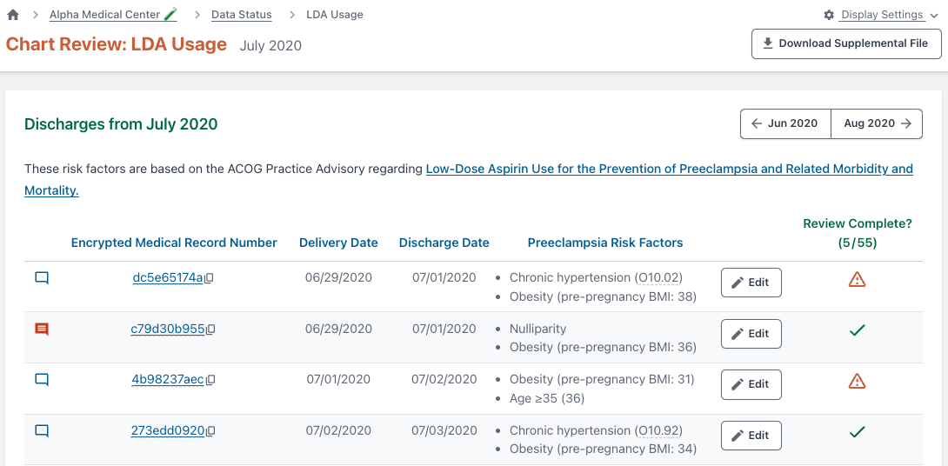
On the chart review screen, the MDC will display all patients identifiable based on risk factors per ACOG, using ICD-10 codes and birth certificate data. Click the “Edit” button to submit data for the patient.

Slide 44
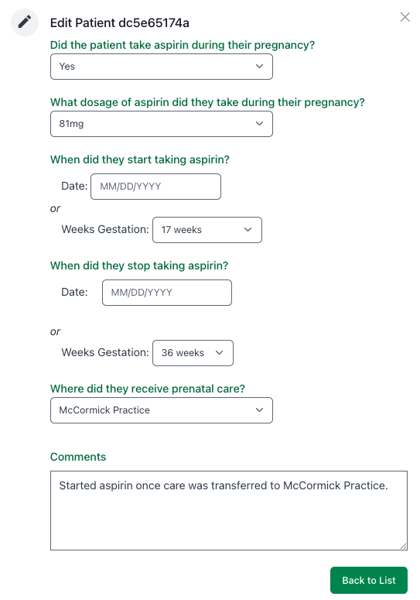
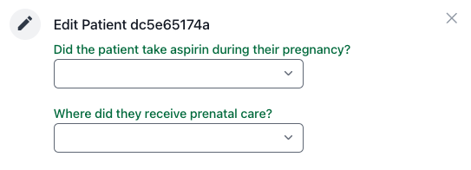
To start, you’re asked two questions.
Did the patient take aspirin during their pregnancy?
- YES or NO
Where did they receive prenatal care?
- The drop-down list will reflect any prenatal care group you’ve identified in the MDC.
If they did take aspirin, additional questions will appear:
- What dosage of aspirin did they take during their pregnancy? 81mg, 100mg, 162mg
- When did they start taking aspirin?
- When did they stop taking aspirin?

Slide 45
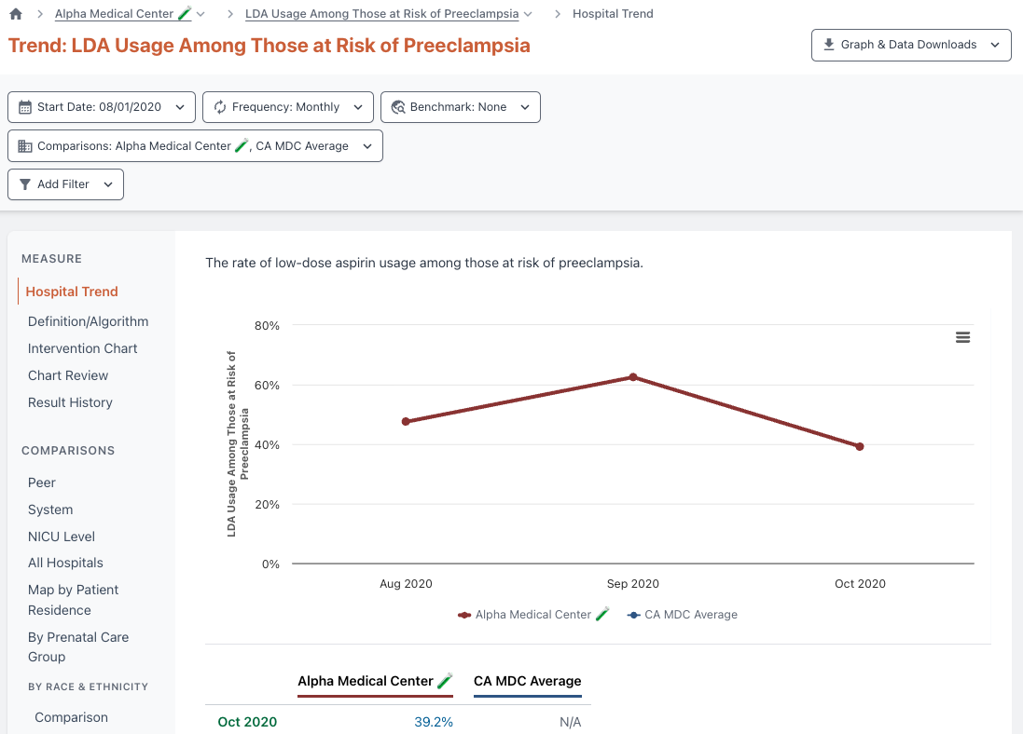
Track interventions on a run chart to see the average rate before and after the intervention
Compare and stratify your rate to identify specific opportunities for improvement
Drill down to the patient level to review cases that didn’t receive LDA

Slide 46
MDC: Compare Two Measures
Questions? Want to learn more? Contact us at datacenter@cmqcc.org

Slide 47
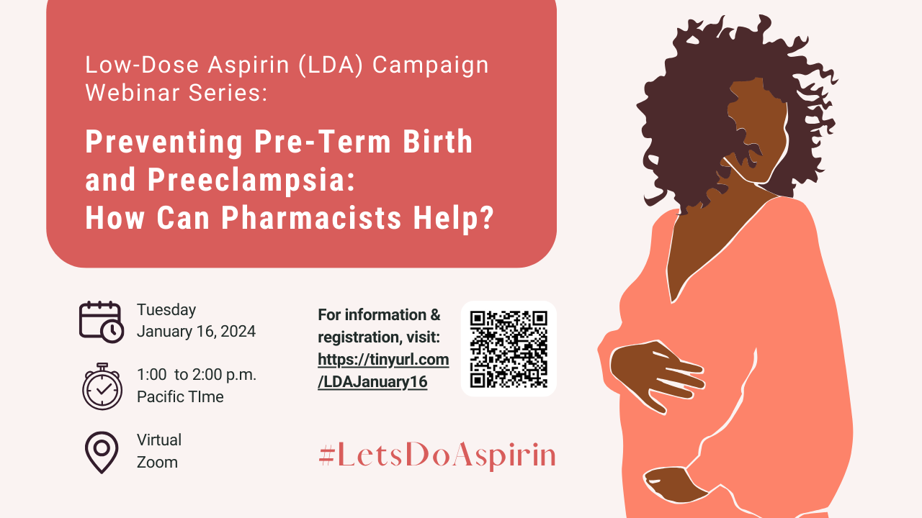
Register for our Next LDA Webinar!

Slide 48
Follow @CMQCC on LinkedIn, Facebook, and X
@CAMaternalQualityCare on Instagram
Access the LDA Project Resources here:
https://www.cmqcc.org/qi-initiatives/low-dose-aspirin-prevent-preeclampsia

Slide 49
Thank you for joining us!

Slide 50
References
Boakye, E., MD, MPH, & Obisesan, O., MD, MPH (2021, December 20). Nativity-Related Disparities in Preeclampsia and Cardiovascular Disease Risk Among a Racially Diverse Cohort of US Women. JAMA Network Open. Retrieved November 30, 2023, from doi:10.1001/jamanetworkopen.2021.39564
Combs, C. A., MD, Ph.D., Kumar, N. R., MD, Morgan, J. L., MD, & SMFM Patient Safety and Quality Committee (2023). Society for Maternal-Fetal Medicine Special Statement: Prophylactic low-dose aspirin for preeclampsia prevention—Quality metric and opportunities for quality improvement. American Journal of Obstetrics and Gynecology, Volume 229(Issue 2), PB2-B9. https://doi.org/10.1016/j.ajog.2023.04.039
Johnson, J. D., MD, & Louis, J. M., MD, MPH (2020). Does race or ethnicity play a role in the origin, pathophysiology, and outcomes of preeclampsia? An expert review of the literature. Ajog.org.
March of Dimes (2021, May 11). High blood pressure, preeclampsia and pregnancy. Healthy Mom Strong Babies. Retrieved October 1, 2023, from https://www.marchofdimes.org/find-support/blog/high-blood-pressure-preeclampsia-and-pregnancy
Poniedziałek-Czajkowska, E., Mierzyński, R., & Leszczyńska-Gorzelak, B. (2023). Preeclampsia and Obesity-The Preventive Role of Exercise. International journal of environmental research and public health, 20(2), 1267. https://doi.org/10.3390/ijerph20021267
Preeclampsia Foundation (2022, February 8). Resources for Nurses. Retrieved October 3, 2023, from https://www.preeclampsia.org/nurses
Singh, N., MD, Shuman, S., MHS, Chiofalo, J., MPA, Cabrera, M., MD, & Smith, A., DO (2023). Missed opportunities in aspirin prescribing for preeclampsia prevention. BMC Pregnancy and Childbirth, 23(717), 1-6. https://bmcpregnancychildbirth-biomedcentral-com.laneproxy.stanford.edu/articles/10.1186/s12884-023-06039-w
SMFM Patient Safety and Quality Committee, Combs, C. A., MD, PhD, & Montgomery, D. M., MD (2019). American Journal of Obstetrics and Gynecology, Volume 223(Issue 3), PB7-B11. https://doi.org/10.1016/j.ajog.2020.06.003

