Slide 1

Elimination of Non-medically Indicated (Elective) Deliveries Before 39 Weeks Gestational Age
A Quality Improvement Toolkit
Funding for the development of this toolkit was provided by:
Federal Title V block grant funding from the California Department of Public Health; Maternal, Child and Adolescent Health Division was used by the California Maternal Quality Care Collaborative to develop the toolkit; and March of Dimes.
Notes:
Slide Set #1
This first slide set presentation was developed to educate clinicians about the growing problem of elective deliveries and how to address the issue within the hospital. This presentation is intended for Grand Rounds or flip chart on L&D.

Slide 2
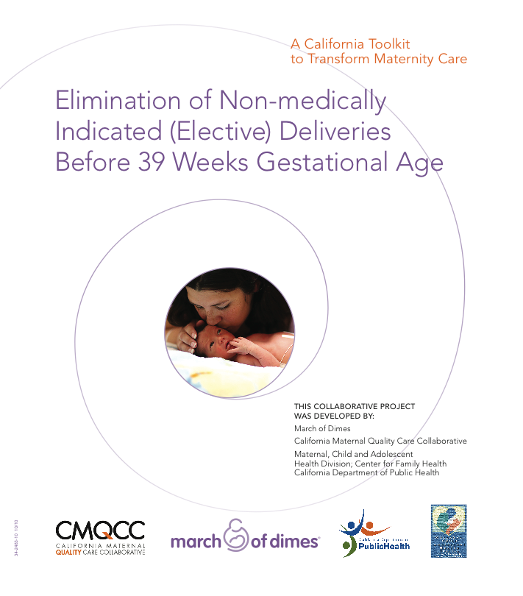
Elimination of Non-medically Indicated (Elective)
Deliveries Before 39 Weeks

Slide 3
Acknowledgments
Toolkit Authors:
Elliott Main, MD
Bryan Oshiro, MD
Brenda Chagolla, RN, MSN, CNS
Debra Bingham, Dr.PH, RN
Leona Dang-Kilduff, RN, MSN
Leslie Kowalewski
Author Organizations:
California Maternal Quality Care Collaborative (CMQCC)
California Pacific Medical Center
Loma Linda University School of Medicine
Catholic Healthcare West
California Perinatal Quality Care Collaborative (CPQCC)
  March of Dimes

Slide 4
Review Committee
Diane Ashton, MD, MPH, FACOG; March of Dimes, Deputy Medical Director (White Plains, NY)
Jennifer Baptiste-Smith, MPH; San Bernardino Public Health Department (San Bernardino)
Scott Berns, MD, MPH, FAAP; March of Dimes, Senior VP Chapter Program Support (White Plains, NY)
James Byrne, MD; Santa Clara Valley Medical Center, Chief, Obstetrics and MFM (San Jose)
William Gilbert, MD; Sutter Health Sacramento, CMQCC Executive Committee (Sacramento)
Jeffrey B. Gould, MD, MPH, PI CPQCC; CMQCC Executive Committee (Stanford)
Rory Jaffe, MD, MBA; Executive Director, California Hospital Patient Safety Organization (Sacramento)
Peyton Mason-Marti, MPH; March of Dimes, State Director of Programs California Chapter (San Francisco)
Connie Mitchell, MD, MPH; CDPH, California Maternal, Child and Adolescent Health Division (Sacramento)
Barbara Murphy, MS, RN; Director of Perinatal Programs, CMQCC Executive Committee (Palo Alto)
Gretchen Page, MPH CNM; Manager, Community Grants, LLUMC/Children’s Hospital (Loma Linda)
Steven Parry, MD; FACOG, MCBWARD, Medi-Cal Benefits Branch, Medical Consultant II (Sacramento)
Karen Ramstrom, DO, MSPH; CDPH, Maternal, Child, Adolescent Health Division Policy Branch Chief
(Sacramento)
Leona Shields, PHN, RN, NP, MFT; Nurse Consultant Specialist, Maternal, Child and Adolescent Health Division
(Sacramento)
Stephanie Turner, Sr VP, RM; Optima Healthcare Insurance Services (Roseville)
Lucy Van Otterloo, RN, MSN; Community Perinatal Network, CMQCC (Whittier)
John Wachtel, MD, FACOG; Adjunct Clinical Professor Department of OB/GYN at Stanford Medical School,
ACOG District IX Patient Safety Officer and Chair, Patient Safety and Quality Improvement Committee
(Menlo Park)
Also a BIG Thank You to All the March of Dimes Big 5 State Reviewers

Slide 5
Letters of Support
American Congress of Obstetricians and Gynecologists District II (New York)
American Congress of Obstetricians and Gynecologists Illinois Section (District VI)
American Congress of Obstetricians and Gynecologists District IX (California)
American Congress of Obstetricians and Gynecologists FACOG (Florida)
American Congress of Obstetricians and Gynecologists District XI (Texas)
Association of Women’s Health, Obstetric and Neonatal Nurses (AWHONN)
  National
  California

Slide 6
Objectives
Describe the increase in non-medically indicated (elective) deliveries before 39 weeks and identify the contributing factors.
Discuss the risks of early term deliveries and the benefits of delaying delivery beyond 39 weeks gestation.
Outline successful initiatives to reduce elective deliveries before 39 weeks at hospital, health system and statewide levels.
Describe a sample implementation plan for the prevention of elective deliveries before 39 weeks.

Slide 7
Terminology
Late Preterm
Early Term
First day of LMP
Week #
0
20 ^{0/7}
34^{0/7}
37 ^{0/7}
39 ^{0/7}
41^{6/7}
Preterm
Term
Post term
Modified from Drawing courtesy of William Engle, MD, Indiana University
Raju TNK. Pediatrics, 2006;118 1207.
Notes:
7
It is understood that prematurity poses significant risks to the neonate. And it is understood that the risks of neonatal morbidity from prematurity are inversely related to advancing gestational age. Due to the tremendous advances in neonatal care, many of us have become complacent about the risks to babies of delivering beyond 34 weeks. It is becoming increasingly clear that there is not only a risk to babies born in the late preterm period (between 34-37 weeks) but there is an increased risk for babies born in the early term period, defined as deliveries taking place between 37 weeks and 0 days and 38 weeks and 6 days.

Slide 8
Inductions of Labor
Since 1979, ACOG has cautioned against inductions before 39 weeks in the absence of a medical indication.
Confirmation of gestational age is CRITICAL:
  Ultrasound before 20 weeks gestation to establish accurate gestational age of the fetus
  Documentation of fetal heart tones for 30 weeks using Doppler ultrasonography
  Confirmation that it has been 36 weeks since a positive pregnancy test was obtained
Notes:
Since 1979, the American Congress of Obstetricians & Gynecologists (ACOG) has cautioned against inducing women before 39 weeks unless there is a medical or obstetrical indication to do so. An obvious issue is to accurately determine gestational age. Fortunately, ACOG has given us some guidance on this issue in their publication on induction of labor. (Read the bullets on confirmation of gestational age).

Slide 9
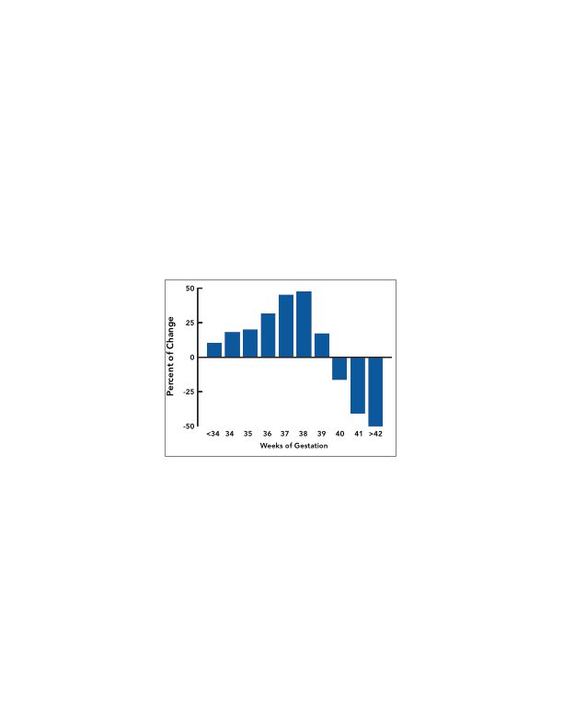
Change in Distribution of Births by Gestational Age: United States, 1990-2006
Source: CDC/NCHS, National Vital Statistics Systems.
Martin JA, Hamilton BE, Sutton PD, Ventura SJ, et al. Births: Final data for 2006. National vital statistics reports; vol 57 no 7. Hyattsville, MD: National Center for Health Statistics. 2009.
Notes:
This slide illustrates the changing distribution of births to a lower gestational age over a 16 year period. As you can see, there is a sharp decline in deliveries occurring after 39 weeks with a concomitant sharp increase in births occurring particularly between 36-38 weeks gestation.

Slide 10
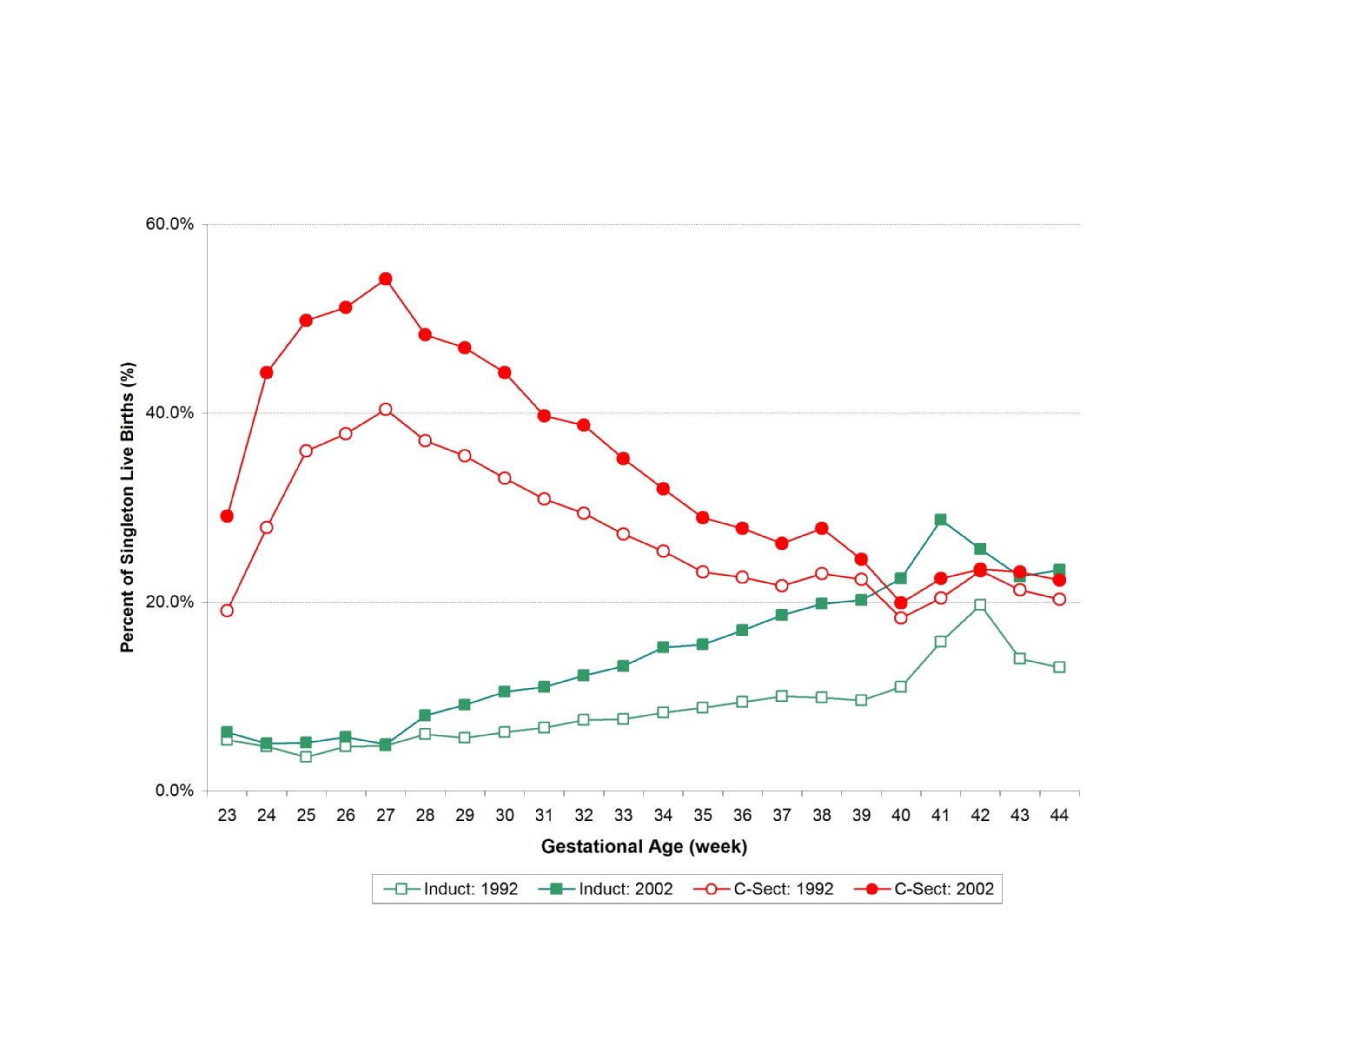
U.S. Cesarean Section and Labor Induction Rates Among Singleton Live Births by Week of Gestation, 1992 and 2002.
2002 C-S
Early Term
1992 C-S
2002 Induction
1992 Induction
Source: NCHS, Final Natality Data, Prepared by March of Dimes Perinatal Data Center, April 2006.
Notes:
This graph illustrates a significant increase in both induction of labor and cesarean deliveries in 2002 compared to 1992. The largest increase in induction of labor seems to occur in the early term and term period and although the cesarean section increase is fairly constant and begins to narrow at around 34-35 weeks, a significant difference only disappears after 39 weeks.

Slide 11
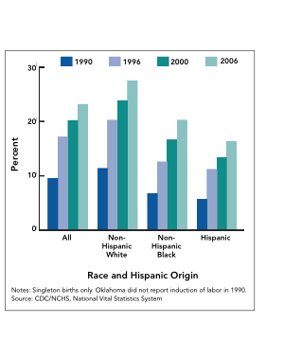
Rates of Induction of Labor by Race and Hispanic Origin in the U.S.
Martin JA, Hamilton BE, Sutton PD, Ventura SJ, et al. Births: Final data for 2006. National vital statistics reports; vol 57 no 7.
Hyattsville, MD: National Center for Health Statistics. 2009.
Notes:
The increased rates of induction have been similar across all racial groups, with the highest increase in non-Hispanic whites.

Slide 12
Why are Non-medically Indicated (Elective/Planned) Deliveries Increasing in Frequency?
Notes:
Let’s take a look at some of the reasons that elective deliveries are increasing.

Slide 13
Elective Induction:
Sounds like a good idea…
Advanced planning
Mother lives far away; history of quick labors
Delivered by her doctor
Maternal intolerance to late pregnancy
      Excess edema, backache, indigestion, insomnia
Prior bad pregnancy
And, it’s okay right?
Clin Obstet Gynecol 2006;49:698-704
Notes:
Why have elective deliveries increased? It is not totally clear. Although the physician is the one who controls the act of scheduling, it is not clear what drives that decision. It may very well be impacted by the fact that patients and obstetricians are unaware of any harm. And there are definitely perceived benefits for timing the delivery. So why not plan the delivery around a convenient date for both the obstetrician and the expectant mother and her family?

Slide 14
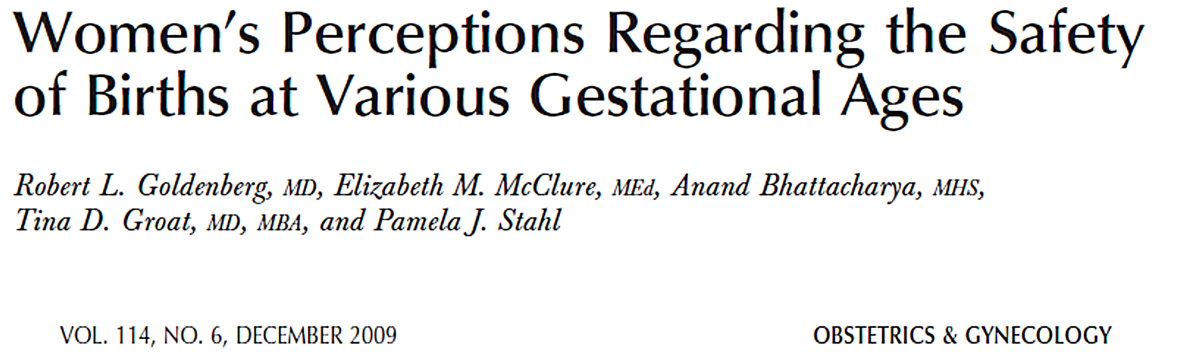
Obstet Gynecol 2009;114:1254
Notes:
This study by Goldenberg et al. addresses the potential impact of the patient on initiating the elective delivery process due to a lack of understanding of the risks of an early delivery. A national sample of 650 insured women was commissioned by a large health care insurance company. The purpose of the study was to understand women’s beliefs related to the meaning of full term and the safety of delivery at various gestational ages. The study was anonymous and voluntary and included women who had given birth within the last 18 months; were first time mothers of singleton infants; currently had health insurance coverage either through their employer or spouse’s employer; had completed at least some high school education; and delivered their child at a hospital or medical facility. Those who had diabetes, hypertension/preeclampsia, or obesity or had any other medical condition that would put them at high risk for a cesarean delivery were excluded from the study. The online survey was conducted August 16-19, 2008, while the telephone portion of the survey was conducted August 18-29, 2008. 58% were white, 93% were married or partnered, and 77% had a yearly family income of at least $50,000. Nearly 50% were employed full-time and nearly 69% held a college degree.

Slide 15
The Gestational Age that Women Considered a Baby to be Full Term
Obstet Gynecol 2009;114:1254
Notes:
When participants were asked “At what gestational age do you believe the baby is considered full term?”, nearly 25% chose 34-36 weeks. Another 50% chose 37-38 weeks and only 25% chose 39-40 weeks.

Slide 16
The Gestational Age that Women Considered it Safe to Deliver
Weeks of Gestation
Obstet Gynecol 2009;114:1254
Notes:
When women were asked “What is the earliest point in the pregnancy that it is safe to deliver the baby, should there be no other medical complications requiring early delivery?”, more than half of the mothers chose 34-36 weeks. Only 7.6% chose 39-40 weeks.

Slide 17
“Non-medical” Indications Often Given for Inductions
Maternal intolerance to late pregnancy
  Excess edema, backache, indigestion, insomnia
Prior labor complication
Prior shoulder dystocia
Suspected fetal macrosomia
History of rapid labor/ lives far away
Possible lower risk for mom or baby
  Lower stillbirth rate,
  less macrosomia,
  less preeclampsia
Notes:
With an increasing role of patients in the decision-making process it is important for not only the physician, but also the patient to understand what constitutes a safe gestational age for the delivery of their babies.

Slide 18
What Motivates Some
Obstetricians to Perform Elective Inductions?
Physician convenience
    Guarantee attendance at birth
    Avoid potential scheduling conflicts
    Reduce being woken at night
… what’s the harm?
  Amnesia due to rare occurrence
  The NICU can handle it
And…
Clin Obstet Gynecol 2006;49:698-704
Notes:
It is of utmost importance that obstetrical providers time the delivery for a good reason and not simply for our convenience.

Slide 19
Suspected Fetal Macrosomia
(Non-Diabetic Population)
Does not reduce risk of shoulder dystocia
Doubles risk of cesarean delivery
262 pregnancies EFW >90%
Elective group:
  57% cesarean delivery rate
  5.3% shoulder dystocia
Spontaneous labor group:
  31% cesarean delivery rate
  2.5% shoulder dystocia
Combs et al. Obstet Gynecol 1993; 81:492-496
Notes:
Induction for macrosomia needs special attention. This has become perhaps one of the leading issues for a planned early induction of labor. However, numerous studies such as this study by Combs et al. show that induction of labor does not decrease the incidence of shoulder dystocia, nor does it decrease the incidence of cesarean deliveries.

Slide 20
Risks of Non-medically
Indicated (Elective) Delivery Before 39 Weeks
Notes:
So let’s take a look at the risks of elective deliveries before 39 weeks.

Slide 21
Complications of Non-medically Indicated (Elective) Deliveries Between 37 and 39 Weeks
Increased NICU admissions
Increased transient tachypnea of the newborn (TTN)
Increased respiratory distress syndrome (RDS)
Increased ventilator support
Increased suspected or proven sepsis
Increased newborn feeding problems and other transition issues
See Toolkit for more data and full list of citations
Clark 2009, Madar 1999, Morrison 1995, Sutton 2001, Hook 1997
Notes:
There is nearly a doubling of the risks for admissions to the neonatal intensive care unit, an increase in respiratory complications and other complications as shown here for every week below 39 weeks.

Slide 22
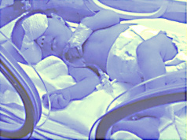
Morbidity of Late Preterm Infants in Massachusetts
Late preterm infants: 22.2% vs Term infants: 3%
  Sample: Term (377,638), Late Preterm (26,170)
Morbidity rates doubled for each gestational week earlier than 38 weeks
  40 wks: 2.5%
  39 wks: 2.6%
  38 wks: 3.3%
  37 wks: 5.9%
  36 wks: 12.1%
  35 wks: 25.6%
  34 wks: 51.9%
Shapiro-Mendoza CK et al. Effect of late-preterm birth and maternal medical conditions on newborn morbidity risk.
Pediatrics. 2008;121:e223–e232
Notes:
This study looking at infants delivered in Massachusetts, also shows that morbidity increases significantly before 39 weeks and nearly doubles for each gestational week below 39 weeks.

Slide 23

NICU Admissions By Weeks Gestation
Deliveries Without Complications, 2000-2003
NICU Admissions
Oshiro et al. Obstet Gynecol 2009;113:804-811.
Notes:
A study by Oshiro et al. looked at elective deliveries in a large integrated healthcare system in Utah and showed increasing risk for NICU admits for each week before 39 weeks.

Slide 24
RDS By Weeks Gestation
Deliveries Without Complications, 2000-2003
RDS
Oshiro et al. Obstet Gynecol 2009;113:804-811.
Notes:
There was also an increased risk for respiratory distress syndrome for each week before 39 weeks.

Slide 25
Ventilator Usage By Weeks Gestation
Deliveries Without Complications, 2000-2003
Ventilator Use
Oshiro et al. Obstet Gynecol 2009;113:804-811.
Notes:
And an increase in neonates on ventilators for each week before 39 weeks.

Slide 26
Timing of Elective Repeat Cesarean Delivery
at Term and Neonatal Outcomes
13,258 elective repeat cesarean births in 19 centers
35.8% done <39 weeks gestation
Increased risk of neonatal morbidity
  Respiratory, hypoglycemia, sepsis, NICU admissions,
  hospitalization ≥ 5 days
  Even among babies delivered at 38-39 weeks
Tita AT, et al. NEJM 2009;360:111
Notes:
The NICHD Maternal Fetal Medicine Units Network evaluated a large cohort of women with viable singleton pregnancies who underwent elective repeat cesarean sections. More than a third of deliveries were performed before 39 weeks of gestation. As compared with deliveries at or after 39 weeks, deliveries before 39 weeks of gestation − even those during the last 3 days before week 39 − were associated with an increased risk of a composite primary outcome that included neonatal death, respiratory complications, need for mechanical ventilation, treated hypoglycemia, newborn sepsis, and admission to the neonatal intensive care unit.

Slide 27
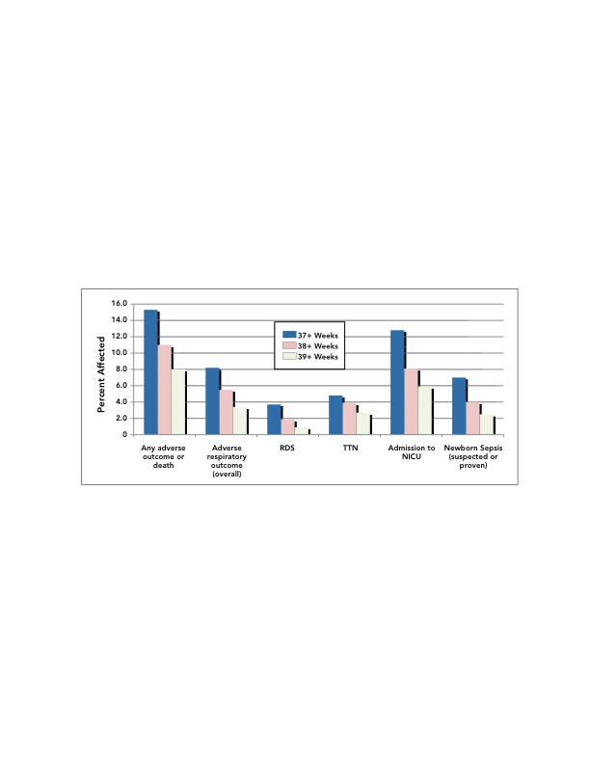
Adverse Neonatal Outcomes According to Completed Week of Gestation at Delivery: Absolute Risk
Adapted from Tita AT, et al. NEJM 2009;360:111
Notes:
The actual percent affected for adverse neonatal outcomes according to completed week of gestation at delivery is shown here. Again, it is clear that EARLY term cesarean births before 39 weeks increase neonatal morbidity.

Slide 28
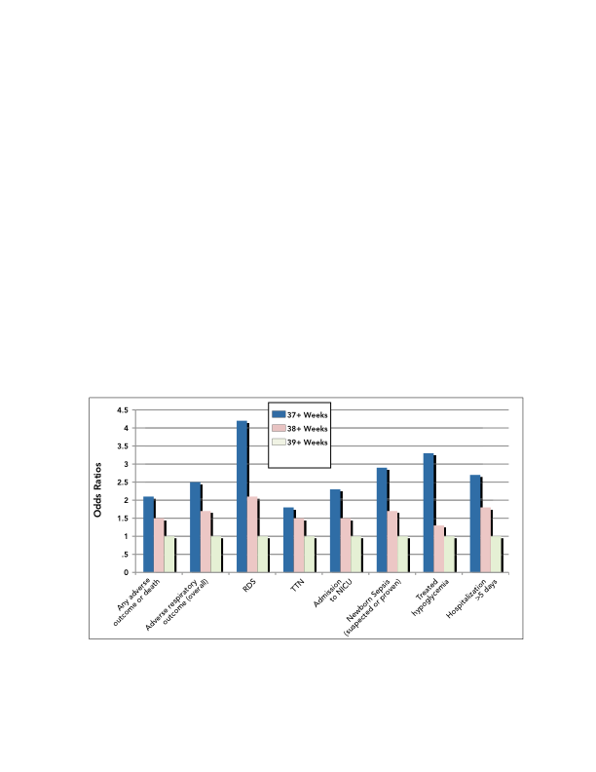
Adverse Neonatal Outcomes According to Completed Week of Gestation at Delivery: Odds Ratios
Adapted from Tita AT, et al. NEJM 2009;360:111
Notes:
The odds ratios for adverse neonatal outcomes according to completed week of gestation at delivery is shown here. The odds ratios vary from 2 to 4-fold higher for births under 38 weeks and 1.5 to 2.5-fold higher for births in the 38th week.

Slide 29
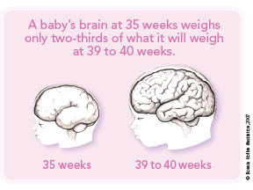
Timing of Fetal Brain Development
Cortex volume increases by 50% between 34 and 40 weeks gestation. (Adams Chapman, 2008)
Brain volume increases at rate of 15 mL/week between 29 and 41 weeks gestation.
A 5-fold increase in myelinated
white matter occurs between
35-41 wks gestation.
Frontal lobes are the last to
develop, therefore the most
vulnerable.
(Huttenloher, 1984; Yakavlev,
Lecours, 1967; Schade, 1961; Volpe, 2001).
Notes:
Read the bullets.

Slide 30
Examples of Successful Programs to Reduce Non-medically Indicated (Elective) Deliveries Before 39 Weeks of Gestation
Magee-Womens Hospital (Pittsburgh)
Intermountain Healthcare (Utah)
Ohio State Department of Health
Notes:
The next few slides will present examples of successful programs that have reduced elective early term deliveries.

Slide 31
Magee-Womens Hospital’s Experience
Magee-Womens Hospital is the largest maternity hospital in western Pennsylvania, performing more than 9,300 deliveries in 2007.
A rise in the use of induction, reaching a high of 28%
in 2003.
In 2006, a process improvement initiative changed
the induction scheduling process and strictly enforced the guidelines.
Fisch et al. Obstet Gynecol 2009;113:797
Notes:
Read the slide.

Slide 32
Magee Womens Hospital Experience with Guidelines
 | Baseline 3mos 2004 | Voluntary 3mos 2005 | Enforced 14mos 2006-7
Deliveries | 2,139 | 2,260 | 10,895
Elective Inductions <39wks (N) Elective Inductions <39wks (rate) | 23 11.8% | 21 10.0% | 30 4.3% (p<0.001)
Elective Nullip Inductions (N) Elective Nullip Inductions =>C/S (N) Elective Nullip Inductions =>C/S (rate) | 29 10 35.7% | 33 5 15.2% | 87 12 13.8% (p<0.01)
Total Induction Rate | 24.9% | 20.1% | 16.6%
Fisch et al. Obstet Gynecol 2009;113:797
Notes:
There were three stages to the program. The first was to establish a baseline. The second was measuring the change in elective deliveries with an educational program, and the third after an enforcement policy was put into place. As you can see, there was no significant reduction in the elective delivery rates until the guidelines were strictly enforced.

Slide 33
Magee Womens Hospital Experience
The importance of strong physician and nursing leadership cannot be overstated. The change in the induction scheduling process that began to enforce
the guidelines strictly in late 2006 was spearheaded by the OB Process Improvement Committee, whose members included the hospital’s Vice President for Medical Affairs, the Medical Director of the Birth Center, and the nursing leadership for the Birth Center.
Fisch et al. Obstet Gynecol 2009;113:797
Notes:
The program can succeed only with commitment from the staff and strong medical and nursing leadership.

Slide 34
Intermountain Healthcare’s Experience
Intermountain Healthcare is a vertically integrated healthcare system that operates 21 hospitals in Utah and southeast Idaho and delivers approximately 30,000 babies annually.
Computerized L&D system.
MFMs hired by system, but OBs are independent.
January 2001: 9 urban facilities participated in a process improvement program for elective deliveries.
28% of elective deliveries were occurring before 39 completed weeks of gestation.
Oshiro, B. et al. Obstet Gynecol 2009;113:804-811.
Notes:
Intermountain Healthcare, a large integrated healthcare system headquartered in Salt Lake City, Utah found that approximately 28% of their elective deliveries were being performed under 39 weeks of age. Intermountain Healthcare is an open system with community obstetricians and midwives performing deliveries at their hospitals, but the MFMs were employed by the hospitals. As in Pittsburgh, the program was successful, but it did take strong medical leadership to curtail the elective delivery rate below 39 weeks.

Slide 35
% Non-medically Indicated Deliveries
<39 Weeks, January 1999 – December 2005
Oshiro, B. et al. Obstet Gynecol 2009;113:804-811.
Notes:
The rate dropped from 28% to under 3% and has been sustained at that level until today.

Slide 36
Common Themes Noted in
Intermountain Healthcare’s Experience
Education provided to obstetricians regarding ACOG guidelines, best practice.
Little change until physicians were held accountable, nurses were empowered, and guidelines were enforced.
Medical leadership important.
Notes:
Although it is necessary to educate everyone on what the risks and benefits are and to inform the medical staff as to what the actual rates of elective deliveries are on a real time basis, it appears that enforcement and strong medical leadership are key to a successful program.

Slide 37
Ohio Perinatal Quality Collaborative
Reduce inappropriate scheduled deliveries at
36^{0/7} to 38^{6/7} weeks
20 maternity hospitals
18,384 births in this gestational window in the 14-month study period
Of these, 4,780 were scheduled deliveries (26% of the 36^{0/7} to 38^{6/7} week population)
www.OPQC.net
OPQC Project
Am J Obstet Gynecol 2010; 202:243.e1-243.e8
Notes:
The final example is from the state of Ohio. The Ohio Department of Health partnered with local hospitals and medical staff and, supported through grants from Medicaid, implemented a state-wide voluntary initiative to curb elective scheduled deliveries before 39 weeks.

Slide 38
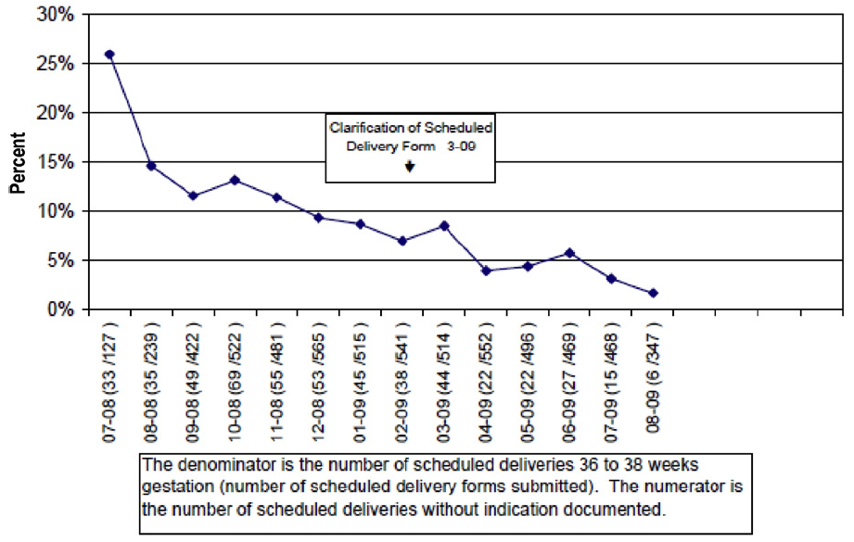
Results (1): Fewer Births at 36^{0/7}-38^{6/7} Weeks Without Documented Medical or Obstetrical Indications
OPQC Project
Am J Obstet Gynecol 2010; 202:243.e1-243.e8
Notes:
This program first demonstrated success in reducing the number of deliveries under 39 weeks without medical or obstetrical indications documented in the mother’s chart. So Step 1 was improved documentation.

Slide 39
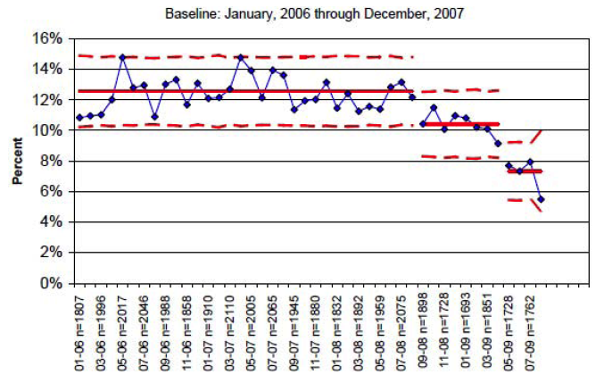

Results (2): Fewer Births at 36^{0/7}-38^{6/7} Weeks Induced Without Medical or Obstetric Indication
(arrow indicates OPQC startup)
OPQC Project
Am J Obstet Gynecol 2010; 202:243.e1-243.e8
Notes:
Step 2 was to show fewer INDUCTIONS without medical or obstetric indications. But was this just due to improved documentation?

Slide 40
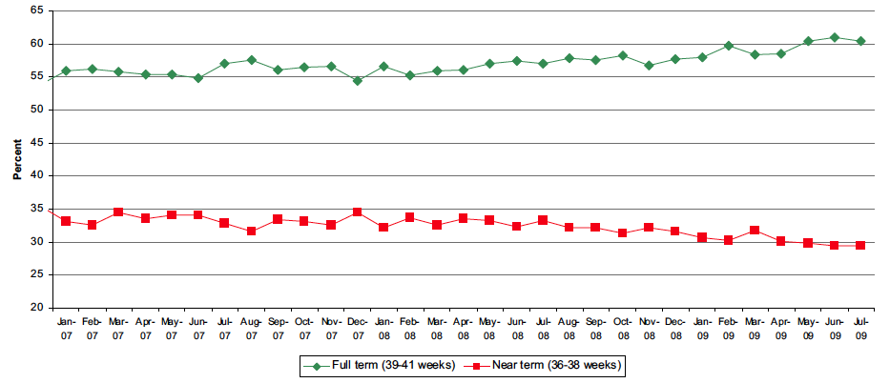
Results (3): Fewer Total Births at 36-38 Weeks
(and More Births at 39-41 Weeks)
(arrow indicates OPQC startup)
2% decrease in births 36-38 weeks and
2% increase in births 39-41 weeks; Approximately 1,000 births moved to >39^{0/7}
OPQC Project
Am J Obstet Gynecol 2010; 202:243.e1-243.e8
Notes:
This slide shows that the reduction in elective deliveries under 39 weeks was not due to a switch in diagnosis from elective to an indicated reason, as the numbers of births at later ages increased, while the early term births declined.

Slide 41
Alleviating Obstetricians’ Fears About
Delaying Delivery
Obstetricians in several of these studies voiced concerns regarding a potential increase in perinatal mortality and maternal morbidity.
Notes:
Some obstetricians felt that the risks of continued pregnancy outweighed the risks of delivering before 39 weeks.

Slide 42
Stillbirths Before and After Implementation of Guidelines at Intermountain Healthcare
1999-2000 |  |  |  | July 2001 to June 2006
Weeks of Gestation | Stillbirths | Deliveries | % | Stillbirths | Deliveries | % | Odds Ratio | 95% CI
37 | 17 | 4,117 | 0.41 | 22 | 13,077 | 0.17 | 0.406 | 0.22-0.77
38 | 19 | 9,954 | 0.19 | 21 | 28,209 | 0.07 | 0.390 | 0.21-0.72
39 | 10 | 13,752 | 0.07 | 28 | 51,721 | 0.05 | 0.744 | 0.36-1.53
40 | 10 | 7,925 | 0.13 | 14 | 24,140 | 0.06 | 0.459 | 0.20-1.03
41 | 2 | 1,938 | 0.10 | 3 | 5,571 | 0.05 | 0.522 | 0.09-3.12
All | 58 | 37,686 | 0.15 | 88 | 122,718 | 0.07 | 0.466 | 0.33-0.65
Oshiro, B. et al. Obstet Gynecol 2009;113:804-811.
Notes:
But the data showed that the risk of stillbirth did not increase after the program was implemented.

Slide 43
Wouldn’t Keeping Women Pregnant for Longer Increase Their Risk of Adverse Outcomes?
The experience in Ohio and Utah has shown that morbidity remained the same for macrosomia, preeclampsia, and maternal infections.
Decreases were seen in stillbirth, low apgar scores, cesarean section for fetal distress, meconium aspiration and postpartum anemia.
Notes:
Read the slide.

Slide 44
Summary: Reasons to Eliminate Non-medically Indicated (Elective) Deliveries Before 39 Weeks
Reduction of neonatal complications
No harm to mother if no medical or obstetrical indication for delivery
Now a national quality measure:
  National Quality Forum (NQF)
  Leapfrog Group
  The Joint Commission (TJC)
Notes:
Therefore, there are strong reasons to stop elective deliveries before 39 weeks. There is a definite benefit in reducing neonatal complications without compromising the health of the mother. Finally, this has become one of the national benchmarks for perinatal safety and quality.

Slide 45
Eliminating Non-medically Indicated (Elective) Delivery Prior to 39 Weeks in Our Hospital:
What are the steps to
make this happen?
Notes:
So how can we get started at our hospital?

Slide 46
First Steps (Fundamentals)
Implement list of “approved” indications
  Have departmental criteria for making certain diagnoses
  (e.g., hypertensive complications of pregnancy)
  Identify strong medical leadership and empower nurses to handle “appeals” for exceptions
Implement criteria for establishing gestational age
>39 weeks
Gather baseline data
Notes:
First, we must agree on what constitutes a medical indication for delivery. Using the ACOG or Joint Commission criteria is a good start. Then we must make sure that we consistently determine gestational age. Finally, we must be able to collect and measure the data.

Slide 47
ACOG: “Examples of maternal or fetal conditions that may be indications for induction of labor” | The Joint Commission: National Quality Core Measure PC-01—Specifications for “Conditions justifying delivery <39 weeks”
 | • Placental abruption, placenta previa, unspecified antenatal hemorrhage
• Fetal demise | • Fetal demise, fetal demise in prior pregnancy
• Post-term pregnancy | • Post-term pregnancy
• Premature rupture of membranes | • Rupture of membranes prior to labor (term or preterm)
• Gestational hypertension, preeclampsia, eclampsia, chronic hypertension | • Gestational hypertension, preeclampsia, eclampsia, chronic hypertension
• Maternal medical conditions, e.g., diabetes, renal disease, chronic pulmonary disease, antiphospholipid syndrome | • Preexisting diabetes, gestational diabetes • Renal disease • Maternal coagulation defects in pregnancy (including anti-phospholipid syndrome) • Liver diseases (including cholestasis of pregnancy) • Cardiovascular diseases (congenital and other) • HIV infection
• Fetal compromise, e.g., severe Intrauterine Growth Restriction (IUGR), isoimmunization, oligohydramnios | • IUGR, oligohydramnios, polyhydramnios, fetal distress, abnormal fetal heart rate • Isoimmunization (Rh and other), fetal-maternal hemorrhage • Fetal malformation, chromosomal abnormality, or suspected fetal injury
ACOG Practice Bulletin: Induction of Labor. Number 107, August 2009.
TJC Specifications Manual for Joint Commission National Quality Core Measures (20101a);
Perinatal Care Core Measure Set. 2009.
These are NOT exhaustive lists!
Notes:
Review list with the audience. Emphasize that this is not an exhaustive list. The Joint Commission list is developed for ease of reporting utilizing ICD-9 codes. If there is not ICD-9 code for an indication, they did not list it. For example, the Joint Commission does not mention previous classical cesarean delivery nor prior myomectomy as an indication for earlier delivery.

Slide 48
Confirmation of Term Gestation
Ultrasound measurement at less than 20 weeks
of gestation supports gestational age of 39 weeks
or greater.
Fetal heart tones have been documented as present for 30 weeks by Doppler ultrasonography.
It has been 36 weeks since a positive serum or urine human chorionic gonadotropin pregnancy test result.
ACOG Practice Bulletin: Induction of Labor. Number 107, August 2009
Notes:
Review with audience.

Slide 49
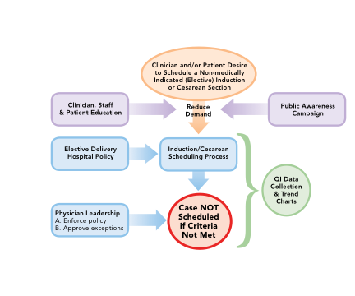
Notes:
This schematic gives an overview of the process for implementing a successful program to reduce or eliminate elective deliveries taking place before 39 weeks gestation. The patient and clinician are critical in reducing elective deliveries. This process must begin with educating not only the clinician, but also the patient as to why it is unsafe to deliver before 39 weeks unless there is a medical or obstetrical reason to do so. The hospital staff is also a key player in this process. In addition, a policy must be created and the medical leadership must be on board. The process will be a lot smoother and cause less angst amongst the hospital staff if they are not placed in a position of having to tell the physician they cannot schedule a delivery. In the event that there is a dispute, the staff must be empowered to refer the scheduling physician to medical leadership for resolution. Finally, in order to track progress, data must be collected and charts reviewed periodically to confirm progress.

Slide 50
Fetal Lung Maturity Testing Before 39 Weeks and Neonatal Outcomes
Adverse neonatal outcome | <39 weeks+FLM % (n=442) | 39-40 weeks %(n=12881) | Unadjusted RR (95% CI) | Adjusted RR (95% CI)
Composite adverse outcome | 5.9 | 2.5 | 2.4 (1.6, 3.5) | 1.6 (1.02, 2.6)
Composite adverse outcome ll* | 5.0 | 2.0 | 2.5 (1.6, 3.8) | 1.7 (1.01, 2.7)
Suspected or proven sepsis | 5.7 | 2.2 | 2.6 (1.7, 3.8) | 1.7 (1.1, 2.8)
Respiratory support | 2.9 | 1.0 | 2.8 (1.6, 5.0) | 1.8 (0.96, 3.5)
RDS | 1.4 | 0.04 | 35.0 (11, 114) | 7.9 (2.0, 31
Hypoglycemia | 2.0 | 0.14 | 15.0 (7.0, 32) | 6.7(2.5, 17.6)
NICU Admission | 5.9 | 2.3 | 2.5 (1.7, 3.7) | 1.7 (1.05, 2.7)
Hospitalization >4 days | 10.8 | 3.3 | 3.3 (2.4, 4.4) | 2.6 (1.8, 3.9)
*Excludes suspected sepsis; Adjusted for maternal age, race, parity, medical complications (hypertensive disorder or diabetes) and baby gender.
Gestational age and Fetal Lung Maturity (FLM)
tests are related but independent predictors
of fetal maturity.
Bates E, Rouse D, Chapman V, Mann ML, Carlo W, Tita A. Am J Obstet Gynecol 201:(6) S17, 2009
Notes:
This is an additional slide for the Q&A period of the talk. This shows that despite having a mature lung profile, neonates still are at higher risk for having complications if delivered before 39 weeks.

Slide 51
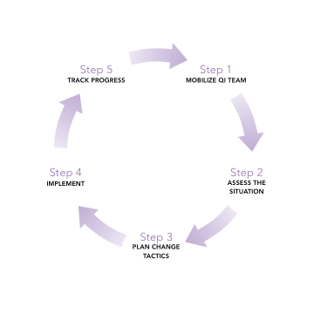
What Do We Need to Get Started?
MAP-IT
Mobilize
Assess
Plan
Implement
Track
Guidry, M., Vischi, T., Han, R., & Passons, O. Healthy people in healthy communities: A community planning guide using healthy people 2010. Washington, D.C.: U.S. Department of Health and Human Services. The Office of Disease Prevention and Health Promotion.
Notes:
This MAP-IT chart is a method for how to implement change. The first step is to organize a QI team to outline the process and to oversee the project. The second step involves this group assessing the scope of the problems and the barriers to change. The third step involves strategizing on how to overcome barriers to change and to plan an implementation process. The fourth step is to implement the plan of action. The fifth step is to track progress and then to make adjustments in the plan as necessary.

Slide 52
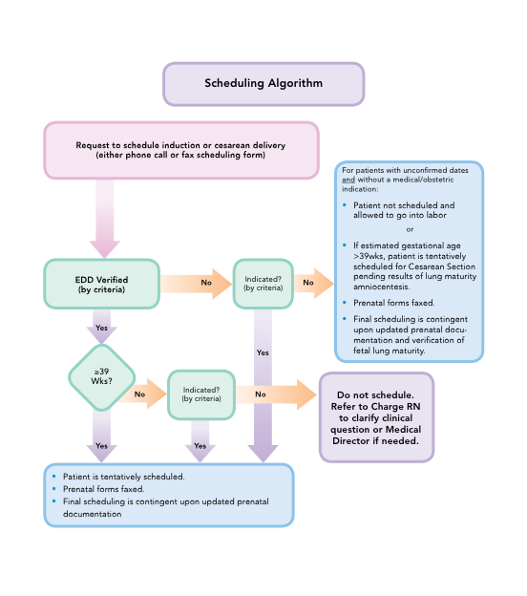
Notes:
A sample scheduling algorithm is shown here. And the next few slides will walk us through this process.

Slide 53
Overview of Changes to the Scheduling Process
Patient is not scheduled and is allowed to go into labor spontaneously:
    Accurate gestational dating.
    Appropriate indication for induction or cesarean section for gestational age.
  Patients can be scheduled either by calling the scheduler
  or faxing in the request.
  Elective deliveries including repeat scheduled cesarean
  sections must be at least 39 weeks gestation based
  upon ACOG criteria.
Notes:
Read the slide.

Slide 54
Scheduling Process (continued)
Any scheduling conflicts will be directed to the OB Chair
or Director of L&D for resolution.
Ongoing problems that are identified will either be
taken care of as soon as possible or discussed at future
department meetings.
Data will be reported back on a regular basis to inform
everyone how the project is going.
Notes:
Data Collection

Slide 55
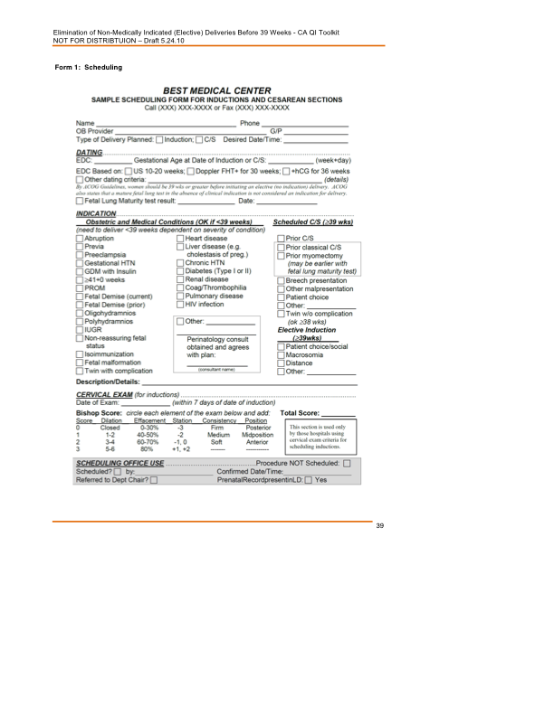
Sample
Scheduling Form
Notes:
Shown here is a sample scheduling form, which can be faxed in. Alternatively, the office can call the scheduler who can take down the pertinent information.

Slide 56
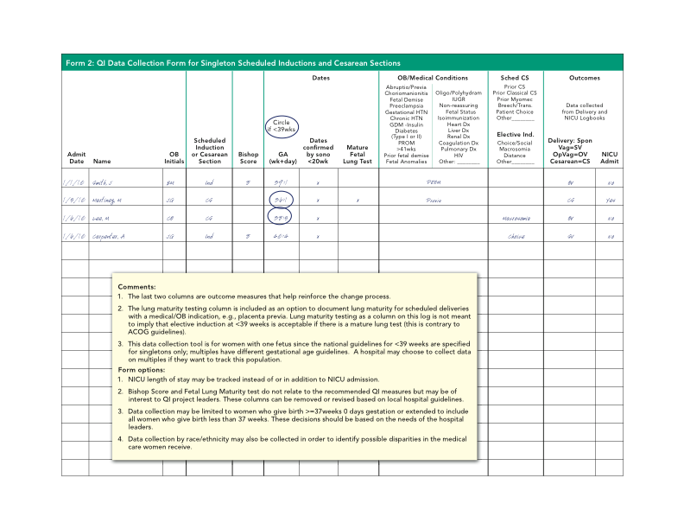
Sample
Notes:
Data collection should mirror the work flow. This is a sample data collection form designed to match the scheduling form so that data can be collected from that form (in the work flow where the scheduling data is verified on admission), with the sample outcomes collected at delivery. The data from this form can be used to track the progress of the program.

Slide 57
What Providers Can Do
Educate your patients and staff about the risks and benefits of delivery before or after 39 weeks.
Perform an ultrasound before 20 weeks to confirm gestational age on all your patients.
Educate your staff on the new scheduling process.
Take a lead on promoting best practice.
Notes:
Read the slide.

Slide 58
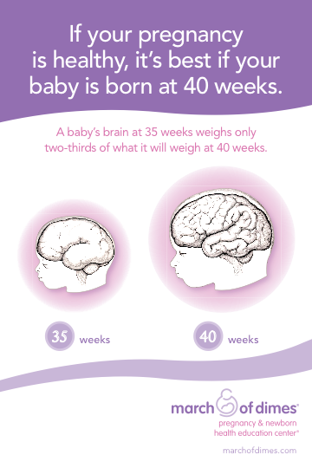
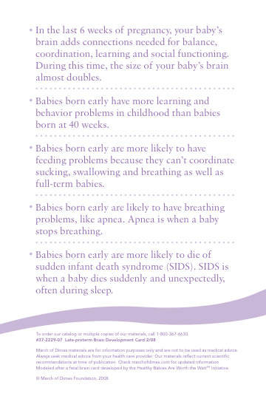
A Tool to Educate Patients
© 2007 Bonnie Hofkin Illustration
marchofdimes.com
Notes:
Here is an example of a patient education tool (provided courtesy of the March of Dimes) that can be used to educate patients in the office or at prenatal classes. Featured on the slide is a copy of the brain card that providers can use to assist them in educating their patients about why the last weeks of pregnancy count.

Slide 59
For More Information, Contact:
Barbara Murphy
barbar@stanford.edu
Leslie Kowalewski
LKowalewski@marchofdimes.com
Notes:
The March of Dimes and California Maternal Quality Care Collaborative Toolkit is a great place to start for further information.

Slide 60
Elimination of Non-medically Indicated (Elective) Deliveries Before 39 Weeks Gestational Age
An Implementation Strategy
Funding for the development of this toolkit was provided by:
Federal Title V block grant funding from the California Department of Public Health; Maternal, Child and Adolescent Health Division was used by the California Maternal Quality Care Collaborative to develop the toolkit; and March of Dimes.
Notes:
Slide Set #2
The following is an implementation overview slide set designed for the program implementation (QI) team. It can be adapted to help support and outline the key change strategies within an institution that need to be addressed to eliminate elective deliveries <39 weeks.

Slide 61
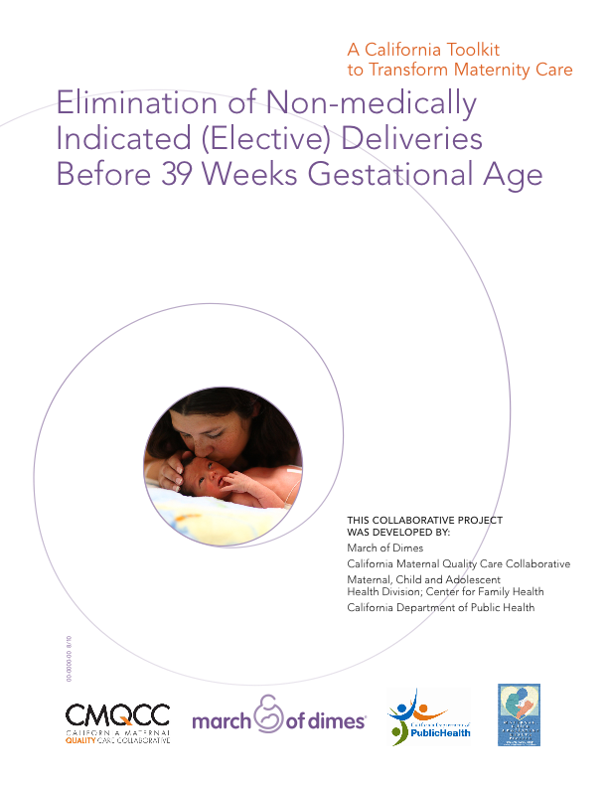
Elimination of Non-medically Indicated (Elective) Deliveries Prior to 39 Weeks

Slide 62
Overview: Critical Elements for Successful Implementation
Notes:
This schematic gives an overview of the process for implementing a successful program to reduce or eliminate elective deliveries taking place before 39 weeks gestation. The patient and clinician are critical in reducing elective deliveries. This process must begin with educating not only the clinician, but also the patient as to why it is unsafe to deliver before 39 weeks unless there is a medical or obstetrical reason to do so. The hospital staff is also a key player in this process. In addition, a policy must be created and the medical leadership must be on board. The process will be a lot smoother and cause less angst amongst the hospital staff if they are not placed in a position of having to tell the physician they cannot schedule a delivery. In the event that there is a dispute, the staff must be empowered to refer the scheduling physician to medical leadership for resolution. Finally, in order to track progress, data must be collected and charts reviewed periodically to confirm progress.

Slide 63
What Do We Need to Get Started?
MAP-IT
Mobilize
Assess
Plan
Implement
Track
Guidry, M., Vischi, T., Han, R., & Passons, O. Healthy people in healthy communities: A community planning guide using healthy people 2010. Washington, D.C.: U.S. Department of Health and Human Services. The Office of Disease Prevention and Health Promotion.
Notes:
This MAP-IT chart is a method for how to implement change. The first step is to organize a QI team to implement to outline the process and to oversee the project. The second step involves this group assessing the scope of the problems and the barriers to change. The third step involves strategizing on how to overcome barriers to change and to plan an implementation process. The fourth step is to implement the plan of action. The fifth step is to track progress and then to make adjustments in the plan as necessary.

Slide 64
Mobilize the QI Team:
Recruit champions
  Who will organize the meetings?
  Who needs to be on the team and at the meetings?
    Nurse leaders: e.g., L&D Manager, CNS, Perinatal QI RN
    Physician leaders: e.g., OB Chair, MFM, Neonatologist, nurse midwife
    Data analyst and Risk Management
What are the goals and aims of the project?
When is the first meeting?
Notes:
A key step is to develop a team to oversee this project. A QI nurse in conjunction with a physician leader (typically the Chair of Obstetrics and the labor and delivery manager) are the key members who should form the core of this team. The QI nurse or manager of L&D are typically aware of the current practice and who the key individuals are. This will be important as you complete your QI team.

Slide 65
Assess the Situation
What is your induction and cesarean section rate? (Baseline assessment)
  Elective vs indicated
  Before 39 weeks and between 37^{0/7} and 38^{6/7} weeks
  What are your NICU admission rates and trends?
Assess your scheduling process
  Who schedules?
  Do you know the Estimated Gestational Age and indication at the time of scheduling?
Who are the champions, adopters, and resisters?
What is the process for refereeing a case?
What are the barriers to change?
Notes:
The actual numbers of cases may not be available or known without further investigation. The data search should typically be performed and the data available before the first meeting with a larger group. If the data are not available, then serious thought should be placed into how to obtain this information, as it will be critical in measuring the success of this program.
What is the current scheduling process? Is the gestational age and indication for delivery recorded at the time the delivery is scheduled? What happens when there is a scheduling conflict? Who are the potential champions, early adopters, or resisters? What are the hurdles that need to be overcome?

Slide 66
ACOG: “Examples of maternal or fetal conditions that may be indications for induction of labor” | The Joint Commission: National Quality Core Measure PC-01—Specifications for “Conditions justifying delivery <39 weeks”
 | • Placental abruption, placenta previa, unspecified antenatal hemorrhage
• Fetal demise | • Fetal demise, fetal demise in prior pregnancy
• Post-term pregnancy | • Post-term pregnancy
• Premature rupture of membranes | • Rupture of membranes prior to labor (term or preterm)
• Gestational hypertension, preeclampsia, eclampsia, chronic hypertension | • Gestational hypertension, preeclampsia, eclampsia, chronic hypertension
• Maternal medical conditions, e.g., diabetes, renal disease, chronic pulmonary disease, antiphospholipid syndrome | • Preexisting diabetes, gestational diabetes • Renal disease • Maternal coagulation defects in pregnancy (including anti-phospholipid syndrome) • Liver diseases (including cholestasis of pregnancy) • Cardiovascular diseases (congenital and other) • HIV infection
• Fetal compromise, e.g., severe Intrauterine Growth Restriction (IUGR), isoimmunization, oligohydramnios | • IUGR, oligohydramnios, polyhydramnios, fetal distress, abnormal fetal heart rate • Isoimmunization (Rh and other), fetal-maternal hemorrhage • Fetal malformation, chromosomal abnormality, or suspected fetal injury
ACOG Practice Bulletin: Induction of Labor. Number 107, August 2009.
TJC Specifications Manual for Joint Commission National Quality Core Measures (20101a);
Perinatal Care Core Measure Set. 2009.
These are NOT exhaustive lists!
Notes:
These are important examples of criteria used by national organizations. It must be emphasized to the medical and nursing staff that these lists are not exhaustive. The Joint Commission list was generated with the ease of capturing the information in mind using ICD-9 codes. There are situations that a delivery prior to 39 weeks is justified − such as a prior classical cesarean section or prior myomectomy − which do not have specific ICD-9 codes.

Slide 67
Confirmation of Term Gestation
Ultrasound measurement at less than 20 weeks
of gestation supports gestational age of 39 weeks
or greater.
Fetal heart tones have been documented as present
for 30 weeks by Doppler ultrasonography.
It has been 36 weeks since a positive serum or urine human chorionic gonadotropin pregnancy test result.
ACOG Practice Bulletin: Induction of Labor. Number 107, August 2009
Notes:
This slide lists ACOG’s recommendations for confirming a term gestational age. In most situations, an early ultrasound is the best method for confirming or determining the gestational age or due date.

Slide 68
Plan Change Tactics
Develop revised scheduling processes and guidelines
  Establish an appeal process
  Appoint physician leader(s) to enforce scheduling process and approve exceptions
Describe the new guidelines
Revise forms and scheduling policy and procedure
Develop data collection plan and forms
Determine what clinician and patient education materials are needed
Determine implementation start date
Notes:
Read the slide.

Slide 69
Implement
Convene department and staff meetings to educate physicians and staff
  Baseline assessment
  Ongoing data collection plan
  Policy and procedure with Approved Indications
  New scheduling process and forms
Provide educational materials for physicians, staff,
and patients
Choose start date and begin data collection and reporting on a regular basis
Notes:
It is important to inform everyone of the project. Key information should include baseline data before the project starts. Also, physicians must be included early in the process and be able to provide input and have their questions and concerns answered.

Slide 70
Notes:
A sample scheduling algorithm is shown here. The next few slides will walk us through this process.

Slide 71
Overview of Changes to the Scheduling Process
All scheduled deliveries (inductions or cesarean sections) must have the following documented at the time of scheduling:
  Accurate gestational dating.
  Appropriate indication for induction or cesarean section for gestational age.
Patients can be scheduled either by calling the scheduler or faxing in the request.
Notes:
The patient’s gestational age and the reason that the delivery is being scheduled are the two critical factors in the scheduling process.

Slide 72
Scheduling Process (continued)
Elective deliveries including repeat scheduled cesarean sections must be at least 39 weeks gestation based upon ACOG criteria.
Any scheduling conflicts will be directed to the OB Chair or Director of L&D for resolution.
Ongoing problems that are identified will either be taken care of as soon as possible or discussed at future department meetings.
Data will be reported back on a regular basis to inform everyone how the project is going.
Notes:
The scheduling form can be either faxed in or the scheduler can fill in the information when the office calls in to request a date and time for delivery. If there are any conflicts or concerns raised by the scheduler, these should be referred to the proper medical chain of command for resolution. For example, if a doctor asks that Mrs. Jones be scheduled at 38 weeks and 6 days for an elective cesarean delivery, the scheduler should answer, “I’m sorry Dr. Smith, I am not allowed to schedule Mrs. Jones as she is less than 39 weeks and it is against our 39 week policy. May I have Dr. Brown, the director of labor and delivery call you?” It is important not to have the scheduler or a nurse be placed in an adversarial position with the physician’s office.

Slide 73
Sample
Scheduling Form
Notes:
Shown here is a sample scheduling form, which can be faxed in. Alternatively, the office can call the scheduler who can take down the pertinent information.

Slide 74
Sample
Notes:
Data collection should mirror the work flow. This is a sample data collection form designed to match the scheduling form so that data can be collected from that form (in the work flow where the scheduling data is verified on admission), with the sample outcomes collected at delivery. The data from this form can be used to track the progress of the program.

Slide 75
A Tool to Educate Patients
© 2007 Bonnie Hofkin Illustration
marchofdimes.com
Notes:
As patients comprise perhaps half of the decision-making process, it is important to educate the patient. Patient education should ideally take place during prenatal care, before the discomfort of the last weeks of pregnancy and far enough ahead to influence her expectations.
Here is an example of a patient education tool (provided courtesy of the March of Dimes) that can be used to educate patients in the office or at prenatal classes. Featured on the slide is a copy of the brain card that providers can use to assist them in educating their patients about why the last weeks of pregnancy count.

Slide 76
Track Progress
Use data and audit tools to track the number of elective deliveries <39 weeks
Develop trend charts and report back to staff and providers on a regular basis
Address issues and concerns as soon as possible
Notes:
Of course, it is essential to track progress and give feedback to the staff and physicians on an ongoing basis and to address issues and concerns sooner rather than later.

Slide 77
For More Information, Contact:
Barbara Murphy
barbar@stanford.edu
Leslie Kowalewski
LKowalewski@marchofdimes.com
Notes:
The March of Dimes and California Maternal Quality Care Collaborative Toolkit is a great place to start for further information

